Slide 1
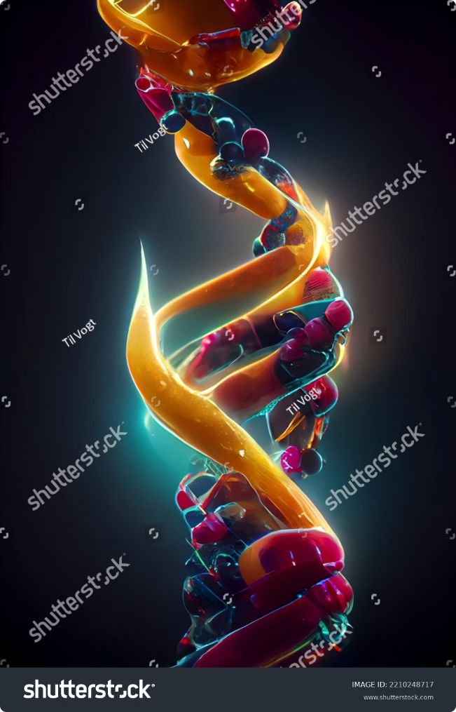
Genes Regulation:
Gene regulation is the intricate process that orchestrates the expression of genetic information within living organisms. This fundamental biological mechanism controls when and how genes are activated or silenced, ultimately determining the characteristics and functions of cells. Understanding gene regulation is crucial for unraveling the complexities of life, from embryonic development to disease progression and potential treatments.
By Mouderas F.

Slide 2
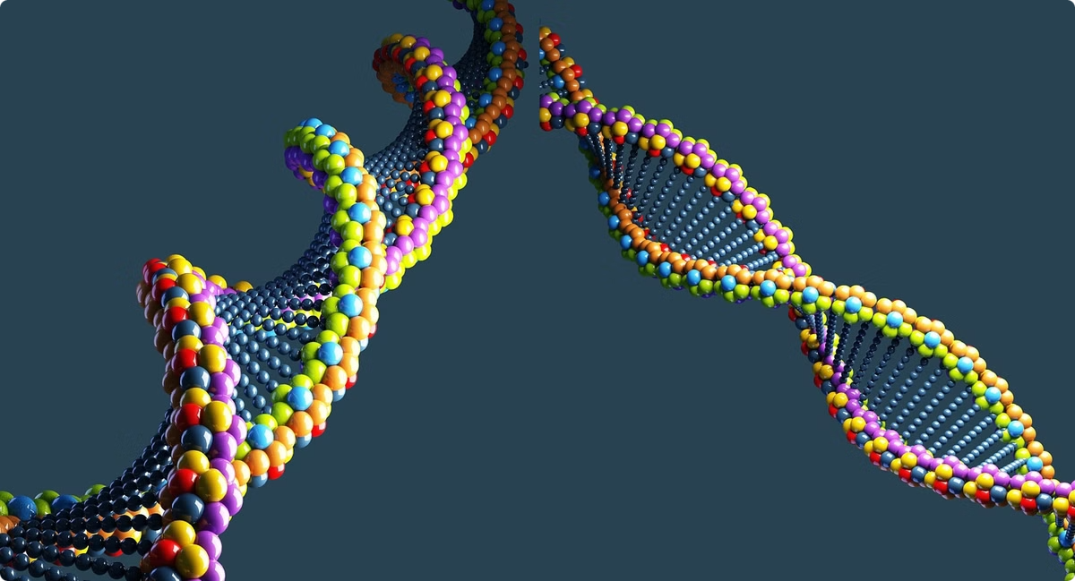
Defining Genes: The Building Blocks of Life
Genetic Units
Structural Components
Genes are distinct segments of DNA that encode instructions for producing specific proteins or functional RNA molecules. They serve as the fundamental units of heredity, passing traits from parents to offspring.
Genes consist of coding regions (exons) and non-coding regions (introns). Exons contain the information for protein synthesis, while introns are removed during RNA processing.
Regulatory Elements
Variability
Genes include regulatory sequences such as promoters and enhancers, which control when and where the gene is expressed. These elements play a crucial role in gene regulation.
Genes can exist in different forms called alleles, which contribute to genetic diversity within populations. This variability is essential for evolution and adaptation.

Slide 3
DNA Structure and Function:
Structure
Base Pairing
Function
DNA (Deoxyribonucleic Acid) is a double-stranded helix composed of nucleotides. Each nucleotide consists of a sugar (deoxyribose), a phosphate group, and one of four nitrogenous bases: adenine (A), thymine (T), guanine (G), or cytosine (C).
The two strands of DNA are held together by hydrogen bonds between complementary base pairs: A pairs with T, and G pairs with C. This specific base pairing is crucial for DNA replication and transcription.
DNA serves as the repository of genetic information, encoding the instructions for all cellular processes. It undergoes replication during cell division, ensuring the transmission of genetic material to daughter cells.

Slide 4
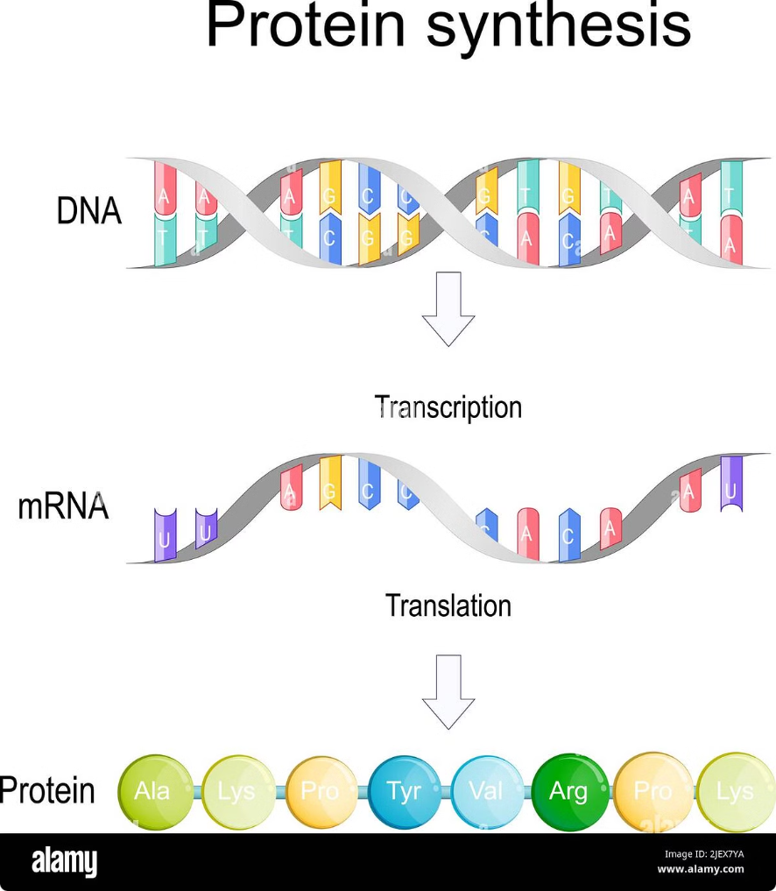
Transcription: From DNA to RNA
1
Initiation
Transcription begins when RNA polymerase binds to the promoter region of a gene. Transcription factors help position the polymerase and unwind the DNA double helix.
2
Elongation
RNA polymerase moves along the template DNA strand, synthesizing a complementary RNA molecule. The growing RNA chain is composed of ribonucleotides (A, U, G, C), with uracil (U) replacing thymine (T).
3
Termination
Transcription ends when RNA polymerase encounters a termination sequence. The newly synthesized RNA molecule, called pre-mRNA, is released and undergoes further processing.

Slide 5
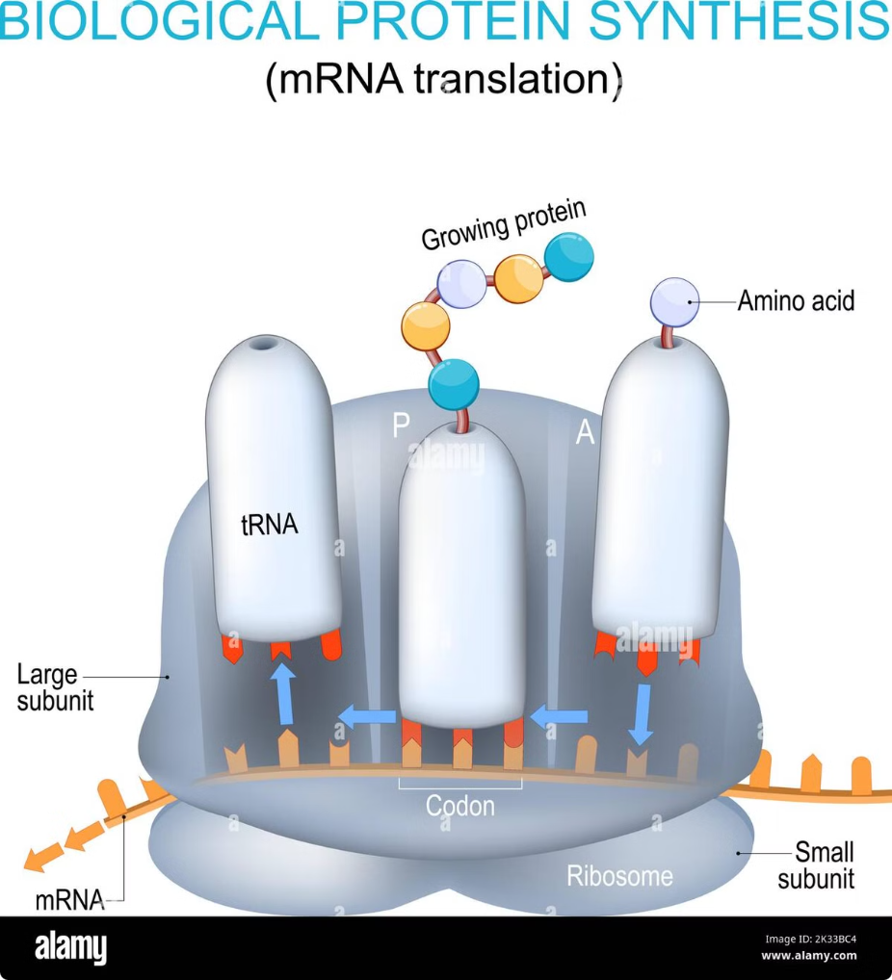
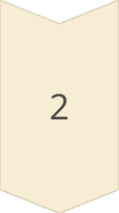
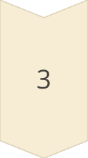
Translation: From RNA to Proteins
Initiation
Translation begins when a ribosome binds to the mRNA at the start codon (AUG). The initiator tRNA carrying methionine attaches to this codon, forming the initiation complex.
Elongation
The ribosome moves along the mRNA, reading each codon and matching it with the appropriate amino acid-carrying tRNA. Peptide bonds form between amino acids, gradually building the polypeptide chain.
Termination
Translation ends when the ribosome encounters a stop codon (UAA, UAG, or UGA). Release factors trigger the release of the completed polypeptide chain, which then folds into its functional protein structure.

Slide 6
Gene Expression Regulation:
1
Transcriptional Control
2
Post-Transcriptional Regulation
Gene expression is primarily regulated at the transcriptional level. This involves the interaction of transcription factors with regulatory DNA sequences, such as promoters and enhancers, to activate or repress gene transcription.
After transcription, various mechanisms control mRNA stability, processing, and translation efficiency. These include alternative splicing, RNA editing, and microRNA-mediated regulation.
3
Translational Control
4
Post-Translational Modifications
The rate of protein synthesis can be modulated by controlling the initiation, elongation, or termination of translation. This level of regulation allows for rapid responses to cellular needs.
Proteins can undergo various modifications after translation, such as phosphorylation, glycosylation, or ubiquitination. These modifications can alter protein function, stability, or localization, providing another layer of regulatory control.

Slide 7
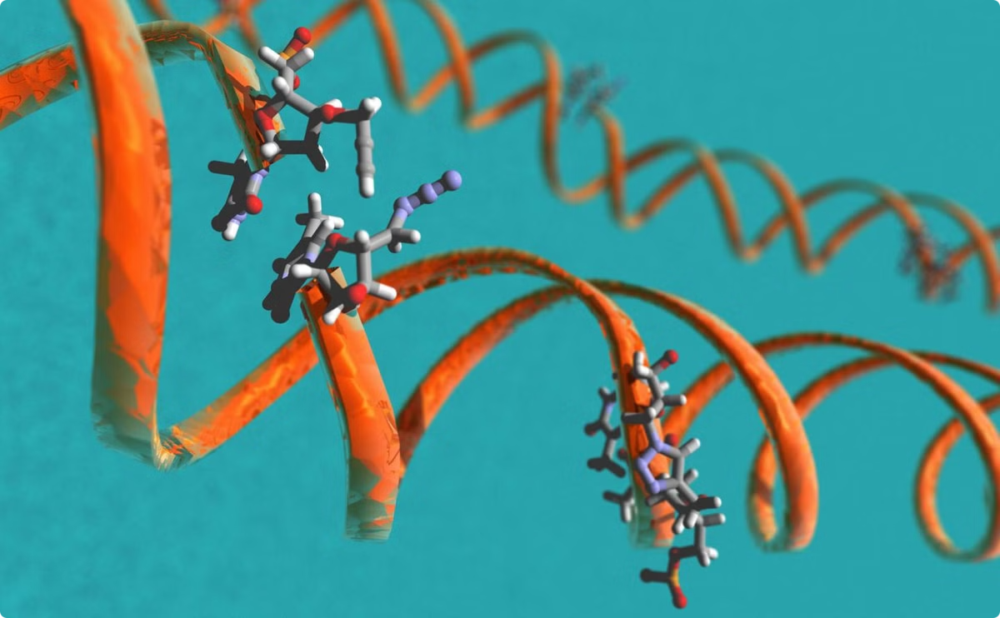
Epigenetic Modifications: Beyond the DNA Sequence
DNA Methylation
Histone Modifications
The addition of methyl groups to DNA, typically at CpG sites, can silence gene expression. This modification is crucial for genomic imprinting and X-chromosome inactivation.
Chemical modifications to histone proteins, such as acetylation, methylation, or phosphorylation, can alter chromatin structure and accessibility, influencing gene expression.
Non-coding RNAs
Chromatin Remodeling
Various types of non-coding RNAs, including microRNAs and long non-coding RNAs, play important roles in regulating gene expression through diverse mechanisms.
ATP-dependent chromatin remodeling complexes can alter nucleosome positioning and density, affecting DNA accessibility for transcription factors and other regulatory proteins.

Slide 8
Transcription Factors: Master Regulators of Gene Expression
Type
Function
Example
General Transcription Factors
Assist RNA polymerase in initiating transcription
TFIID, TFIIA, TFIIB
Activators
Enhance transcription by recruiting coactivators or modifying chromatin
NF-κB, AP-1
Repressors
Inhibit transcription by blocking activator binding or recruiting corepressors
REST, MECP2
Inducible Factors
Respond to specific cellular signals or environmental stimuli
HIF-1, p53

Slide 9
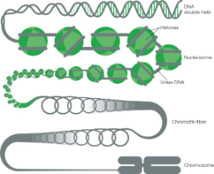
Chromatin Remodeling:
Nucleosome Repositioning
Higher-Order Structure Changes
ATP-dependent chromatin remodeling complexes slide or evict nucleosomes, altering DNA accessibility for transcription factors and other regulatory proteins.
Modifications to chromatin looping and 3D genome organization can bring distant regulatory elements into proximity, affecting gene expression patterns.
1
2
3
Histone Variant Exchange
Specialized histone variants can replace canonical histones, conferring unique properties to specific genomic regions and influencing gene expression.

Slide 10
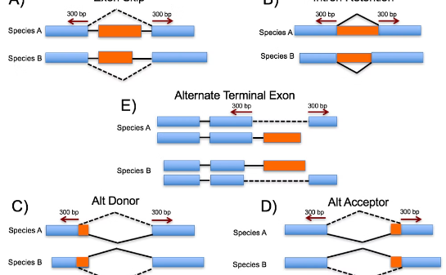
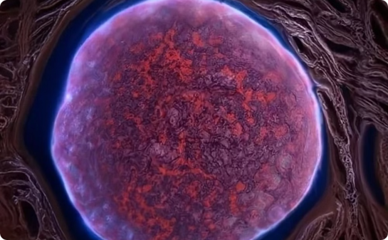
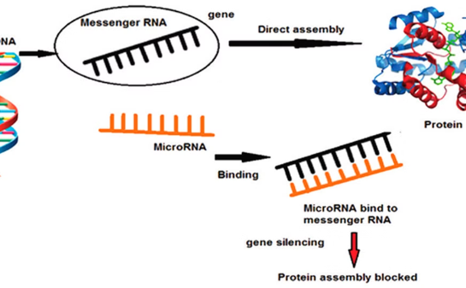
Post-Transcriptional Regulation: Fine-Tuning Gene Expression
Alternative Splicing
mRNA Stability
microRNA Regulation
This process allows a single gene to produce multiple mRNA variants by selectively including or excluding exons, greatly increasing protein diversity from a limited number of genes.
The half-life of mRNA molecules can be regulated through the action of ribonucleases and stabilizing factors, controlling the duration of gene expression.
Small non-coding RNAs can bind to complementary sequences in mRNA, typically leading to translation repression or mRNA degradation, providing an additional layer of gene expression control.

