Slide 1
Welding in Renewable Energies
L2 as 2023/2024

Slide 2
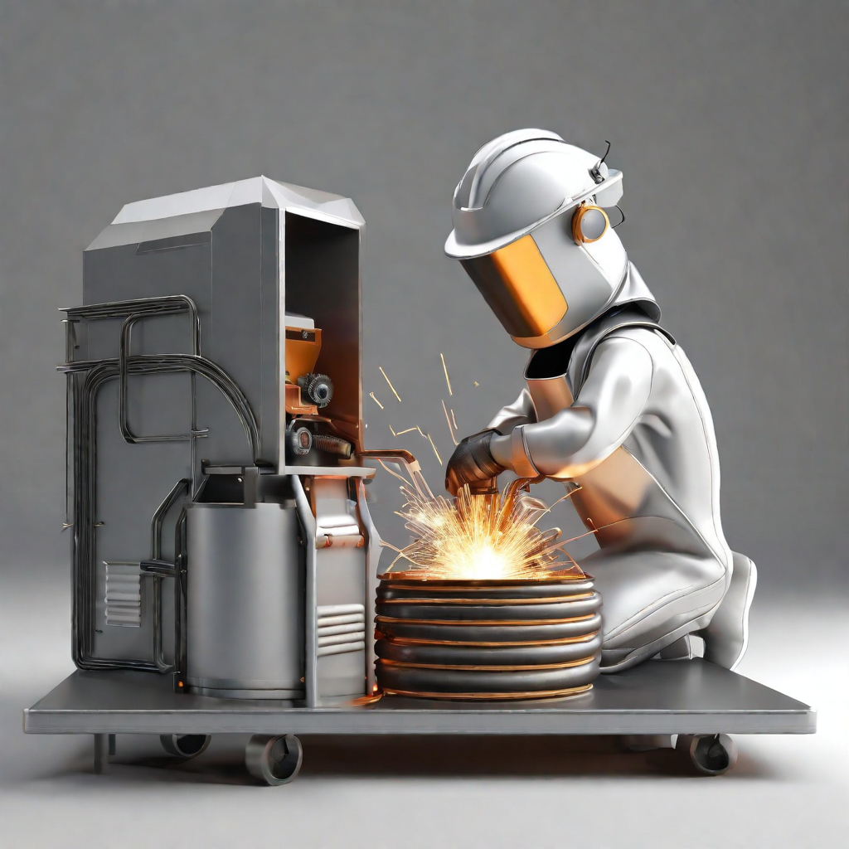
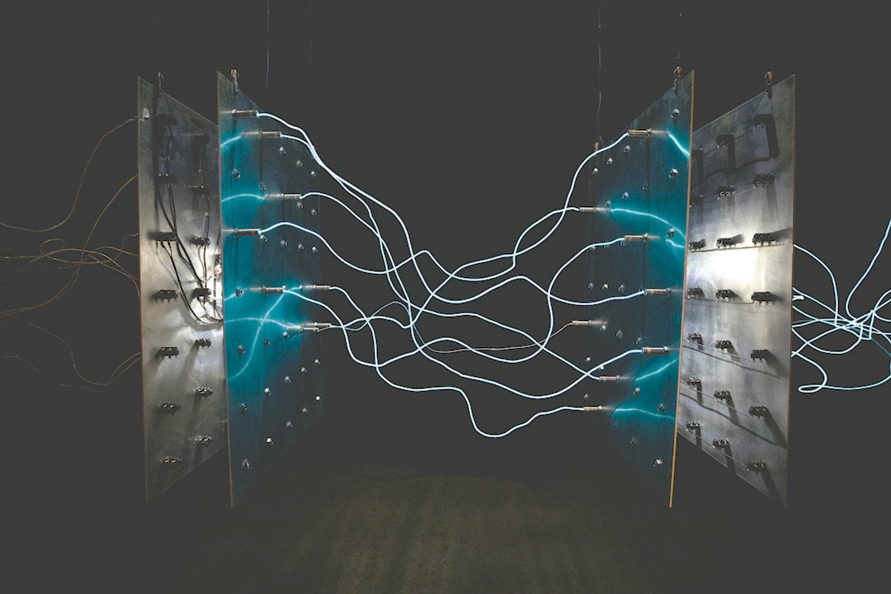
Introduction to Welding
Importance in the Renewable Energy Industry
Welding plays a crucial role in the renewable energy industry, enabling the construction and maintenance of various renewable energy systems.
What is Welding?
Welding is a fabrication process that joins materials, typically metals, by melting and fusing them together.

Slide 3
Welding Techniques for Solar Energy
Photovoltaic Panel Installation
Welding plays a crucial role in the installation of photovoltaic panels for solar energy systems.
There are several welding techniques commonly used in solar energy applications:
Tungsten Inert Gas (TIG) Welding
Metal Inert Gas (MIG) Welding
Resistance Spot Welding
Tungsten Inert Gas (TIG) Welding
TIG welding is commonly used in solar energy applications for its precision and clean welds.
Metal Inert Gas (MIG) Welding
MIG welding is known for its speed and versatility, making it suitable for large-scale solar panel installations.
Resistance Spot Welding
Resistance spot welding is often used in the assembly of solar energy components, such as connecting busbars.

Slide 4
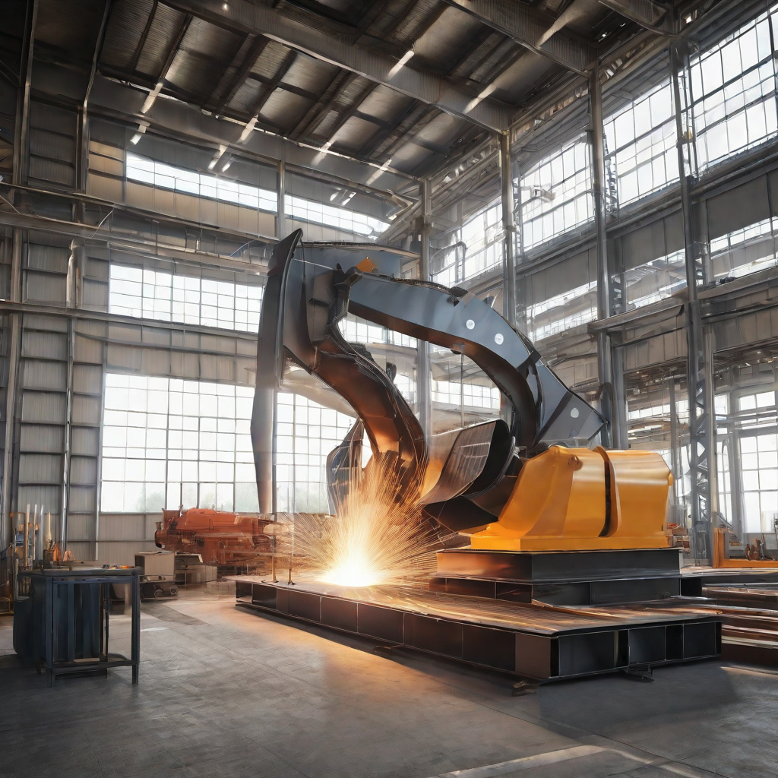
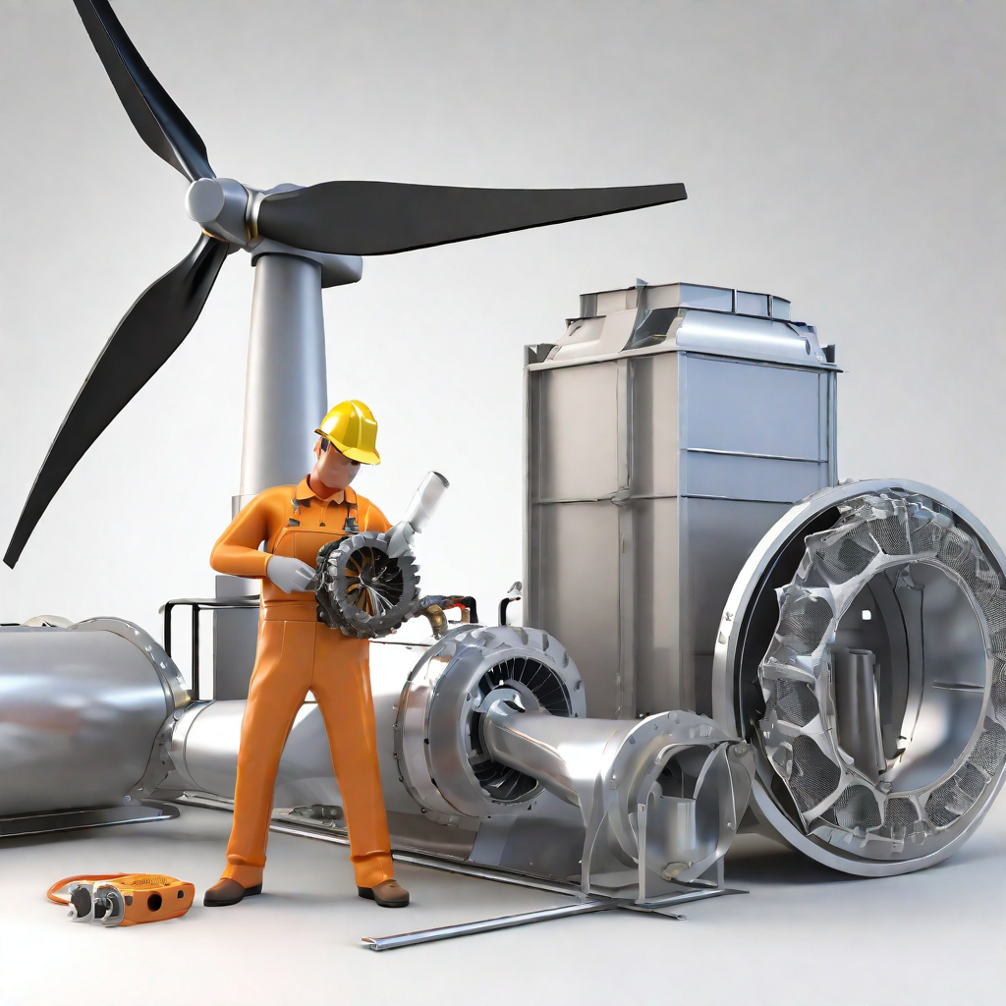
Welding Techniques for Wind Energy
Turbine Construction
Welding techniques play a crucial role in wind turbine construction, ensuring the structural integrity and longevity of the turbines.
Maintenance
Regular maintenance of wind turbines requires welding techniques to repair or replace components, ensuring optimal performance and safety.

Slide 5
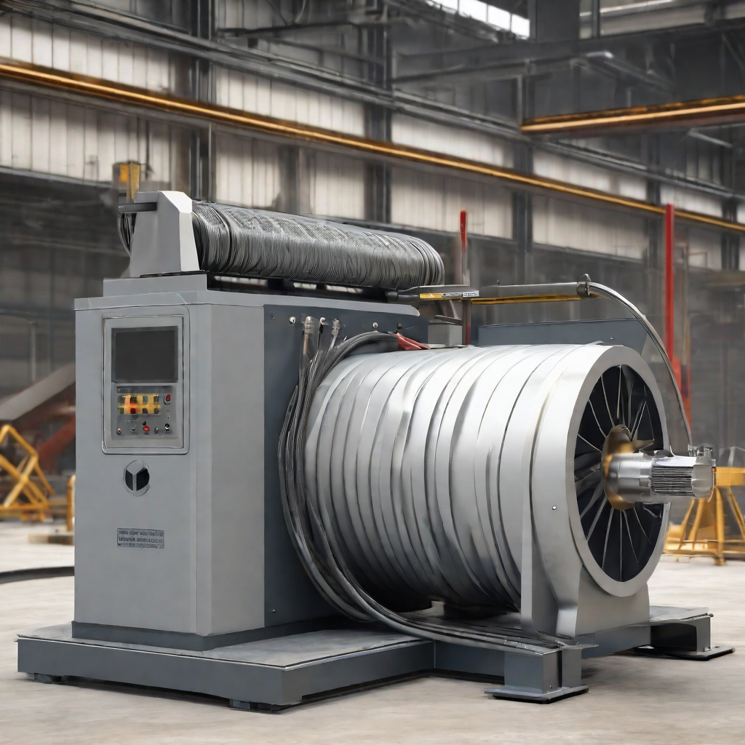
Welding Techniques for Hydroelectric Power
Welding in Dam Construction
Shielded Metal Arc Welding (SMAW) is commonly used for welding structural components in dam construction.
Gas Metal Arc Welding (GMAW) is used for welding non-structural components and piping systems.
Welding in Maintenance
Tungsten Inert Gas (TIG) welding is commonly used for repairs on hydroelectric turbines and other critical components.
Flux-Cored Arc Welding (FCAW) is used for welding stainless steel and other corrosion-resistant materials in hydroelectric power plants.

Slide 6
Challenges and Innovations in Welding for Renewable Energies
Material Compatibility
One of the main challenges in welding for renewable energies is ensuring material compatibility. Different renewable energy systems, such as solar panels and wind turbines, are made from a variety of materials, including metals, composites, and polymers. Welding these materials together requires careful consideration of their compatibility to ensure the strength and durability of the joints.
Joint Strength
Another challenge in welding for renewable energies is achieving strong and reliable joints. The joints in renewable energy systems are often subjected to harsh environmental conditions, such as high temperatures, strong winds, and corrosive environments. Innovations in welding techniques and materials are being developed to enhance joint strength and durability, ensuring the long-term performance of renewable energy systems.

Slide 7
Safety Considerations
💨 Proper Ventilation
Proper ventilation is crucial in welding for renewable energies to ensure the removal of harmful fumes and gases. Adequate ventilation systems should be in place to prevent the accumulation of hazardous substances in the work area.
⛑ Personal Protective Equipment (PPE)
The use of appropriate personal protective equipment (PPE) is essential to ensure the safety of welders in the renewable energy industry. This includes items such as welding helmets, safety glasses, gloves, and protective clothing to protect against sparks, UV radiation, and other potential hazards.

