Slide 1
جــــــــامـعـــــــــة ابوبكربلقايد–تلمسان AbouBekrBelkaid University of Tlemcen كـليــــــــــــة الـعـلــــــــــوم و الــتكنولـــــوجــــــــــيــا Faculity Of Sciences And Technology
Exposed
The Topic:
Welding Defects
Presented by: Wissame Ahmed Aicha
College Year: 2023/2024

Slide 2
Work Plan
Introduction To Welding Defects
Welding Defects and their Causes
Impact of Defects on Weld Quality and Welded Materials
Preventing Welding Defects
Examples of Welding Defects and How to Fix Them
Conclusion

Slide 3
Introduction
Welder defects are common issues that arise during the welding process. These defects can compromise the strength, durability, and overall quality of welded joints. It is essential for welders to have a comprehensive understanding of different types of welding defects, their causes, and the impact they can have on the final weld. By identifying and addressing these defects, welders can ensure the production of high-quality welds that meet industry standards and specifications.

Slide 4
Welding Defects And Their Causes
1
Surface contamination
Removing impurities and dirt from the surface before welding is essential to ensure optimal contact between the components.
2
Improper parameter settings
Check for proper flow of argon, electrical current, and feed speed to ensure welding quality.
3
Misuse of welding tools
Using improper or damaged tools can contribute to welding defects.

Slide 5
Impact of Defects on Weld Quality and Welded Materials
1 2
3
Reduced Weld Strength
Can weaken the structural strength of the welded assembly and impact its ability to withstand tension and compression.
Effect on Corrosion Resistance
Poor welding technique can increase the lifespan of the welded materials and result in exacerbated corrosion.
Repair Costs
The occurrence of welding defects can significantly increase repair costs and lead to production delays.

Slide 6
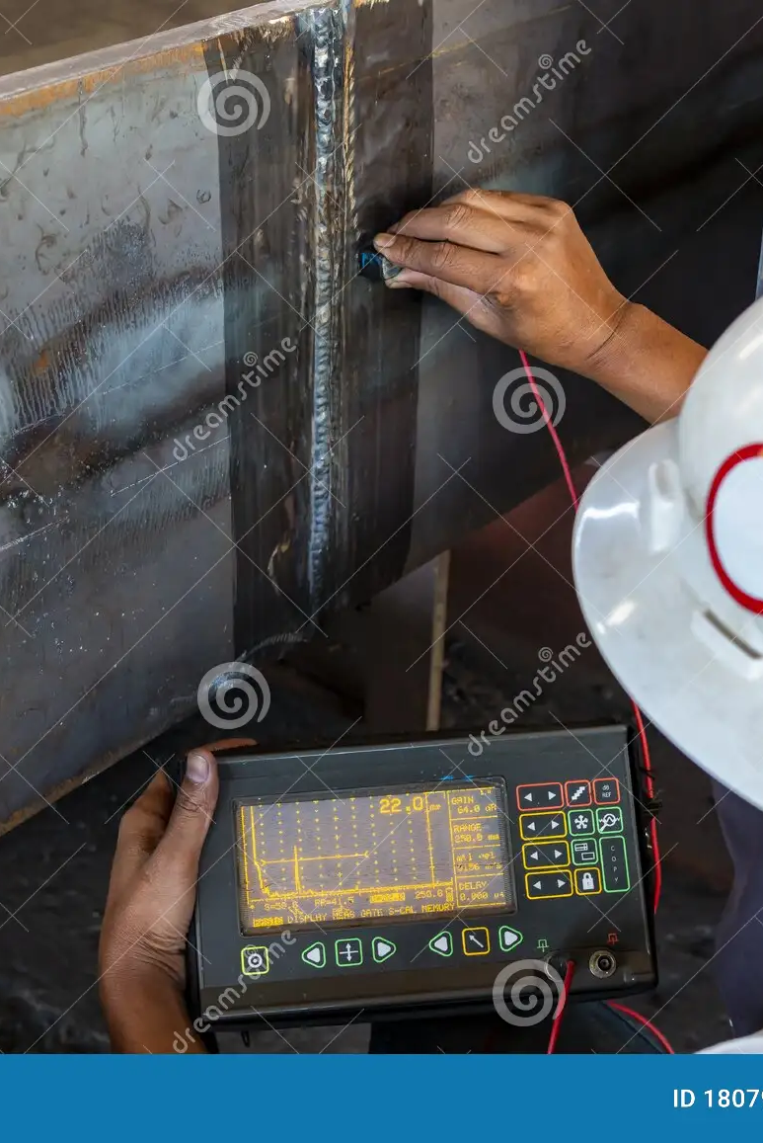
Preventing Welding Defects
Ensure surface cleanliness and remove dirt and impurities before welding.
Check for proper parameter settings and use appropriate tools for the process.
Provide proper training for operators to ensure correct welding execution.

Slide 7
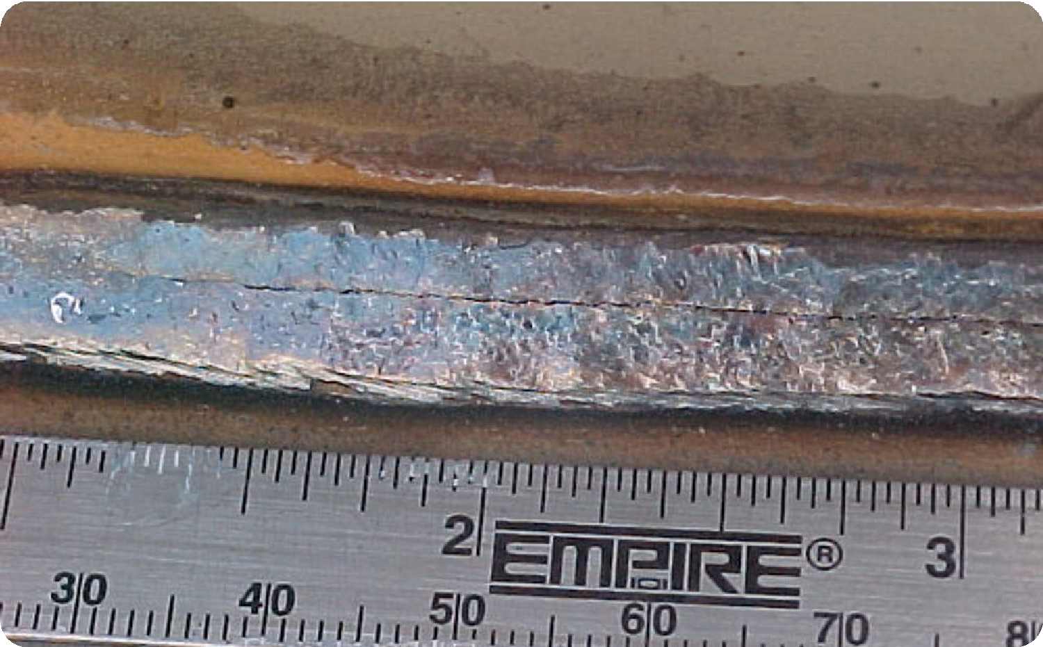
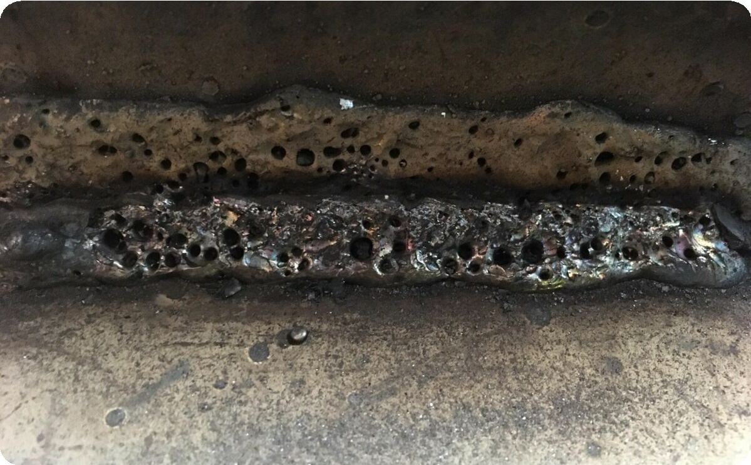
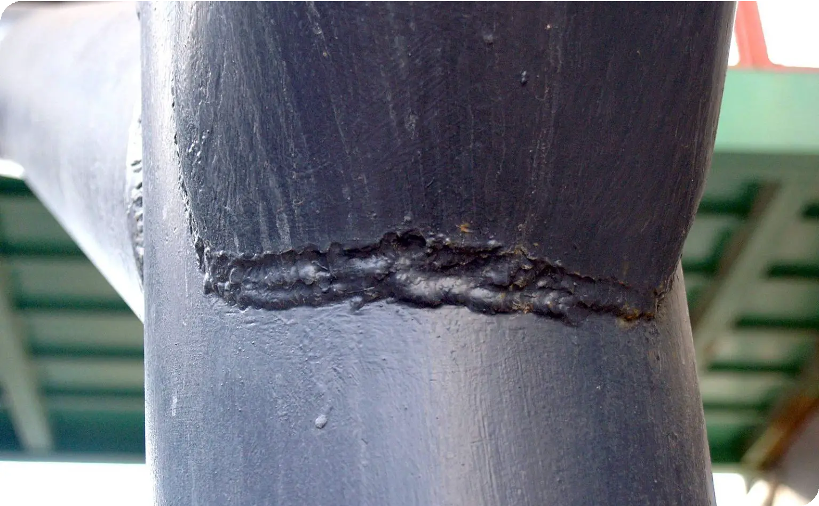
Examples of Welding Defects and How to Fix Them
Cracked Welding
Use controlled heating repair technique and filler welding to fix the crack.
Welding Holes
Use re-welding technique for the perforated area or replace the defective part with a new piece.
Welding Sinking
Refill the depression with welding at an angle of up to 45 degrees to fix the sinking.

Slide 8
Conclusion
Understanding the different types of welding defects, their causes, and the potential consequences is crucial for welders to produce high-quality welds. By implementing proper preventive measures and addressing defects promptly, welders can ensure the production of strong and durable welds that meet industry standards.

