Slide 1
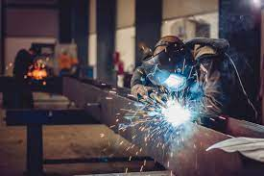
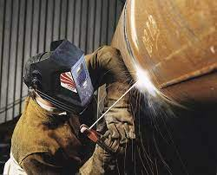
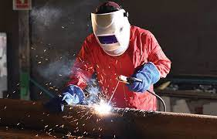
WELDING TOOLS
By:
Guennar Halima.
Miss:
chabouli Meriem.

Slide 2
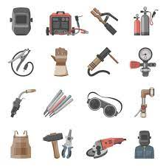
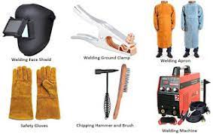
introduction:
Welding is a process that involves joining materials, usually metals, by melting and fusing them together. Various tools are used in welding to ensure a safe and effective process.

Slide 3
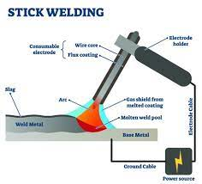
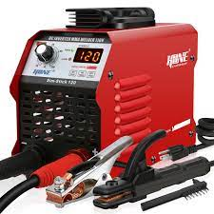
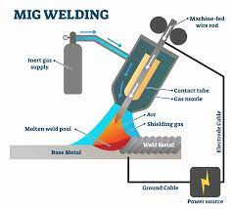
Welding tools:
Welding Machine:
Arc Welder (Stick Welder): Uses a consumable electrode to create an electric arc between the electrode and the workpiece.
MIG Welder (Metal Inert Gas): Uses a wire electrode and a shielding gas to create a clean weld.

Slide 4
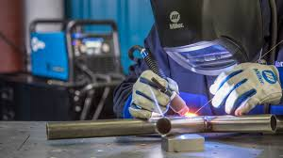
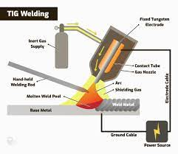
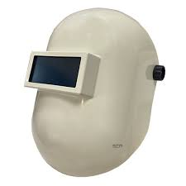
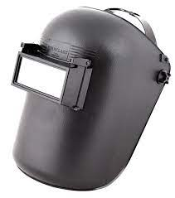
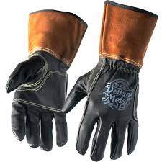
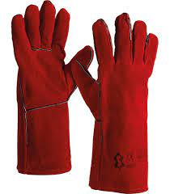
‘
TIG Welder (Tungsten Inert Gas): Uses a tungsten electrode and a shielding gas for precise and high-quality welds.
Welding Helmet:
Protects the welder's eyes and face from sparks, UV light, and infrared radiation.
Welding Gloves:
Heat-resistant gloves to protect hands from sparks, heat, and molten metal.

Slide 5
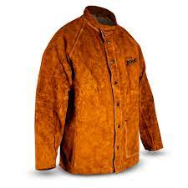
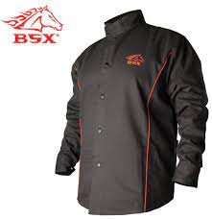
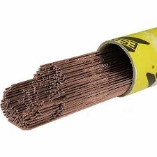
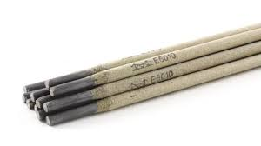
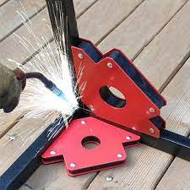
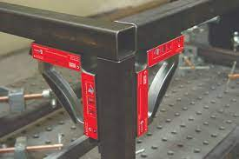
‘
Welding Jacket:
Flame-resistant jacket to protect the upper body from sparks and heat.
Welding Apron:
Provides additional protection for the lower body and legs.
Welding Electrodes and Filler Metals:
Consumable materials used to add material to the weld joint.
Welding Clamps and Magnets:
Hold pieces in place during welding to ensure proper alignment

Slide 6
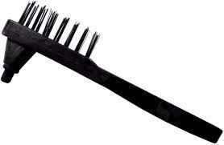
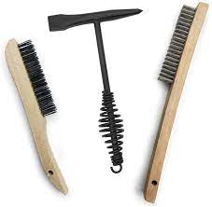
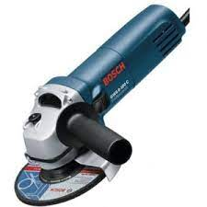
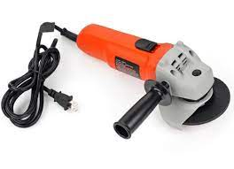
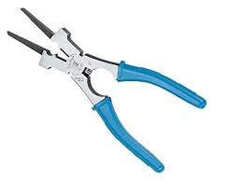
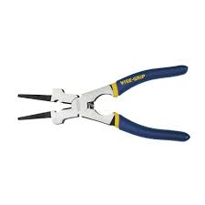
Chipping Hammer and Wire Brush:
Used to remove slag and spatter from the weld bead.
Grinding Tools:
Angle grinders and other grinding tools are used for preparing the weld joint and cleaning up welds.
Welding Pliers:
Specialized pliers designed for various welding tasks, such as removing hot metal.

Slide 7
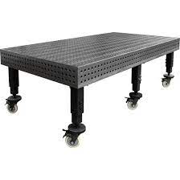
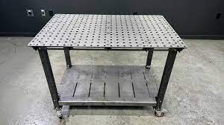
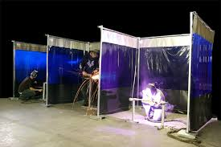
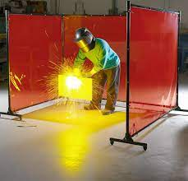
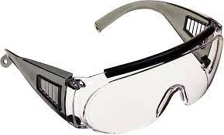
‘
Welding Table:
A sturdy table with a metal surface for supporting workpieces during welding.
Welding Curtain:
Shields nearby areas from sparks and protects against UV light.
Safety Glasses:
Eye protection for tasks that don't require a welding helmet.

Slide 8
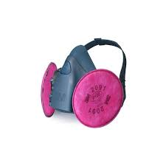
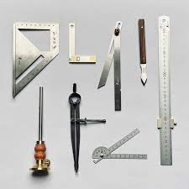
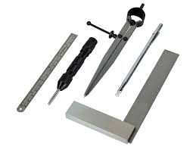
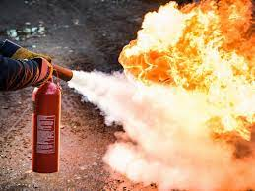
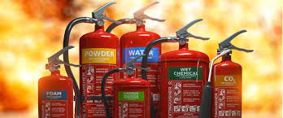
‘
Welding Respirator:
Protects the welder from fumes and gases produced during welding.
Measuring and Marking Tools:
Tools like rulers, squares, and chalk are used to measure and mark the welding area.
Fire Extinguisher:
Important for safety in case of a fire.

Slide 9
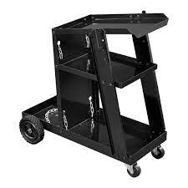
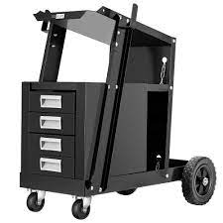
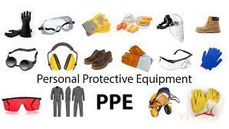
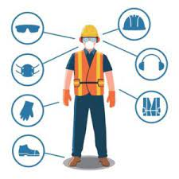
‘
Welding Cart:
A mobile cart to hold and transport the welding machine and accessories.
Personal Protective Equipment (PPE):
In addition to gloves and helmets, other PPE such as steel- toed boots and flame- resistant clothing may be necessary.

Slide 10
Conclusion:
The specific tools required may vary based on the welding process and the materials being welded.
During the welding process we have to always follow the safety guidelines, and wear appropriate protective gear when we are welding to ensure a safe working environment.

