Slide 1
Artificial Neural Networks as a Model of the Human Brain
A. A. BOUBRIS

Slide 2
Have you ever wondered why there are tasks that are extremely simple for any human but incredibly difficult for computers – recognizing people?
Have you ever wondered how it all has become possible?
.
Artificial intelligence:
Using facial recognition powered by Artificial Neural Networks.

Slide 3
Artificial Neural Networks (ANNs) is the main tool used in Machine learning.
They were inspired by Biological Neural Networks (BNNs).
ANN’s are built upon simple signal processing elements that are connected together into a large mesh.
ANN’s have been successfully applied to a number of problem domains:
·
Classify data by recognizing patterns Is this a tree on that picture?
· Approximate a target function useful for predictions and forecasting.

Slide 4
BNNs Vs. ANNs
SIZE
An artificial neural network has 10-1000 neurons in them, whereas a human brain has around 86 billion neurons in it.
Both networks have different types of working and structure.
In a human brain, the single neuron can function both input and output information using it’s different ends
In Artificial Neurons there are different layers of neurons for input and output completely.

Slide 5
BNNs Vs. ANNs
TRAINING TIME
BNN’S don’t usually start or stop learning, and we still don’t know exactly how it learns or recalls information.
However, we are aware that Neuroplasticity allows new connections to be created and how synapses may strengthen or weaken based on the function’s importance.
We also understand that we learn by repetition and while we are sleeping.
Tasks which might have required pure focus can be done automatically once they are mastered by our human brain.
ANN’s have a predefined model, only the weights of connections can change during training.
The neurons can neither be added nor removed.
BNN will have a solution to every problem a human brain would face but this cannot be experienced with ANN.

Slide 6
BNNs Vs. ANNs
Power Consumption
We are well aware of how much heat artificial machines generate while being used.
An average Graphics processing unit consumes 250 watts and needs a power supply to be working all the time.
The human brain consumes only 20% of the energy of our body to function.
Despite the brain having a huge cut, it only needs 20 watts to operate, making it very efficient as more energy than this will be needed to light a bulb.

Slide 7
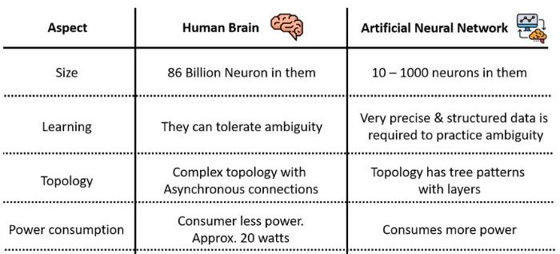
BNNs Vs. ANNs
Speed
Signals in a human brain move at a speed dependent on the nerve impulse.
It can vary from 0.61m/s to 119m/s.
Some of the biological neurons can also fire up to 200 times a second on average.
The signal’s speed varies from person to person.

Slide 8
Topology
There are many ways of connecting the node of a neural network together, and each way results in a more or less complex behavior.
Possibly the simplest of all topologies is the feed-forward network.
Signals flow in one direction only; there is never any loop in the signal paths.
Typically, ANN’s have a layered structure.
The input layer picks up the input signals and passes them on to the next layer, the so-called ‘hidden’ layer. (Actually, there may be more than one hidden layer in a neural network). Last, comes the output layer that delivers the result.

Slide 9
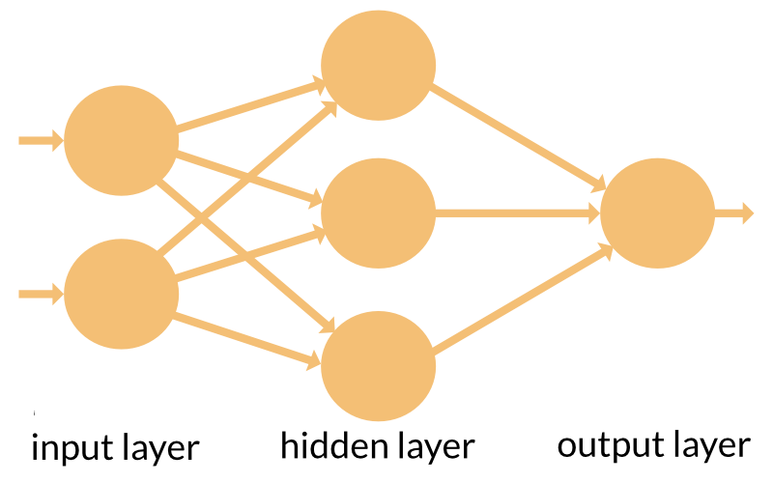
Topology
There are different topologies, or node maps, are also known as the neural network zoo.
The topology is chosen according to the use-case of the ANN that we want to train.

Slide 10
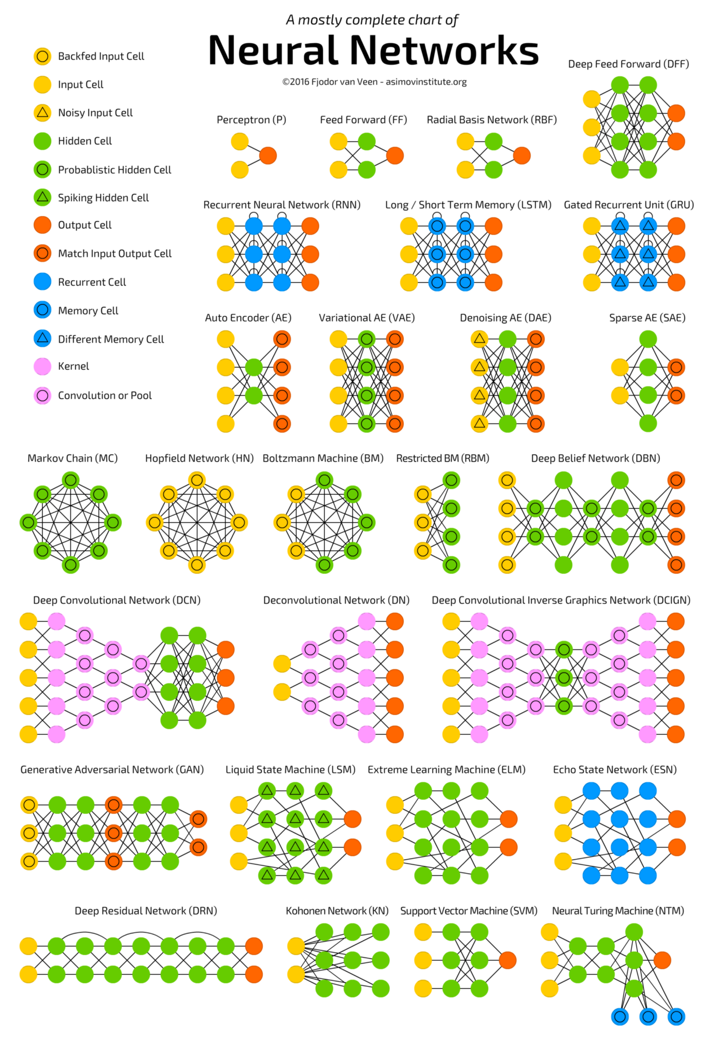
The ANNs Zoo
For a better quality, please find the picture in the folder « Supports de Cours »

Slide 11
ANNs Must Learn
Unlike traditional algorithms, ANNs cannot be ‘programmed’ or ‘configured’ to work in the intended way.
Just like BNNs, they have to learn how to accomplish a task.
Roughly speaking, machine learning can be supervised and unsupervised.
Supervised learning can be used if a (large enough) set of test data with known results exists.
“Process one dataset. Compare the output against the known result. Adjust the network and repeat.”

Slide 12
THANK YOU!

