Slide 1
محاضرات في مقياس اقتصاديات التأمينات Insurance Economics
Abu Bakr Belkaid University of Tlemcen,
Department of Economic Sciences
DR Benazza IKRAM
Department of Economic Sciences
الأستاذة بن عزة إكرام
Insurance Economics Course, Business Economics Specialization, Second Year Master's

Slide 2
The Concept of Insurance, Its Origin, and Development
DR Benazza IKRAM
The First
Topic
Dear Students,
Welcome to this online lesson on Insurance Economics, a part of your second-year Master's program in Business Economics. In this session, we will explore the key economic principles behind the insurance industry and how it functions within the larger context of the economy and business.
Insurance plays a crucial role in modern economies by helping individuals and businesses manage risks and uncertainties. As future professionals in the field of business, understanding how insurance markets operate, how prices are determined, and how government regulations influence the sector will be essential to your career; In this lesson, we will cover the following main topics:

Slide 3
The Concept of Insurance, Its Origin, and Development
DR Benazza IKRAM
The First
Topic
The Emergence of Traditional Insurance:
The History of Insurance: The early signs of commercial insurance appeared in the late 14th century in Europe, specifically for goods transported by ships, to facilitate trade across the shores of the Mediterranean Sea. It took the form of a maritime loan contract, known as bottomary bonds (maritime contract)

Slide 4
The Concept of Insurance, Its Origin, and Development
DR Benazza IKRAM
The First
Topic
What Is Bottomry?
Bottomry, referring to the ship's bottom or keel, is a maritime transaction, where the owner of a vessel borrows money and uses the ship itself as collateral. However, if an accident should happen during the voyage, the creditor will lose out on the loan because the guaranteed security no longer exists, or exists in a damaged fashion. Should the vessel survive the journey intact and whole, then the lender will receive the return of the loaned principal plus interest.
Bottomry transactions are mostly obsolete in modern-day maritime activity. The interest received by the lender on a bottomry loan is known as maritime interest and may be more than the legal rate of interest.
What Is Collateral?
Collateral in the financial world is a valuable asset that a borrower pledges as security for a loan.

Slide 5
The Concept of Insurance, Its Origin, and Development
DR Benazza IKRAM
The First
Topic
What Is the Oldest Form of Insurance?
Some of the oldest forms of insurance are considered to be the bottomry contracts of merchants
What Is the Oldest Insurance Company in the World?
The oldest insurance company in the world is considered to be Hamburger Feuerkasse, which was founded in 1676. Its first policies provided fire insurance within the the city walls of Hamburg and reimbursed owners the market value of their buildings up to 15,000 marks, with a 25% deductible.10Hamburger Feuerkasse

Slide 6
Theories Explaining Insurance
DR Benazza IKRAM
The Second
Topic
Insurance theories can be divided into several types based on different perspectives. The main classifications can be summarized as follows:
Economic Theories of Insurance:I nsurance and the Need Theory (Protection and Security) ; nsurance and the Guarantee Theory
Legal Theories of Insurance: Insurance and Damage Theory ; Insurance and Compensation Theory
. Technical Theories of Insurance: Theory of Cooperation Replacing Pure Chance through Exchange; Theory of Insurance as an Organized Project:

Slide 7
insurances types and classifications
DR Benazza IKRAM
The Second
Topic
insurances types and classifications:

Slide 8
DR Benazza IKRAM
insurances types and classifications
The Second
Topic
What Is Insurance?
Insurance is a contract, represented by a policy, in which a policyholder receives financial protection or reimbursement against losses from an insurance company. The company pools clients’ risks to make payments more affordable for the insured. Most people have some insurance: for their car, their house, their healthcare, or their life
Insurance policies hedge against financial losses resulting from accidents, injury, or property damage. Insurance also helps cover costs associated with liability (legal responsibility) for damage or injury caused to a third party

Slide 9
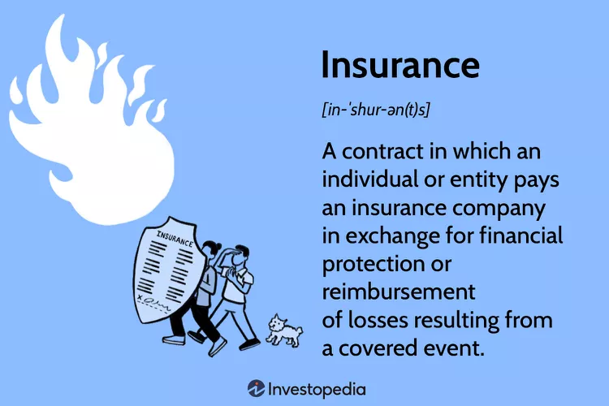
insurances types and classifications
DR Benazza IKRAM
The Second
Topic

Slide 10
insurances types and classifications
DR Benazza IKRAM
The Second
Topic
There are several types and classifications of insurance, each designed to provide financial protection in different situations. Here’s an overview of the most common insurance types and their classifications:
1. Life Insurance
Life insurance provides a payout to beneficiaries in the event of the policyholder's death. There are two main types of life insurance:
Term Life Insurance: Offers coverage for a specific period (e.g., 10, 20, or 30 years). If the insured person dies within the term, the beneficiaries receive a payout.
Whole Life Insurance: Provides lifelong coverage and includes an investment component that builds cash value over time.
2. Health Insurance
Health insurance covers medical expenses, including doctor visits, hospital stays, surgeries, and prescriptions.

Slide 11
insurances types and classifications
DR Benazza IKRAM
The Second
Topic
3. Auto Insurance
Auto insurance covers financial losses due to vehicle accidents, theft, or damage. Types include:
Liability Insurance: Covers damages to other vehicles or property if the policyholder is at fault.
Comprehensive Insurance: Covers damage to the insured vehicle not involving an accident, like theft, vandalism, or natural disasters.
Collision Insurance: Covers damage to the insured vehicle from a collision with another object or vehicle.

Slide 12
insurances types and classifications
DR Benazza IKRAM
The Second
Topic
5. Disability Insurance
Disability insurance provides income replacement if the policyholder is unable to work due to illness or injury. There are two main types:
Short-Term Disability Insurance: Provides temporary income if the policyholder is unable to work for a limited period.
Long-Term Disability Insurance: Provides income for an extended period if the policyholder is unable to work long-term due to illness or injury.
6. Property Insurance
Property insurance protects physical property from damage or loss. Types include:
Homeowners Insurance: As mentioned, it covers residential property.
Commercial Property Insurance: Covers business properties, including buildings, equipment, and inventory.
Renters Insurance: Covers renters’ personal property within a rented space.

Slide 13
insurances types and classifications
DR Benazza IKRAM
The Second
Topic
7. Travel Insurance: Travel insurance provides coverage for various risks related to traveling, such as:
Trip Cancellation Insurance: Reimburses non-refundable expenses if a trip is canceled due to unforeseen circumstances.
Travel Medical Insurance: Covers medical expenses incurred while traveling abroad.
Lost Baggage Insurance: Covers losses related to lost or delayed luggage.
8. Liability Insurance: Liability insurance protects individuals and businesses from legal claims for damages caused to others. Types include:
General Liability Insurance: Covers legal costs from claims of bodily injury or property damage.

Slide 14
insurances types and classifications
DR Benazza IKRAM
The Second
Topic
Professional Liability Insurance: Covers professionals against claims of negligence or malpractice.
Product Liability Insurance: Protects businesses from legal claims related to product defects.
10. Marine Insurance
Marine insurance covers damage to ships, cargo, and other maritime property. It includes:
Cargo Insurance: Covers goods being transported by sea.
Hull Insurance: Covers damage to ships and boats.

Slide 15
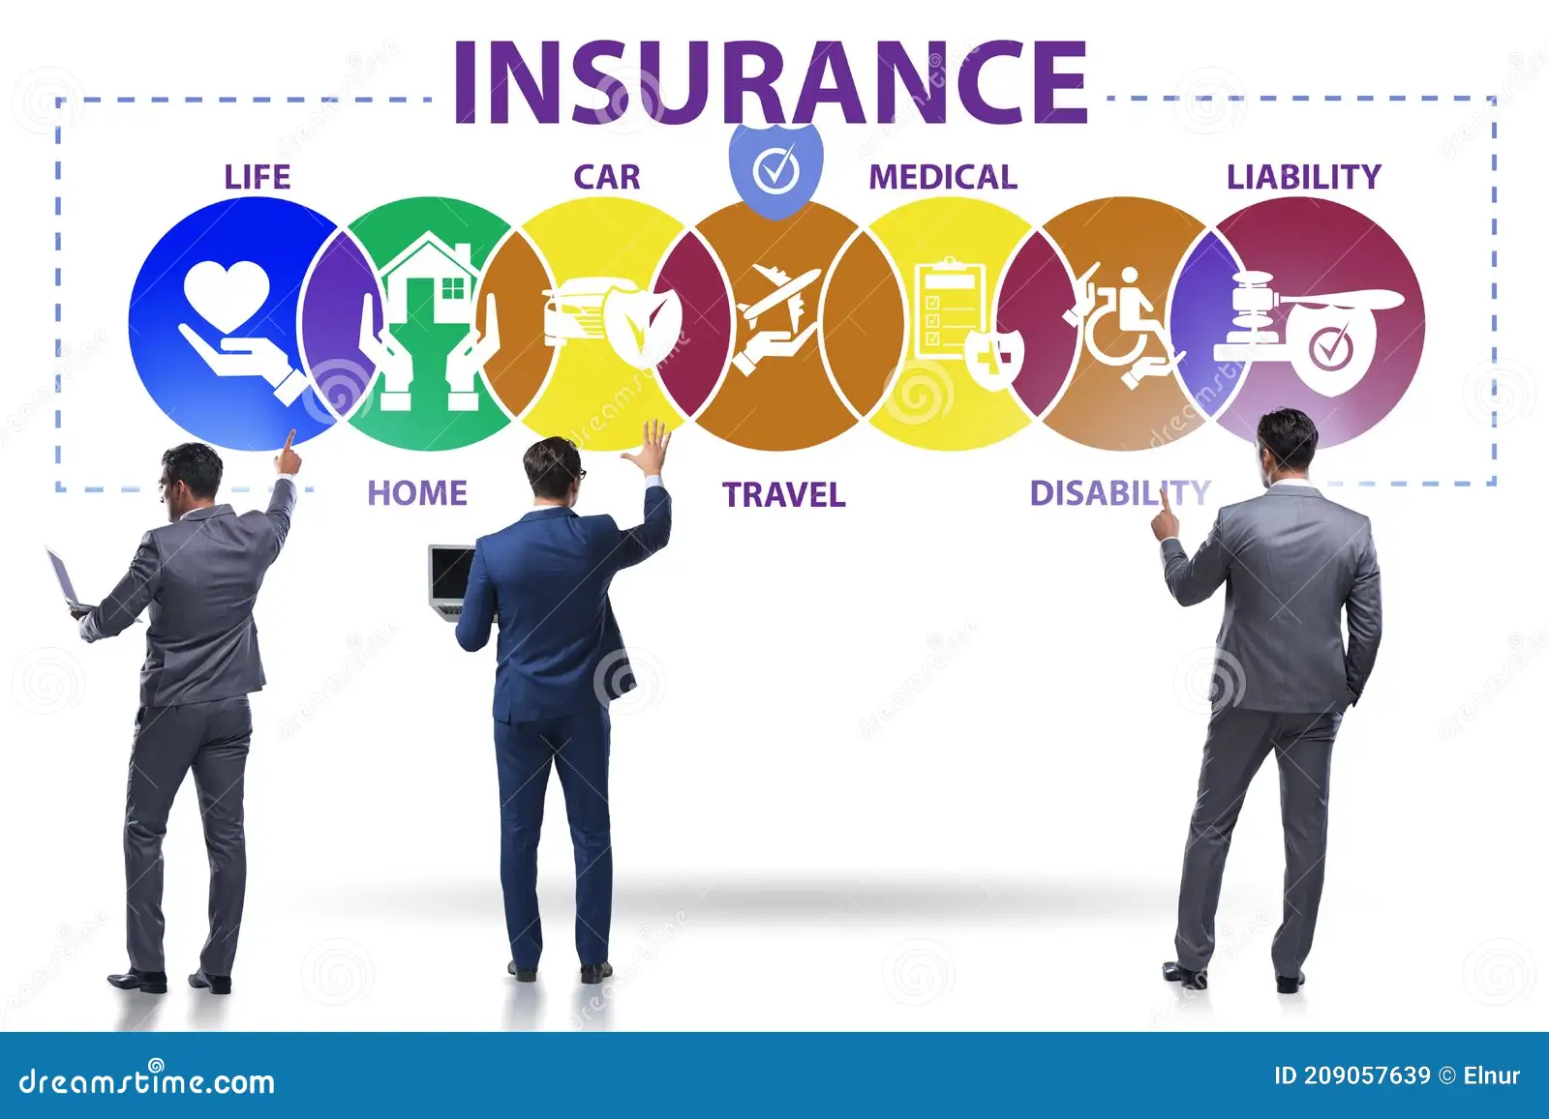
insurances types and classifications
DR Benazza IKRAM
The Second
Topic

Slide 16
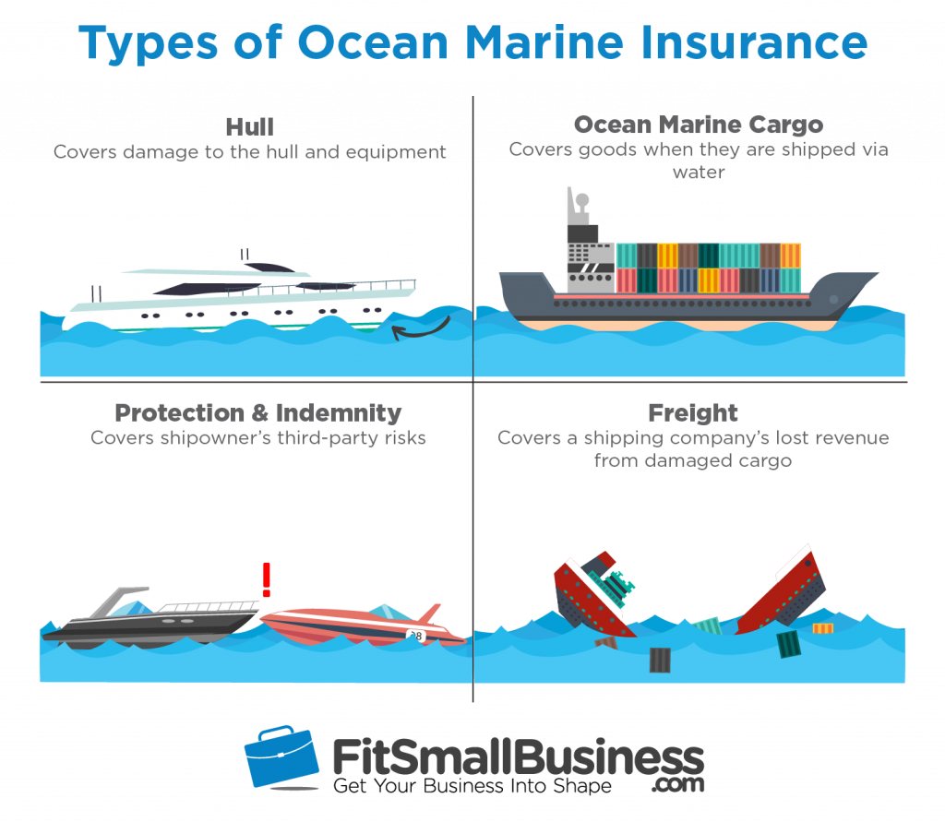
insurances types and classifications
DR Benazza IKRAM
The Second
Topic

Slide 17
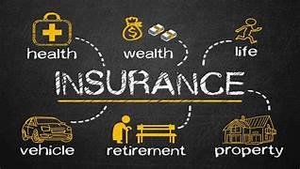
insurances types and classifications
DR Benazza IKRAM
The Second
Topic
Workers’ compensation | If an employee is injured on the job.

