Slide 1
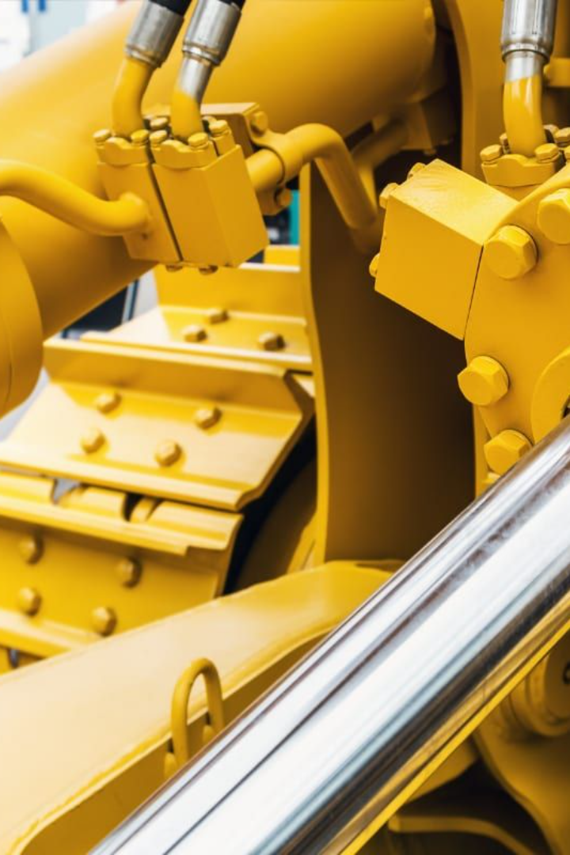
Hydraulics
Welcome to the exciting world of hydraulics! Discover how this versatile technology powers various industries and learn about its working principles.

Slide 2
Definition of Hydraulics
Hydraulics is a branch of engineering that uses fluids to transmit power. It involves the study and application of liquid properties, such as pressure, flow, and density, for various mechanical tasks and control systems.

Slide 3
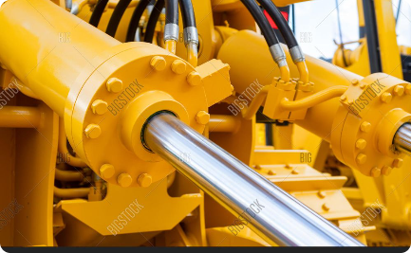
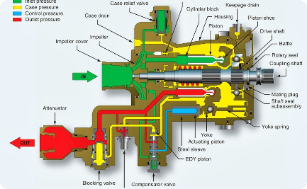
Applications of Hydraulics
Construction
Manufacturing
Aerospace
Explore how hydraulics heighten the efficiency and strength of heavy machinery, from excavators to bulldozers, allowing for precise movement and increased power.
Discover how hydraulics drive the processes in manufacturing plants, enabling smooth movements in machines, such as presses and robots, for accurate production.
Learn about the critical role of hydraulics in aircraft systems, including landing gear operation, flight control movement, and braking mechanisms.

Slide 4
Working Principles of Hydraulic Systems
1
Pascal's Law
2
Pressure Transmission
3
Fluid Flow and Control
Explore how pressure is transmitted equally in all directions within a confined fluid, allowing hydraulic systems to generate and transfer force efficiently.
Discover how hydraulic fluids, typically oil-based, transmit pressure from the power source (pump) through the system to perform work at various points using cylinders, pistons, and valves.
Learn how flow control valves and other components regulate the speed and direction of hydraulic fluid, offering precise control over equipment.

Slide 5
Components of a Hydraulic System
Pump
Actuators
The heart of the hydraulic system, the pump generates the necessary pressure to transfer the fluid and initiate the force.
Discover how hydraulic cylinders convert fluid pressure into linear mechanical motion or force, performing tasks such as lifting, pushing, or pulling.
Valves
Fluid Reservoir
Explore the role of valves in controlling the flow, pressure, and direction of hydraulic fluid, ensuring smooth operation and safety.
Learn about the importance of a reservoir for maintaining an adequate supply of hydraulic fluid, as well as heat dissipation and contamination control.

Slide 6
Advantages and Disadvantages of Hydraulics
Advantages
Disadvantages
High power density
Fluid leakage
Precise control
Cost of maintenance
Reliability
Environmental impact

Slide 7
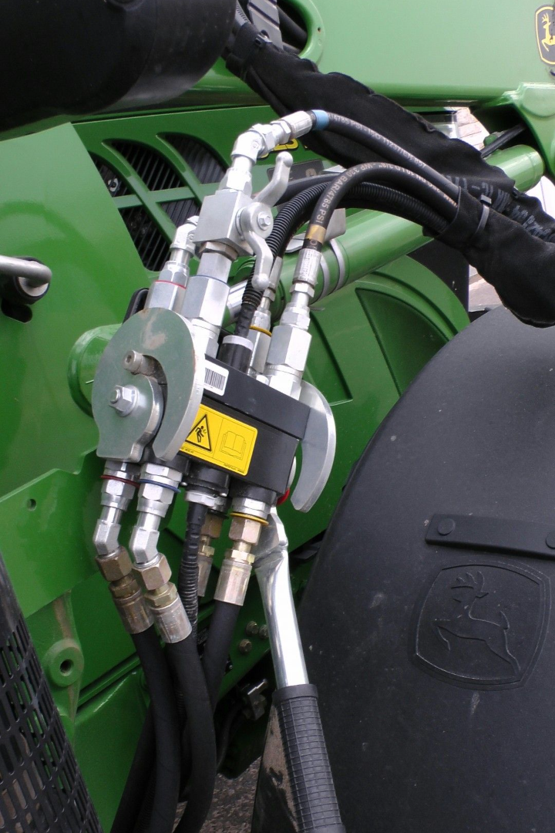
Conclusion
Hydraulics prove to be an essential force behind powerful machinery and precise control in various industries. With its advantages and disadvantages, this technology continues to shape the modern world.

