Slide 1
Classical mechanics.

Slide 2
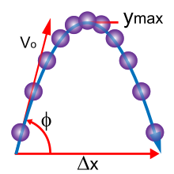
1. **Newton's Laws of Motion:** Look for diagrams demonstrating the three laws of motion, showcasing examples of objects at rest, in uniform motion, and experiencing forces.
2. **Projectile Motion:** Seek diagrams depicting the trajectory of a projectile under the influence of gravity, illustrating its path, velocity, and acceleration.
3. **Force Diagrams:** Search for free-body diagrams illustrating forces acting on an object in equilibrium or in motion, such as tension, friction, gravity, and normal force.
4. **Simple Machines:** Explore illustrations of simple machines like levers, pulleys, inclined planes, etc., showcasing their mechanical advantage and how they operate based on classical mechanics principles.
5. **Collisions:** Look for diagrams or simulations depicting different types of collisions (elastic and inelastic) between objects, illustrating conservation of momentum and energy.

Slide 3
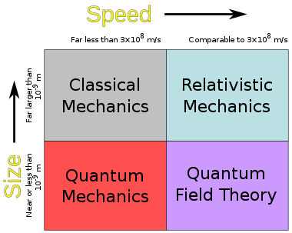
Classical mechanics, the bedrock of physics, elucidates the fundamental principles governing the motion and interaction of physical entities in our observable universe. Its genesis lies in Sir Isaac Newton's monumental contributions, encapsulated within his three laws of motion and the law of universal gravitation. At its inception, classical mechanics birthed the understanding of kinematics, unraveling the tapestry of motion by defining position, velocity, acceleration, and time relationships. Yet, its brilliance extends far beyond mere motion.
Within its realm of dynamics, classical mechanics unveils the unseen forces that orchestrate the dance of celestial bodies, govern the graceful arc of a thrown object, or propel vehicles along their trajectories. The mathematical elegance of Newton's second law, F = ma, serves as a guiding beacon, depicting how forces applied to an object alter its motion, shaping our comprehension of inertia, acceleration, and action-reaction pairs.

Slide 4
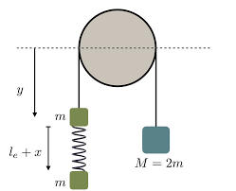
Statics, an integral facet, examines equilibrium and stability, elucidating the delicate balance of forces that maintains objects at rest. This domain dissects the equilibrium of structures, providing the blueprint for architects and engineers to construct robust edifices and mechanisms.
Classical mechanics, while seemingly confined to the macroscopic world, transcends boundaries, paving the way for deeper explorations into the subatomic realms. It sets the stage for understanding the limits of its own applicability, particularly when delving into the realms of extreme velocities or minuscule scales where quantum and relativistic effects take precedence.
Despite the revolutionary advancements in physics since its inception, classical mechanics endures as a critical cornerstone. Its principles persist as the initial stepping stones for budding physicists, engineers, and scientists, fostering an enduring legacy that underpins our understanding of the physical world.

Slide 5
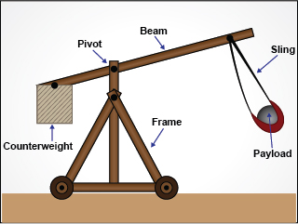
The profundity of classical mechanics lies not just in its historical significance but in its perennial relevance, providing a timeless framework for comprehending and manipulating the mechanics of our tangible reality.

