Slide 1
Intelligence ?
An Introduction to Cognitive Science

Slide 2
Здравствуй
Вы говорите по-английски?
你好
你会说英语吗？
नमस्ते
क्या आप अंग्रेज़ी बोलते हैं?

Slide 3
Merhaba
İngilizce biliyor musun?
سلام
آیا انگلیسی صحبت می کنید؟
Hallo
Sprichst du Englisch?

Slide 4
Mental Processes …
The things that individuals can do with their minds …
Affective
Psychomotor
Cognitive
Involving feelings and emotional areas
(attitude or self)
Manual and physical skills
(fundamental and
skilled movements)
Higher mental processes,
involving intellectual skills and knowledge such as
perception, memory, …

Slide 5
Knowledge is …
Information that is stored in short term memory or long term memory.
It can be …
Factual: including isolated bits of information, such as vocabulary definitions and knowledge about specific details.
Conceptual: consisting of systems of information, such as classifications and categories.
Procedural: including algorithms, techniques and knowledge about when and how to use a particular procedure - knowing how to do something.

Slide 6
Cognition is "the mental action or process of acquiring knowledge and understanding through thought, experience and senses".
Cognitive processes use existing knowledge and generate new knowledge.

Slide 7
Здравствуй
Вы говорите по-английски?
你好
你会说英语吗？
नमस्ते
क्या आप अंग्रेज़ी बोलते हैं?

Slide 8
Reading is a complex mental process
cognitive
affective
psychomotor

Slide 9
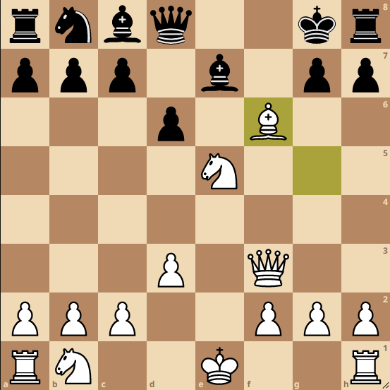
What do you need to do this?
What is the best move for white?

Slide 10
Remember
Understand
Apply
Analyze
Evaluate
Create

Slide 11
Some of the Cognitive mental skills are:
Remembering: Retrieving relevant knowledge from long-term memory ( duplicate/memorize/define/).
Understanding: Determining the meaning of instructional messages, including oral, written, and graphic communication (recognize/classify/describe).
Applying: Carrying out or using a procedure in a given situation (execute/use/interpret/).
Analyzing: Breaking material into its constituent parts and detecting how the parts relate to one another and to an overall structure (compare/examine/Judge).

Slide 12
Cognitive science is …
the interdisciplinary scientific study of the mind and its processes.
It examines …
The nature and the functions of cognition.
Cognitive psychologists …
Study how people acquire and perceive, process and store, information.

Slide 13
Infographic Style
Read the text and complete
the reading-report worksheet.
Homework

Slide 14
Infographic Style

