Slide 1
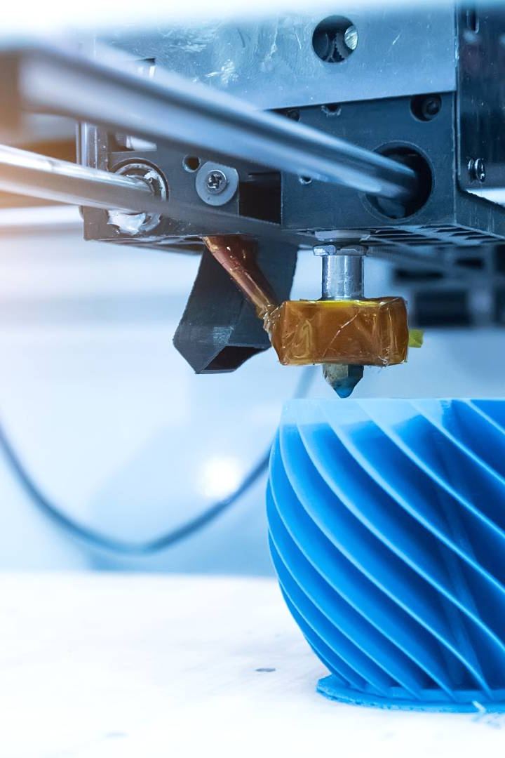
3D Printing: Revolutionizing the Future of Manufacturing
Welcome to the world of 3D printing, where imagination becomes reality! Explore the endless possibilities and innovation that this groundbreaking technology brings.
CB
by Chaimaa Bouali

Slide 2
Introduction to 3D Printing
Discover the incredible process of turning digital designs into tangible objects through layer-by-layer construction. Step into the world of additive manufacturing!

Slide 3
Applications of 3D Printing
Healthcare
From prosthetics to medical devices, 3D printing revolutionizes personalized treatments and improves patient care.
Architecture
Architects envision intricate structures and bring them to life with 3D printed models, enhancing design precision and creativity.
Fashion
Embrace innovative designs and sustainable practices as 3D printing reshapes the fashion industry with customizable garments and accessories.

Slide 4
Advantages of 3D Printing
1
Design Freedom
Unlock unparalleled design possibilities by creating complex geometries and intricate details with ease.
2
Rapid Prototyping
Accelerate product development with quick iterations, reducing time-to-market and boosting innovation.
3
Customization
Deliver personalized products tailored to individual needs, offering a unique customer experience.

Slide 5
Materials Used in 3D Printing
PLA (Polylactic Acid)
Biodegradable, derived from renewable sources like cornstarch and sugarcane.
ABS (Acrylonitrile Butadiene Styrene)
Durable and impact-resistant, often chosen for functional prototypes and end-use parts.
Metal Alloys
From titanium to stainless steel, metal 3D printing opens doors for complex, high-performance applications.

Slide 6
3D Printing Techniques
1
Fused Deposition Modeling (FDM)
Stereolithography (SLA)
2
Build objects layer by layer using melted thermoplastic materials, making FDM one of the most popular and accessible techniques.
Create models with exceptional surface finishes and high accuracy by curing liquid resin layer by layer using precise UV light.
3
Selective Laser Sintering (SLS)
Utilize lasers to fuse powdered materials, offering the flexibility to print complex parts and a wide range of materials.

Slide 7
Challenges and Limitations of 3D Printing
Scaled Production
Mechanical Properties
Print Speed
Traditional manufacturing still excels in mass production, while 3D printing is more suitable for customization and low-volume production.
Printing intricate designs can be time-consuming, hindering large-scale production and time-sensitive projects.
Some materials lack the same strength and durability as conventionally manufactured counterparts, limiting certain applications.

Slide 8
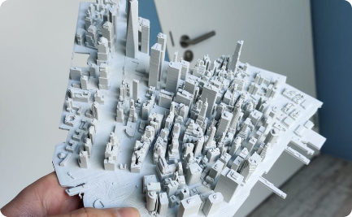
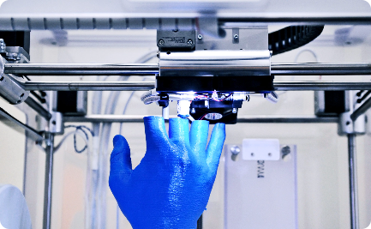
Future Trends in 3D Printing
Urban Construction
Medical Breakthroughs
Culinary Innovation
Visualize a world where entire buildings are constructed using large-scale 3D printers, reducing costs and increasing sustainability.
Witness the advancement of bioprinting organs and tissues, revolutionizing organ transplants and regenerative medicine.
Experience a fusion of technology and gastronomy, as 3D food printers redefine culinary creativity and personalization.

