Slide 1
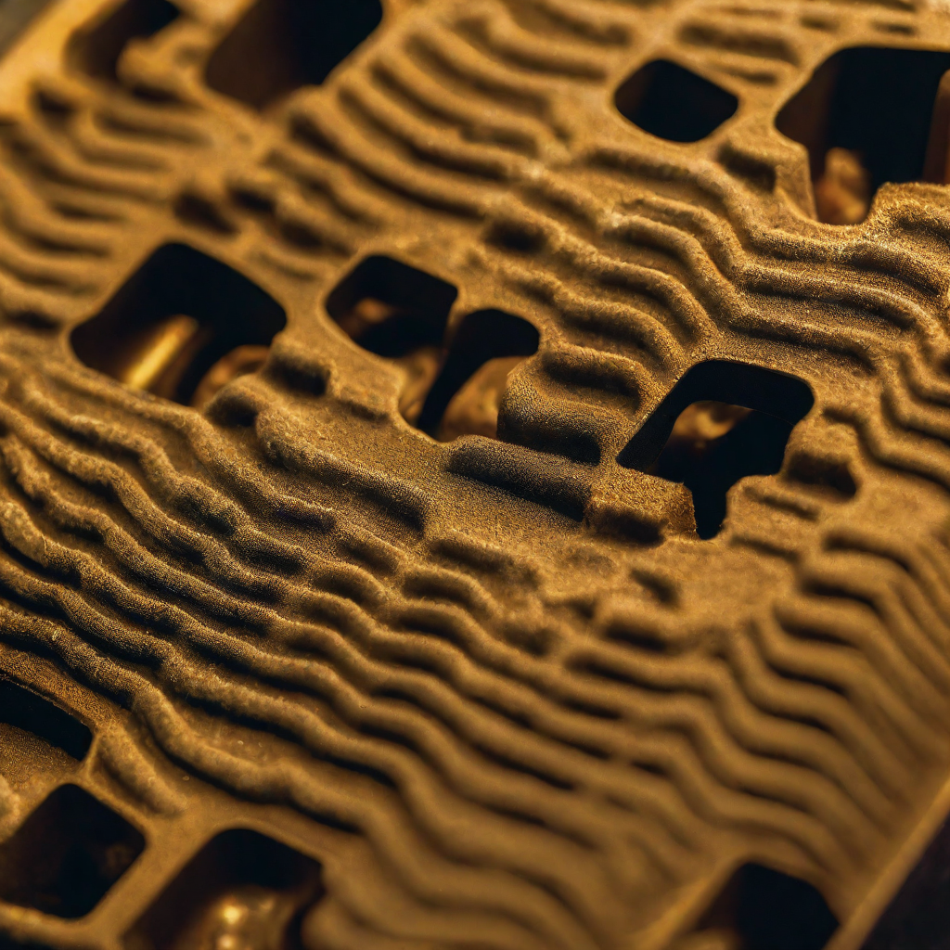
Sand Molding in Mechanical Engineering
University of Abou Bekr Belkaid Tlemcen
FACULTY OF TECHNOLOGY
DEPARTMENT OF MECHANICAL ENGINEERING
BOUHENNI MOHAMMED EL AMIN

Slide 2
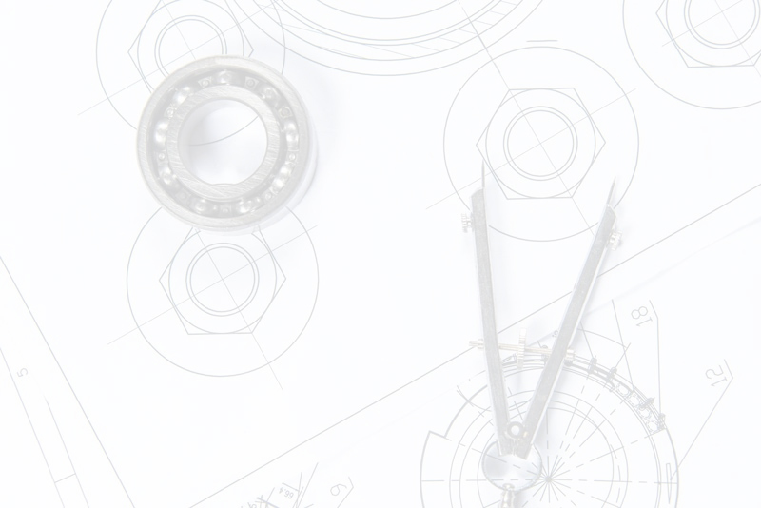
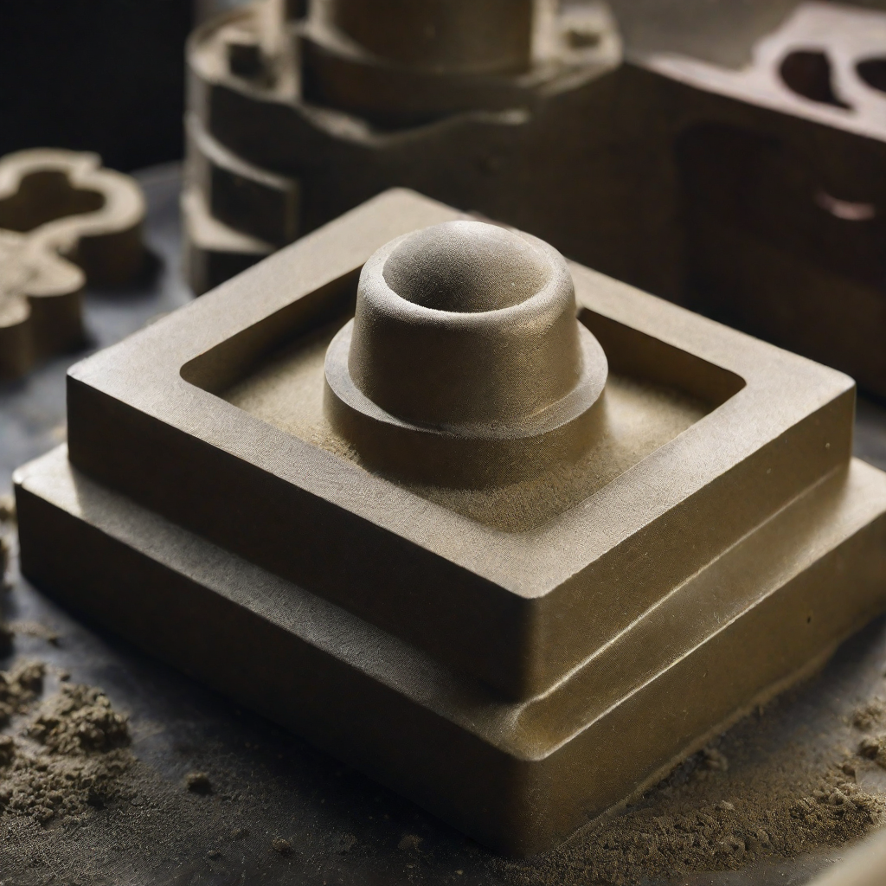
Introduction to Sand Molding
Sand molding is a critical process in mechanical engineering that involves the creation of molds made from sand. These molds are then used to cast metal parts and components. Sand molding is an essential part of the manufacturing process for a wide range of products, from small parts to large machinery and equipment.
The importance of sand molding in mechanical engineering cannot be overstated. It allows for the creation of complex shapes and designs that would be difficult or impossible to achieve through other methods. Sand molding is also a cost-effective and efficient way to produce large quantities of parts and components.

Slide 3
Types of Sand Molds
Green Sand Molds
Dry Sand Molds
No-Bake Sand Molds
Green sand molds are the most commonly used sand molds in mechanical engineering. They are made by mixing sand, clay, and water, which creates a mold that is easy to shape and has good durability. Green sand molds can be used for both ferrous and non-ferrous metals.
Dry sand molds are made by baking the sand mold after it has been shaped. This process removes any moisture and hardens the mold. Dry sand molds are more precise than green sand molds and are often used for larger, more complex castings. They are typically used for non-ferrous metals.
No-bake sand molds are made by mixing sand with a resin binder and hardener. The mold is then cured with a gas or heat. No-bake sand molds are very precise and can be used for both ferrous and non-ferrous metals. They are often used for complex castings or castings with thin walls.

Slide 4
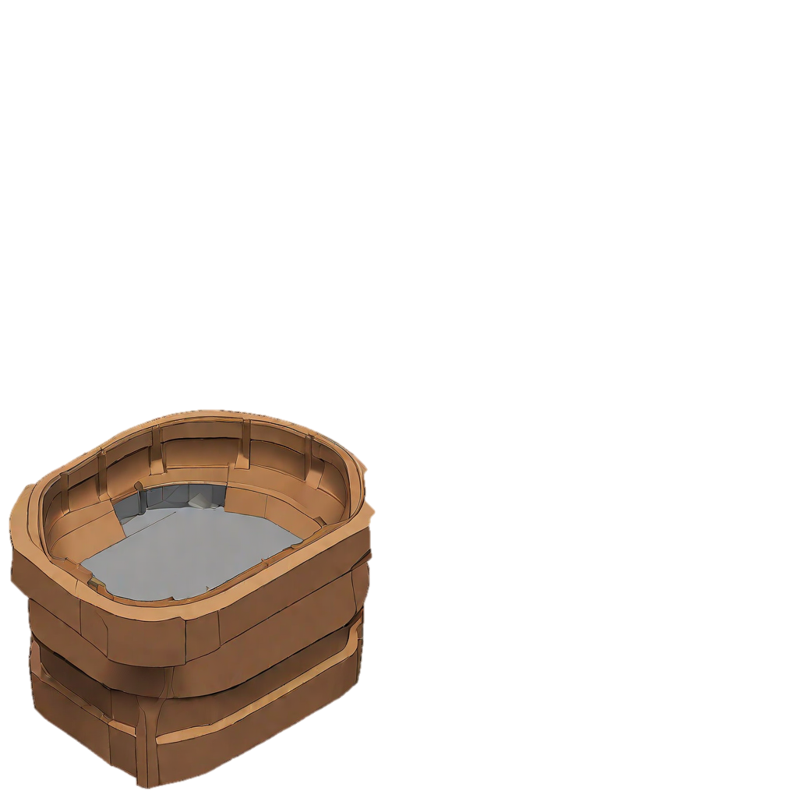
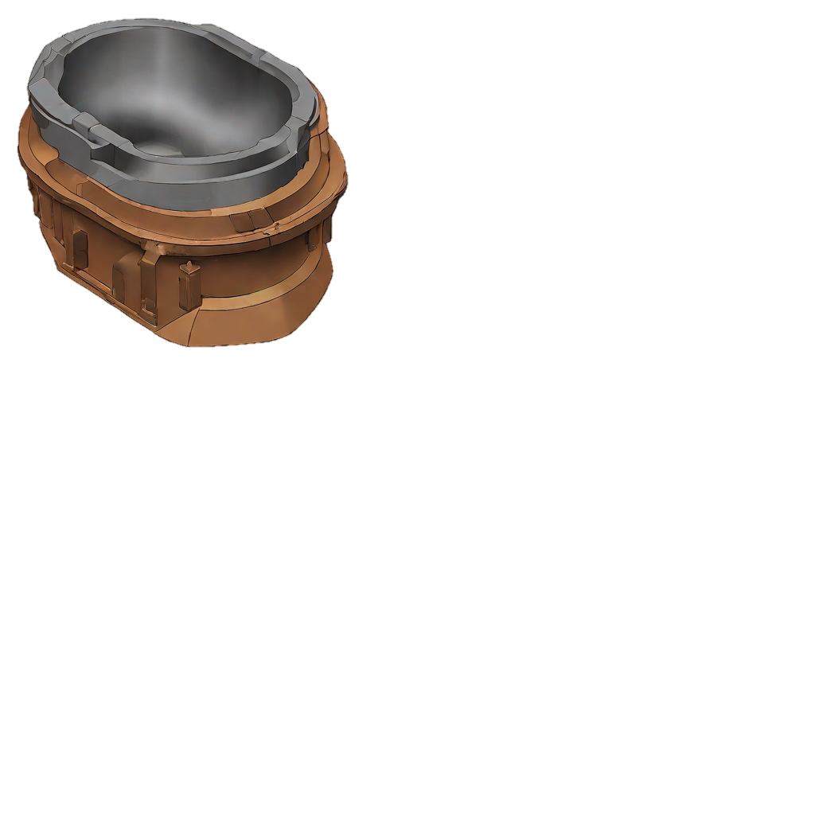
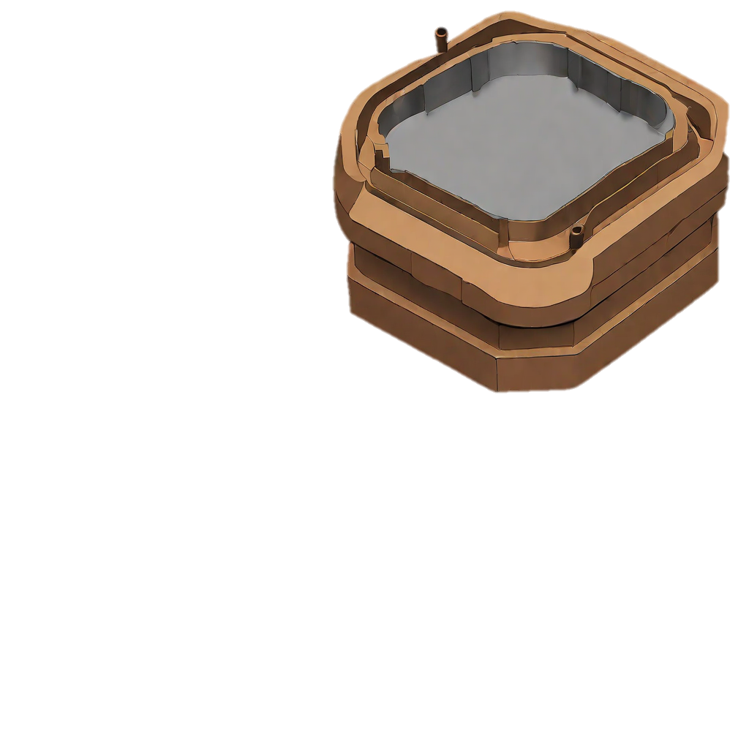
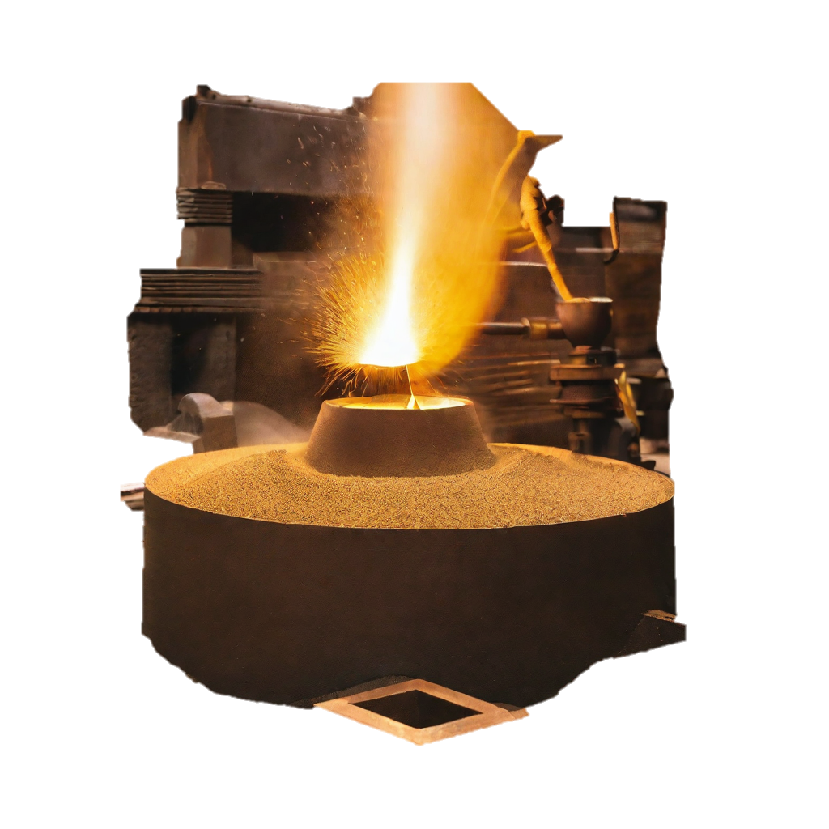
Sand Molding Process Step-by-Step Process
1-Create a pattern of the desired part out of wood, plastic, or metal.
2-Pack sand around the pattern to create the mold.
3-Remove the pattern from the mold.
4-Pour molten metal into the mold.
5-Allow the metal to cool and solidify.
6-Break the mold to remove the cast part.

Slide 5
Applications of Sand Molding in Mechanical Engineering
-Casting of Complex Shapes-
-Production of Large Parts-
-Low-Volume Production Runs-

Slide 6
THANK YOU
FOR
WATCHING

