Slide 1
Chapter 5 Simple plane Bending

Slide 2
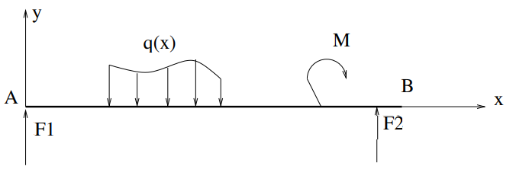
1.Definition
A beam is in plane bending when all the external forces are perpendicular to the mean line, and all external moments are around the z axis.

Slide 3
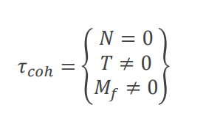
A beam is considered to be subjected to simple plane bending if:
❑ The system of external forces reduces to a planar system.
❑ The forces are perpendicular to the mean line. A beam is therefore subject to simple bending if its cohesion torsor is
Simple bending is a load condition such that in any straight section beam, there is only one bending moment 𝑴_{𝒇} and one shear force 𝑻

Slide 4
Internal forces
In plane bending, N is always null, and M_{f} and T are generally non-null.
Additional hypotheses specific to bending
The mean line of the beam is straight
The beam has a plane of symmetry
All forces applied to the beam are:
◦ Perpendicular to the mean line
◦ Located in the longitudinal plane of symmetry or
symmetrically distributed in relation to it
◦ Concentrated at one point or distributed according
to a specific law.

Slide 5
Determining internal forces:
Since the objective is to dimension a beam, it is necessary to define the maximum stresses to be applied.
To do this, we need to draw internal stress diagrams also known as cohesive force diagrams.
How to determine the cohesive forces?
Section method

Slide 6
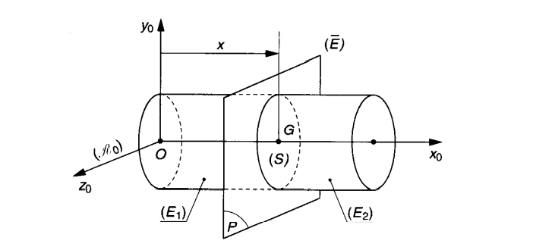
Determining internal forces
Isolate the complete structure and determine the unknown links
Identify all external actions
Make a cut in a section

Slide 7
Determination of internal forces
Isolate the left-hand section or the right-hand section
Isolate the left-hand
Section
Isolate the right-hand
section
Between the left-hand section and the right-hand section, a connecting link transmits three action components:
𝑻(𝒙) : Shearing force
𝑴_{𝒇}(𝒙)
: Bending moment
In the case of simple bending
𝑵(𝒙)=0

Slide 8
Determination of internal forces
Apply the fundamental principle of static (PFS) to the isolated section
of the left-hand Section
of the right-hand Section
of the left-hand Section
of the right-hand Section
Repeat the cuts as many times as necessary to cover the entire beam and finish by plotting the diagrams of the internal forces T and M as a function of x (abscissa of the centre of gravity of the section where the cut is made)

Slide 9
Control of T and M diagrams
Where T is zero, M has a maximum value.
Where T crosses zero discontinuously, the M diagram loses its monotonic shape.
In sections where concentrated loads are applied T is subjected to a jump, the diagram of M presents an angular point (M changes slope).
In sections where concentrated moments are applied M is subject to a jump in proportion to these moments, whereas T will not change.
The M diagram of a symmetrical system (geometry and loading) is symmetrical, while that of T is antisymmetric

Slide 10
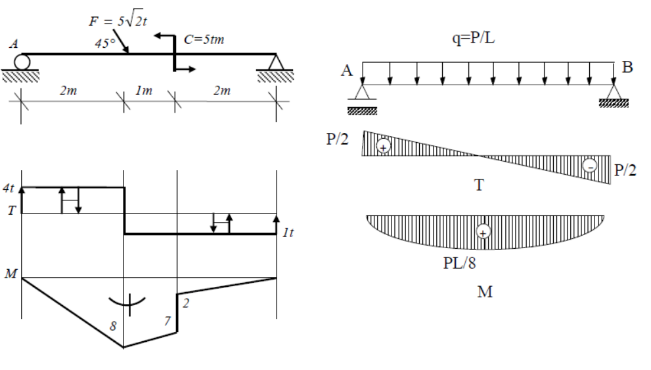

Slide 11
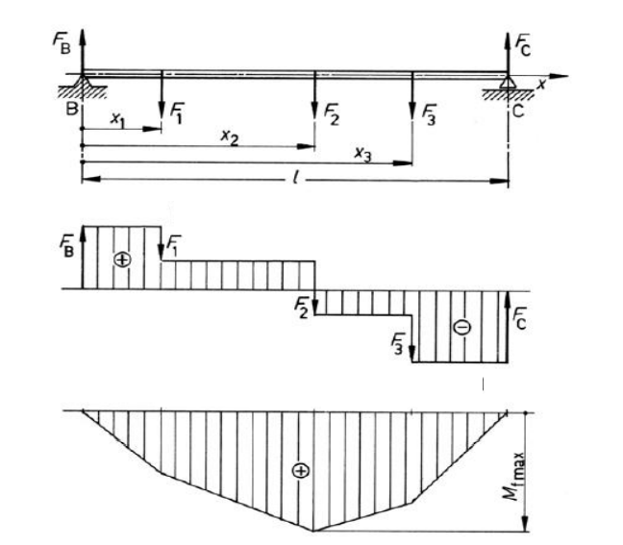

Slide 12
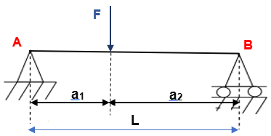
Example 1 Concentrated Load
$$L= a_{1}+ a_{2}$$
$$with { a}_{1}=2m et { a}_{2}=3m$$

Slide 13
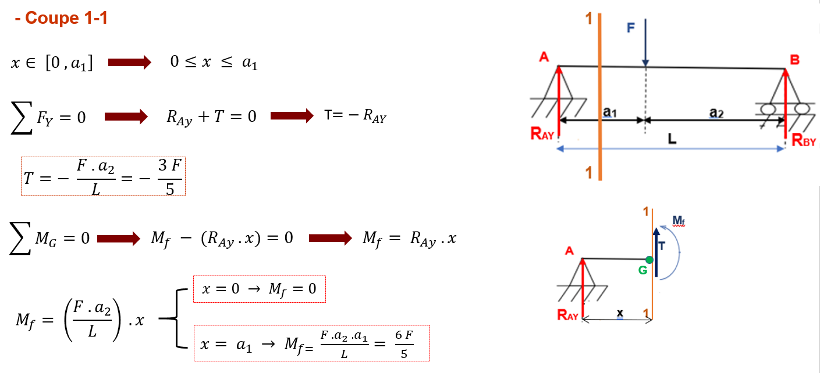

Slide 14
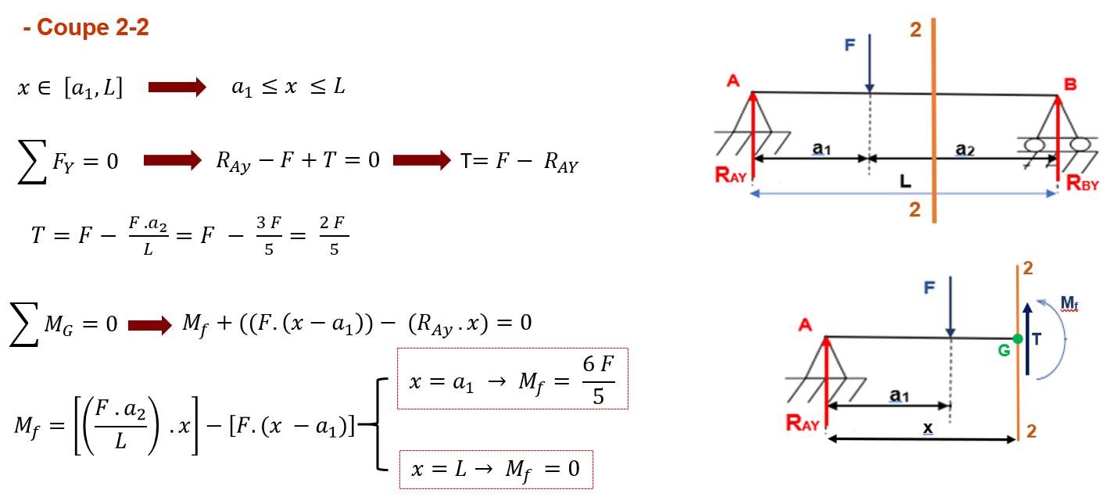

Slide 15
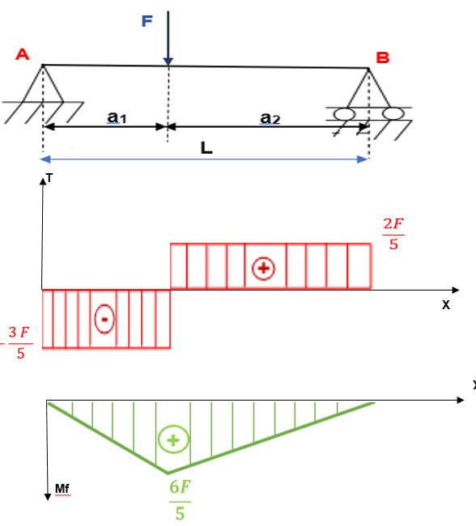

Slide 16
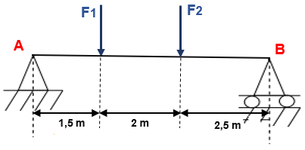
Example 2
F1= 200 daN et F2= 300 daN

