Slide 1
Non-destructive Testing
Non-destructive testing (NDT) is a method used to evaluate materials or components without causing damage. It plays a crucial role in ensuring the integrity and reliability of various industries.

Slide 2
What is Non-destructive Testing?
1
Ensuring Asset Safety
2
Identifying Defects
3
Quality Control
NDT refers to a group of techniques used to inspect and test materials, components, and assemblies without altering their future usefulness.
It enables the detection of surface and subsurface defects, such as cracks, voids, and discontinuities, helping prevent catastrophic failures.
NDT provides a comprehensive evaluation of manufacturing processes, ensuring the quality and reliability of products before they reach the market.

Slide 3
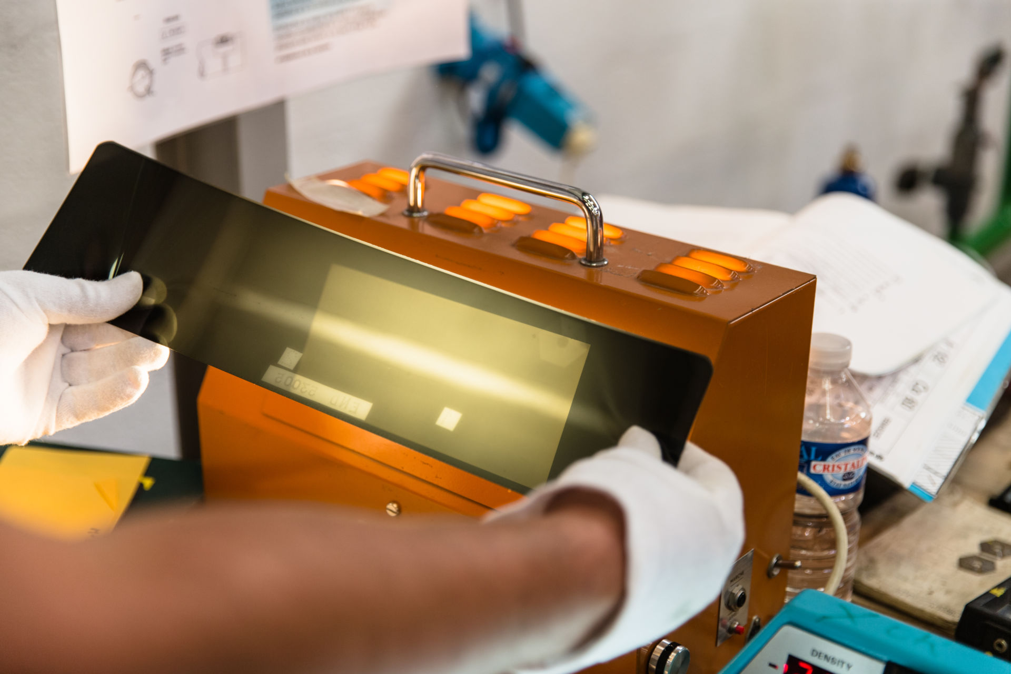
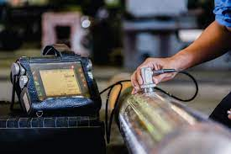
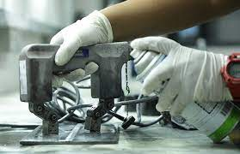
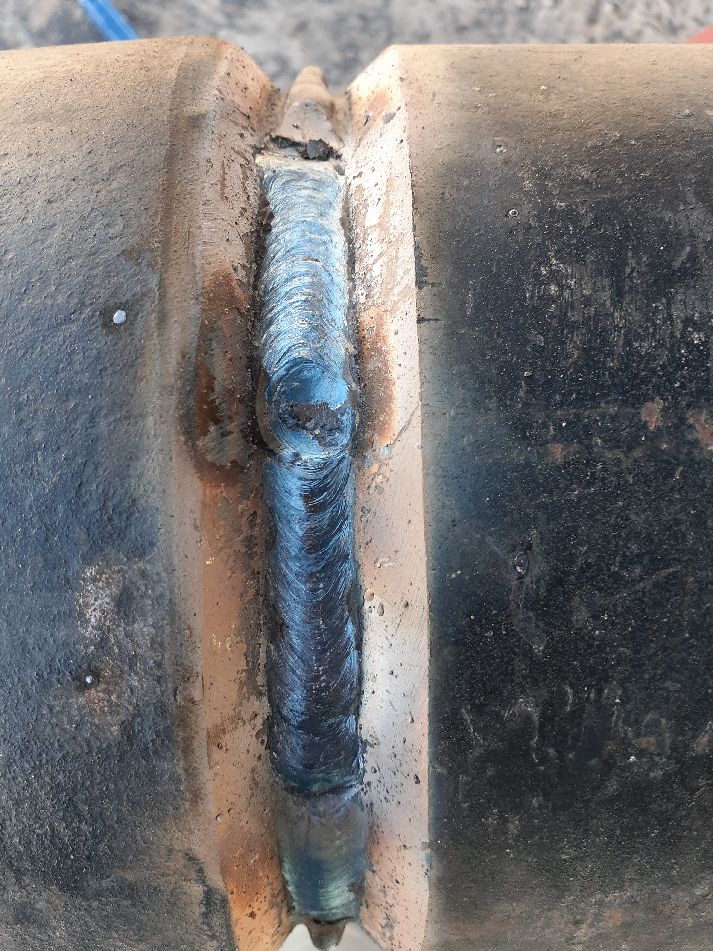
Types of Non-destructive Testing
Radiography
Ultrasound
Magnetic Particle Testing
Visual Inspection
Utilizes high-frequency sound waves to detect internal flaws by measuring the time it takes for sound echoes to bounce back.
Uses X-rays or gamma rays to examine internal structures and defects in materials with high density contrasts.
A manual method where inspectors use their eyes to visually examine and assess the condition of a component or structure.
Identifies surface or near-surface defects by applying magnetic fields and inspecting the accumulation of magnetic particles.

Slide 4
Benefits of Non-destructive Testing
Cost Savings
Safety Assurance
Enhanced Quality Control
By identifying potential issues early on, NDT can help prevent costly failures and minimize maintenance expenses.
NDT ensures the safety of critical structures, components, and systems, reducing the risk of accidents or catastrophic failures.
By inspecting the integrity of products during the manufacturing process, NDT improves quality and reduces defects.

Slide 5
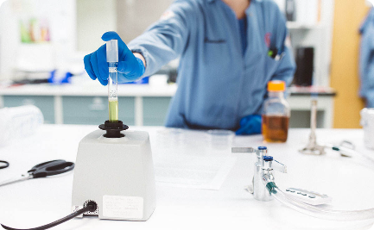
Applications of Non-destructive Testing
Aerospace
Infrastructure
Medical
NDT techniques are used to inspect aircraft structures and engines, ensuring safe and reliable flights.
NDT plays a crucial role in assessing the health of bridges, pipelines, and other critical infrastructure to prevent failures.
NDT is utilized in medical equipment testing, including X-rays and ultrasound devices, ensuring accurate diagnostics.

Slide 6
Challenges and Common Issues
1
Interpretation Complexity
2
Limitations on Materials
3
Environmental Factors
NDT results sometimes require highly skilled experts to interpret the obtained data accurately.
Not all materials are easily inspected using common NDT methods, leading to challenges in certain industries.
Extreme temperatures, varying environmental conditions, and noise interference can impact the accuracy of NDT.

Slide 7
The Future and Trends of NDT
1
Automation & Robotics
Increasing adoption of automated NDT systems and robots to enhance efficiency and reduce human error.
2
Advanced Data Analysis
Integration of artificial intelligence and machine learning to analyze NDT data for more accurate defect detection.
3
Remote Inspections
Advancements in remote technologies, such as drones and robotics, for conducting inspections in challenging environments.

