Slide 1
THE CARDIO-VASCULAR SYSTEM
2nd Year Medicine
Academic Year 2023/2024

Slide 2
The Cardio-Vascular System
also called
The Circulatory System

Slide 3
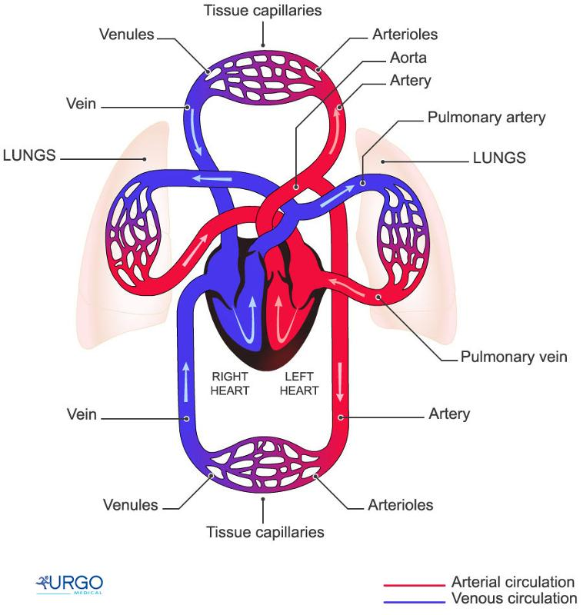

Slide 4
The 3 major structures of the Cardio-Vasc-Syst are:
HEART
BLOOD
BLOOD VESSELS

Slide 5
The Function
The heart pumps the blood in order to move nutrients through the blood vessels to nourish and remove the metabolic wastes from the body

Slide 6
1- The Heart
It Is a muscular organ
It contains 4 hollow chambers:
2 Atria (upper) / 2Ventricles (lower)
It is made of 3 layers tissue
-Endocardium,
- Myocardium &
- Pericardium

Slide 7
2- BLOOD VESSELS
ARTERIES
Arterial capillaries drop off oxygen and nutriments to the body’s cells
VEINS
Venous capillaries pick up metabolic waste from the body’s cells

Slide 8
3-BLOOD
Is a fluid / liquid (plasma)
Contains many different substances
3 main blood’s substances
- Red blood cells (Erythrocytes)
- White blood cells (leukocytes)
- Platelets (thrombocytes)

Slide 9
CHEST PAIN
Chest pain | Douleur thoracique/douleur à la poitrine
Crushing / Squeezing pain | Douleur écrasante
Knife-like / stabbing pain | Douleur perçante / lancinante
Constricting pain | Douleur en étau / oppressante / angoissante
Heavy pain / heaviness | Douleur forte / intense / une lourdeur
Burning pain | Sensation de brûlure
Nagging pain | Douleur continue / tenace / persistante
Stinging | Un picotement / piqûre de rappel

Slide 10
Associated Factors (Facteurs associés)
Feel sick / Get sick | Se sentir mal / tomber malade
Sweat | Sueurs / transpiration
Get palpitations | Avoir des palpitations
Get fainting sensation | Sensation de malaise / évanouissement
Have a temperature / fever | Température / fièvre
Spit blood sputum | Crachat de sang
Get short of breath | Avoir le souffle court / être essoufflé
Nauseas / vomiting - emesis | Nausées / vomissements

Slide 11
Relieving Factors (Facteurs de soulagement / calmants)
Rest | Le Repos
Position (sitting, bending forward) | La position (assise, penchée en avant)
Medication | Les médicaments
Check heart rate (HR) & respiratory rate (RR) | Vérifier le rythme/fréquence cardiaque et respiratoire
Check blood pressure (BP) | vérifier ou mesurer la tension artérielle

Slide 12
Exacerbating Factors ( Facteurs aggravants /exacerbants
Exercise | L’effort
Walking | La marche
Stress | Les émotions / stress
Eating | Trop manger
Coughing | La toux

Slide 13
The way of giving advice
In order to give advice to your patient you may use some modals such in these sentences:
You should avoid saturated fat
You have to loose weight
You had better eat small portions
You ought to practice a physical activity / sport
You must stop smoking

Slide 14
References
http://humananatomybody.info/neck-arteries-model-labeled/
www.youtube.com/watch?v=_lgd03h3te8

