Slide 1
Software Development Life Cycle
SDLC

Slide 2
Introduction
Software development …
has become more and more crucial, since the demand for software is fast rising. Almost every machine that we use can be a by-product of some software empowering it.
Software can either be …
“off-the-shelf (e.g. Microsoft Word) or tailor-made for a particular application (e.g. software for the Apollo moon shots). The latter is sometimes called bespoke software.”
Bell, D. (2005). Software engineering for students: a programming approach. Pearson Education.

Slide 3
It is agreed that software development is a highly intelligent and precise process, involving various steps to make it successful.
Generally speaking, any software process must include the following steps :
Software Specification (Requirements Engineering)
Software Design and Implementation
Software Verification and Validation
Software Maintenance and Evolution

Slide 4
Software Specification
The process of understanding and defining what services are required and identifying the constraints on these services.
It ensures software will meet the user’s expectations.
It’s a critical stage of the software process as errors at this stage will reflect later on the next stages.
At the end of this stage, a requirements document that specifies the requirements will be produced and validated with the stakeholders.

Slide 5
Software Design and Implementation
A software design is a description of the structure of the software to be implemented, data models, interfaces between system components, and maybe the algorithms used.
The implementation phase is the process of converting a system specification into an executable system.

Slide 6
Software Verification and Validation
Software V&V is intended to show that a system both conforms to its specification and that it meets the expectations of the customer.
Validation may also involve checking processes, such as inspections or reviews at each stage of the software process, from defining the requirements till the software development.
Testing, where the system is executed using simulated test data, is an important validation technique.

Slide 7
Software Maintenance and Evolution
Requirements are always changing, even after the system has been put into its operating environment.
Even after deployment, software systems may need to undergo changes, to ﬁx problems or improve the system.
Software maintenance can be adaptive, corrective, perfective, or preventive.
It’s hard to design a maintainable system, because it’s hard to foresee all future change
Evolution is intrinsic to the nature of software development.

Slide 8
SDLC is …
a process used by the software industry to design, develop and test high quality software.
a methodology for improving the quality of software and the overall development process.
SDLC aims for …
the production of high quality software that meet customer’s expectations and reaches completion within times and cost estimates.
SDLC Models …
Some of the most important and popular SDLC models followed in the industry are:
Waterfall Model, Iterative Model, Spiral Model, V-Model, Agile Model, RAD Model.
Each model follows a series of steps unique to its type to ensure success in the process of software development.

Slide 9
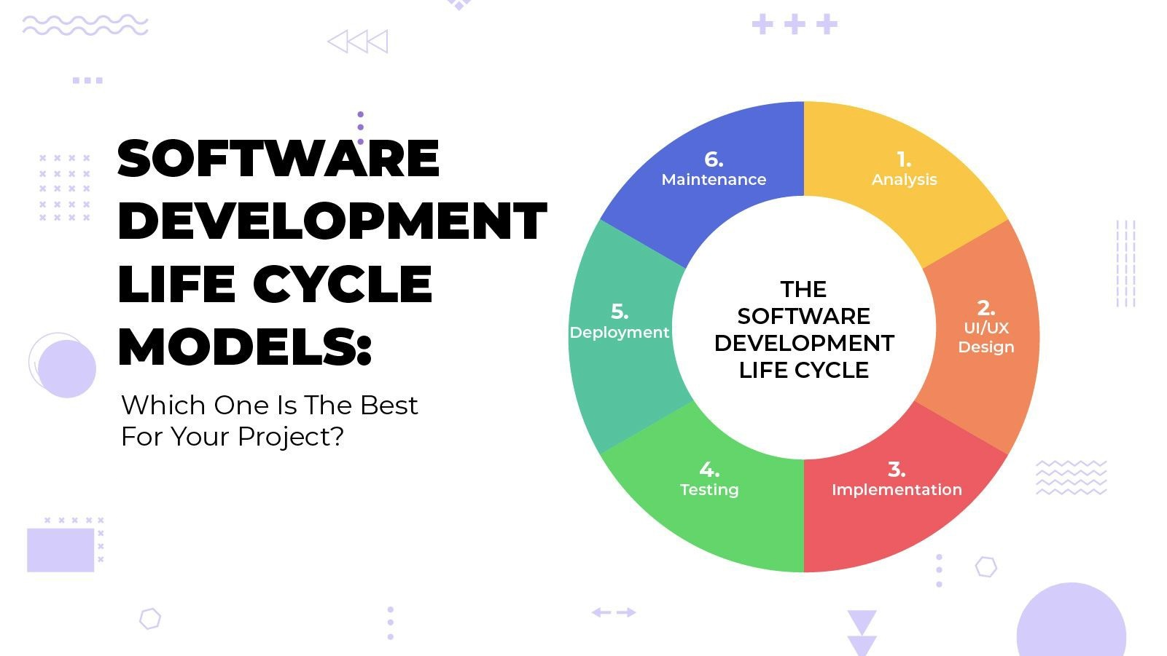
Homework II
There exist six (6) basic and widely known SDLC frameworks (methodologies).
In an essay:
State which of them you consider to be the best and why.
Describe the steps of the SDLC you have chosen

Slide 10
For further reading, please refer to
Bell, D. (2005). Software engineering for students: a programming approach.
You can find this book in PDF in the “Support de Cours” Folder

