Slide 1
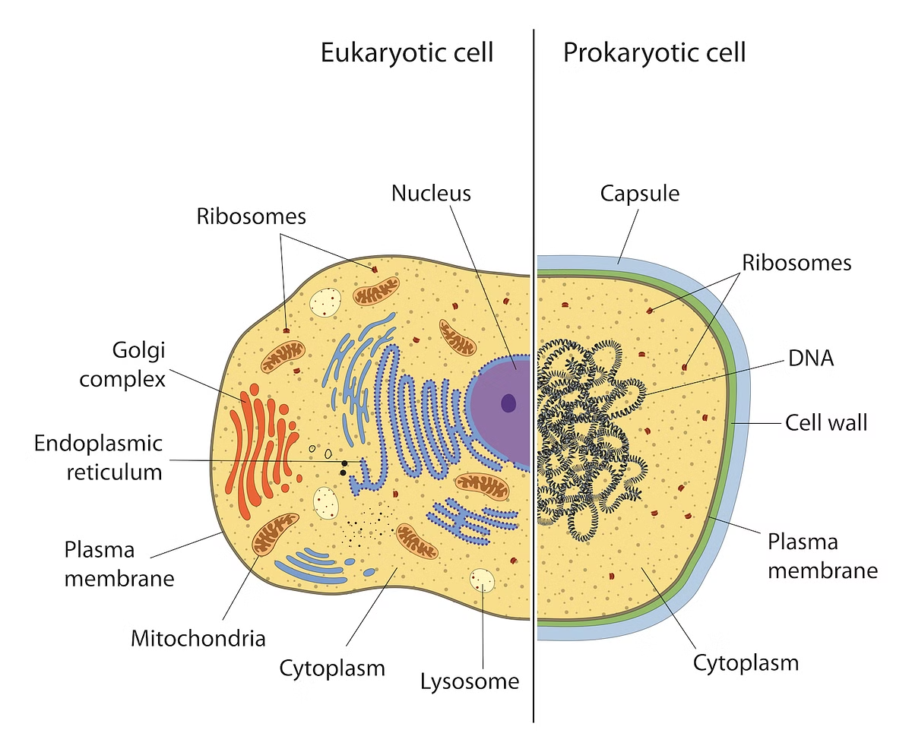
Eukaryotic Cell Structure and Functions
Eukaryotic cells are the building blocks of complex organisms, including plants, animals, and fungi. These cells possess a well-defined nucleus that houses the genetic material, as well as a variety of specialized organelles that work together to maintain the cell's structure and carry out essential functions. Understanding the intricate details of eukaryotic cell structure and how these components interact is crucial for understanding the fundamental principles of biology and the processes that sustain life.
by Mouderas F.
by Mouderas F.

Slide 2
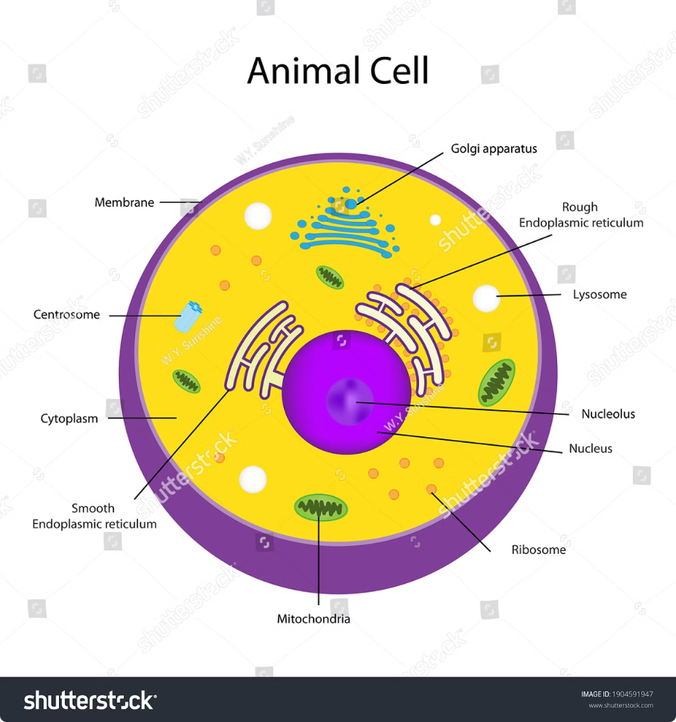
by Mouderas F.
Nucleus: The Command Center
Genetic Material
Cellular Regulation
The nucleus is the control center of the eukaryotic cell, housing the genetic material in the form of DNA. This genetic information is organized into chromosomes and encodes the instructions for all cellular activities and functions.
The nucleus also regulates gene expression, controlling which genes are turned on or off at any given time. This allows the cell to adapt to changing environmental conditions and coordinate its activities.
Cell Division
During cell division, the genetic material in the nucleus is faithfully replicated and distributed to the newly formed daughter cells, ensuring the continued propagation of the organism's genetic information.

Slide 3
Cytoplasm: The Bustling Interior
Cytosol
Cytoskeleton
Chemical Reactions
The cytoplasm, which is the jelly-like substance that fills the cell, is composed of the cytosol - a complex mixture of water, dissolved ions, and a variety of organic molecules that facilitate various cellular processes.
The cytoplasm also contains a network of filaments and tubules known as the cytoskeleton, which provides structural support, allows for the movement of organelles and vesicles, and plays a crucial role in cell division.
The cytoplasm is the site of many essential chemical reactions, such as metabolism, energy production, and the synthesis of various biomolecules, all of which are necessary for the cell's survival and function.

Slide 4
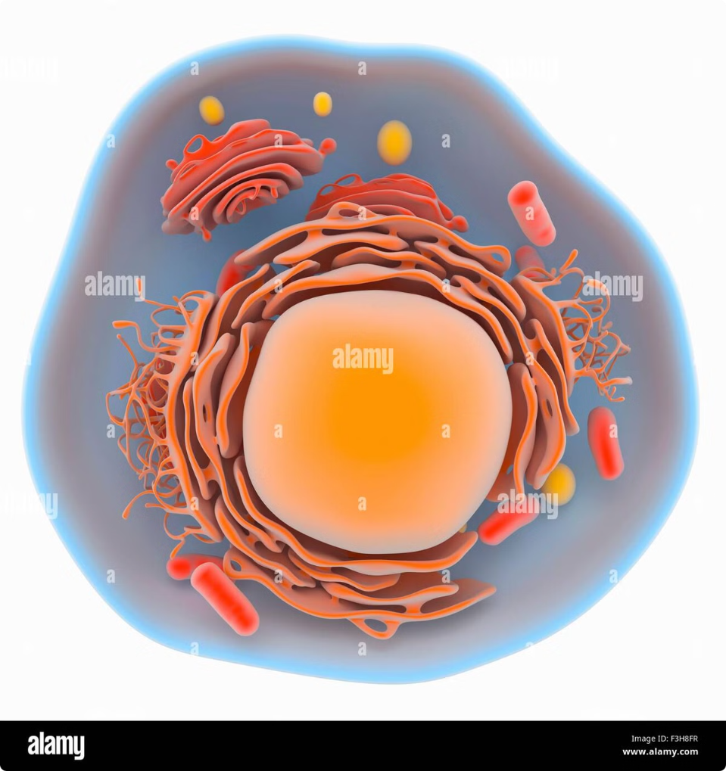
Organelles: Specialized Cellular Components
1
Mitochondria
The powerhouses of the cell, mitochondria are responsible for generating the majority of the cell's energy in the form of ATP through a process called cellular respiration.
2
Endoplasmic Reticulum
The endoplasmic reticulum (ER) is a network of tubules and sacs that play a crucial role in the synthesis, folding, and modification of proteins.
3
Golgi Apparatus
The Golgi apparatus is responsible for the processing, packaging, and distribution of proteins and other biomolecules produced by the cell, ensuring they reach their intended destinations.

Slide 5
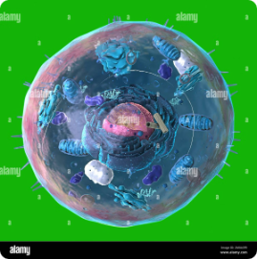
Cell Membrane: Controlling Cell Boundaries
Transport Proteins
Cell Receptors
Cell Signaling
The cell membrane is studded with specialized transport proteins that regulate the movement of materials, such as nutrients, waste products, and signaling molecules, in and out of the cell.
The cell membrane also contains receptor proteins that allow the cell to respond to external stimuli, such as hormones or growth factors, and coordinate its activities with other cells.
The cell membrane is a key player in cell signaling, as it facilitates the transmission of information between the cell and its external environment, enabling the coordination of cellular processes.

Slide 6
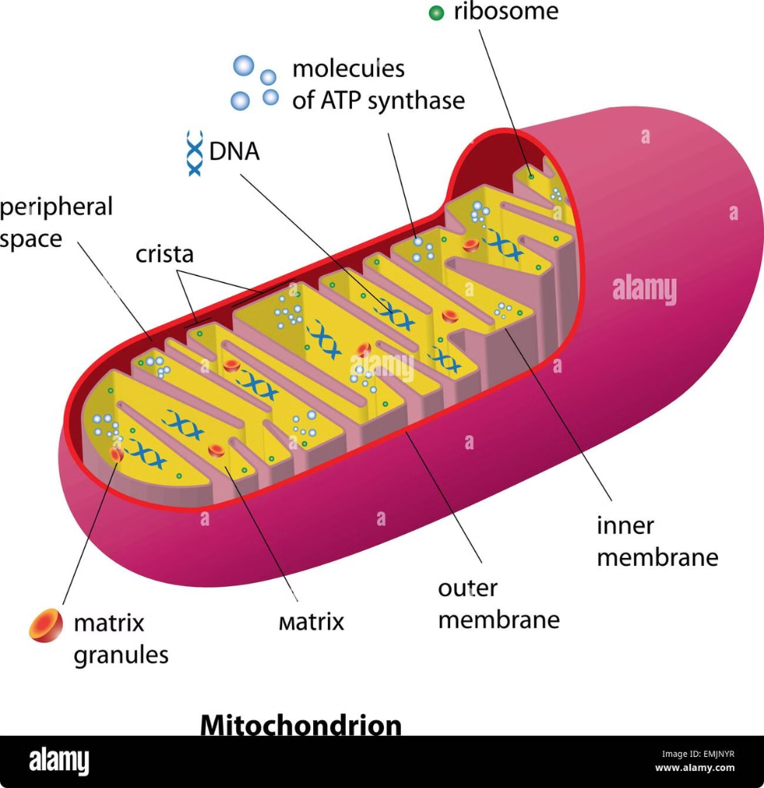
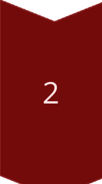
Mitochondria: The Power Plants
Energy Production
Mitochondria are the primary sites of ATP synthesis, the energy currency of the cell, through a process called oxidative phosphorylation.
Cellular Respiration
Mitochondria also play a central role in cellular respiration, the series of metabolic reactions that break down nutrients to release the energy needed for cellular processes.
Calcium Regulation
Mitochondria can also sequester and release calcium ions, which are essential for various cellular signaling pathways and processes.

Slide 7
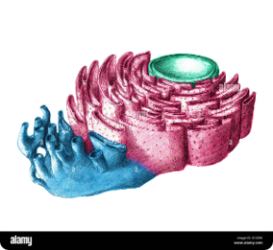
Endoplasmic Reticulum: Protein Production
1
Protein Synthesis
2
Protein Folding and Modification
3
Lipid Synthesis
The endoplasmic reticulum (ER) is the site of protein synthesis, where ribosomes attached to the ER membrane translate mRNA into polypeptide chains.
In addition to protein synthesis, the ER is also involved in the production of lipids, such as phospholipids, which are essential components of cell membranes.
The ER also plays a crucial role in the folding and post-translational modification of newly synthesized proteins, ensuring they adopt their correct three-dimensional structures.

Slide 8
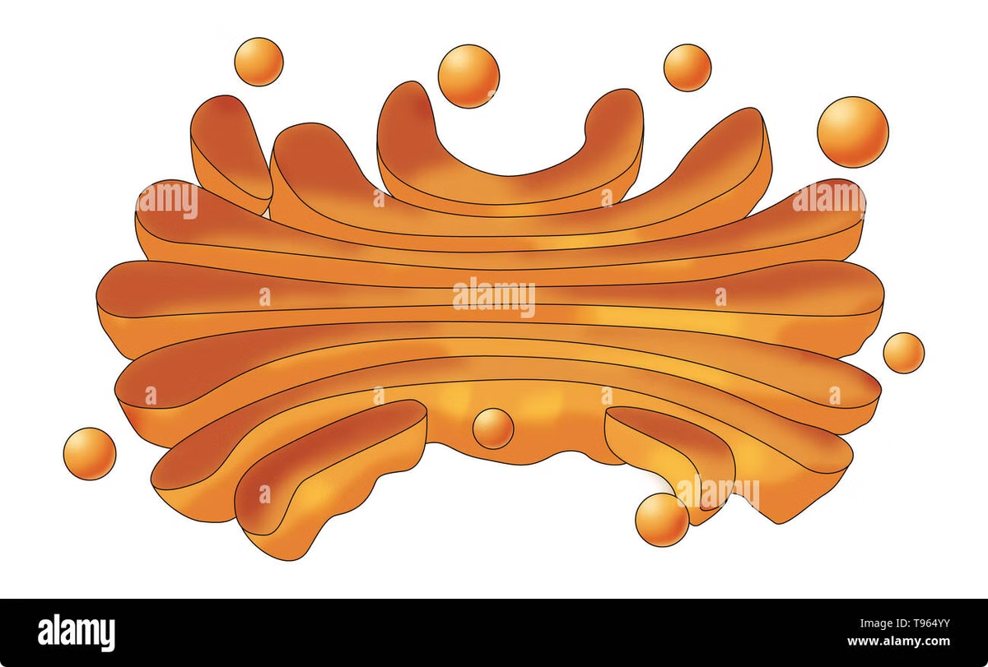
Golgi Apparatus: Packaging and Processing
Protein Modification
The Golgi apparatus further modifies proteins by adding or removing chemical groups, such as carbohydrates, to create the final, functional form of the protein.
Vesicle Formation
The Golgi apparatus packages proteins and other cellular products into membrane-bound vesicles, which are then transported to their final destinations within the cell or secreted from the cell.
Lipid Synthesis
The Golgi apparatus also plays a role in the synthesis and transport of lipids, such as sphingolipids and glycolipids, which are important components of cell membranes.

Slide 9
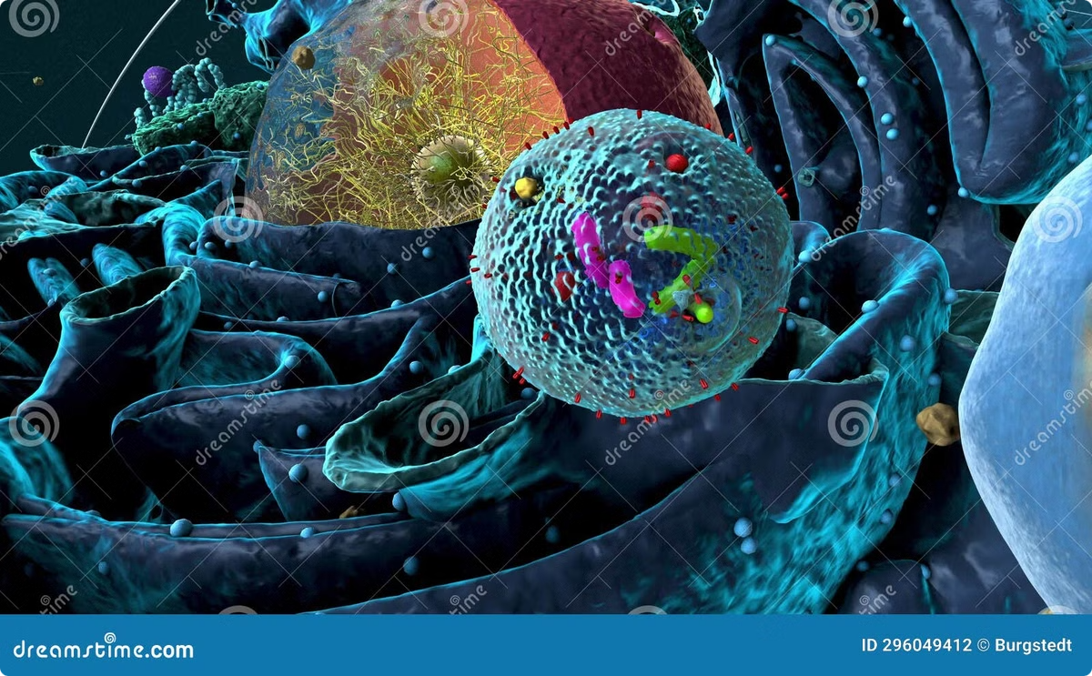
Lysosomes: The Cellular Recyclers
Degradation and Recycling
Cellular Digestion
Lysosomes play a crucial role in the process of cellular digestion, breaking down materials from both the cell's internal and external environments, and recycling the resulting building blocks for the cell's use.
Lysosomes are specialized organelles that contain a variety of hydrolytic enzymes capable of breaking down a wide range of biomolecules, including proteins, nucleic acids, and polysaccharides.
Apoptosis
Lysosomes are also involved in the process of programmed cell death, or apoptosis, by releasing their digestive enzymes and triggering the self-destruction of the cell.

Slide 10
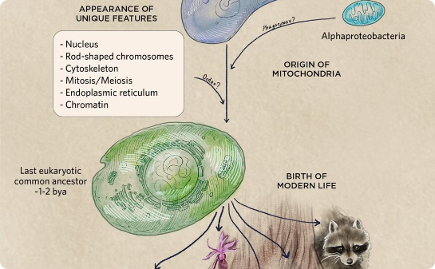
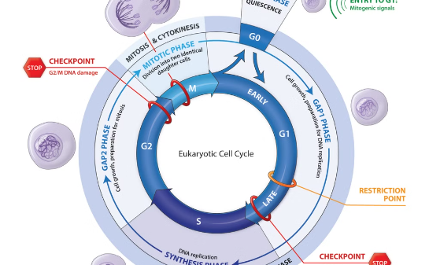
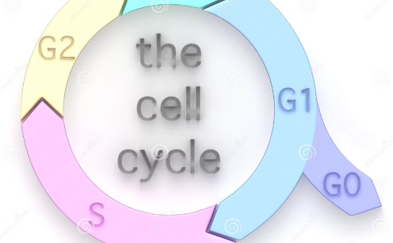
Cellular Processes and Homeostasis
Metabolism
Cell Signaling
Cell Division
Eukaryotic cells engage in a variety of metabolic processes, such as cellular respiration, photosynthesis (in plants), and the synthesis of essential biomolecules, all of which are necessary for the cell's survival and growth.
Eukaryotic cells use complex signaling pathways to communicate with their environment and coordinate their activities, allowing them to respond to changes and maintain homeostasis within the organism.
The orderly division of eukaryotic cells, through processes like mitosis and meiosis, is essential for growth, repair, and the propagation of genetic information to the next generation of cells and organisms.

