Slide 1
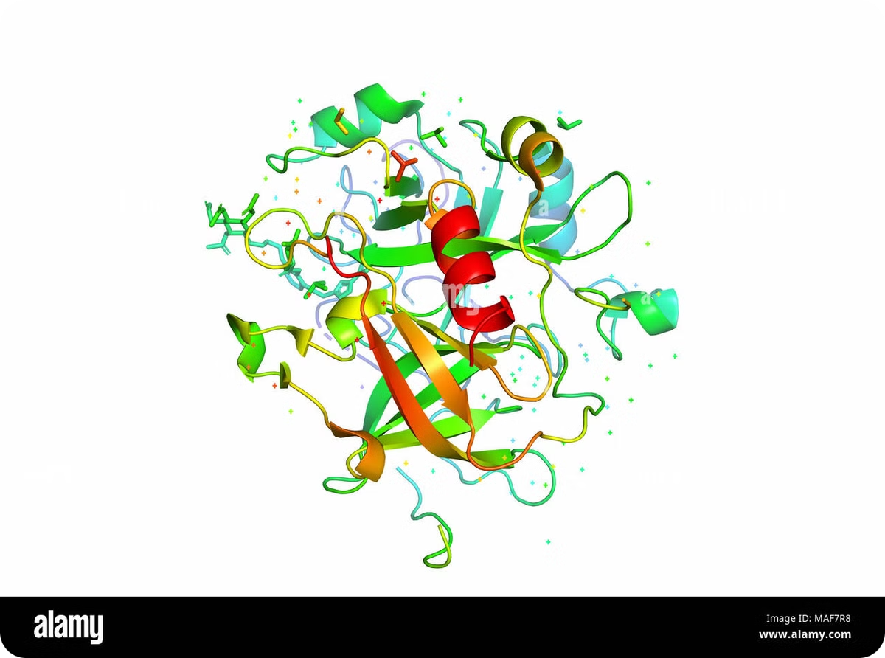
Protein Synthesis:
Protein synthesis is a fundamental biological process that lies at the heart of life itself. It is the intricate mechanism by which cells create proteins, the essential macromolecules that perform a vast array of functions in living organisms. From structural support to enzymatic catalysis, from cellular signaling to immune responses, proteins are the workhorses of biological systems.
This complex process involves decoding the genetic information stored in DNA, transcribing it into messenger RNA, and finally translating that information into the specific sequence of amino acids that form a protein. Understanding protein synthesis is crucial for comprehending how genetic information is expressed and how cells maintain their function and structure.
By Mouderas F.

Slide 2
Introduction to Proteins
Structure
Function
Importance
Proteins are large, complex molecules composed of amino acid chains. These chains fold into intricate three-dimensional structures, determining the protein's function. From the simple primary structure of amino acid sequences to the complex quaternary structures of multi-subunit proteins, each level of organization plays a crucial role in protein functionality.
The diversity of protein functions is astounding. They act as enzymes catalyzing biochemical reactions, form structural components like collagen, transport molecules like hemoglobin, and participate in cell signaling as hormones. This versatility makes proteins indispensable for life.
Understanding proteins is key to comprehending cellular processes, disease mechanisms, and developing new therapies. Protein synthesis, the process by which these molecules are created, is therefore a cornerstone of molecular biology and medicine.

Slide 3
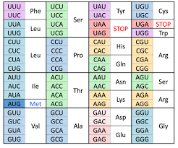
The Genetic Code
1
Discovery
The genetic code, deciphered in the 1960s, revolutionized our understanding of how genetic information is stored and translated into proteins. This breakthrough allowed scientists to understand the link between DNA sequences and amino acid chains in proteins.
2
Structure
The code consists of 64 three-letter combinations of nucleotides called codons. Each codon specifies either an amino acid or a stop signal in protein synthesis. This universal language of life is shared by almost all organisms, from bacteria to humans.
3
Degeneracy
An intriguing feature of the genetic code is its degeneracy. Multiple codons can code for the same amino acid, providing a level of redundancy that helps protect against the potentially harmful effects of mutations.

Slide 4
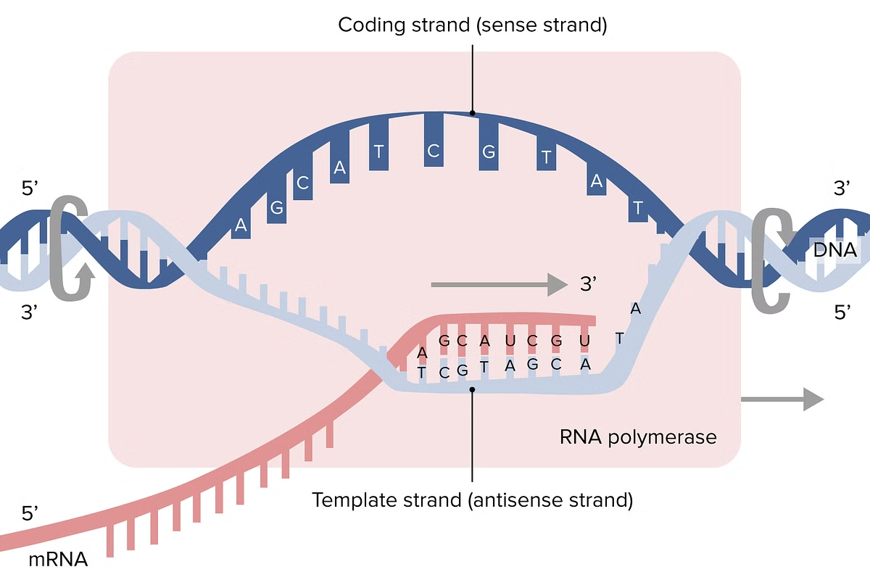
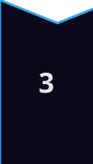
Transcription: From DNA to mRNA
Initiation
Transcription begins when RNA polymerase binds to a specific DNA sequence called the promoter. This enzyme, along with various transcription factors, unwinds the DNA double helix, exposing the template strand for RNA synthesis.
Elongation
As RNA polymerase moves along the DNA, it adds complementary RNA nucleotides to the growing mRNA strand. This process continues, creating a single-stranded mRNA molecule that is complementary to the DNA template strand.
Termination
The transcription process ends when RNA polymerase encounters a termination sequence. The newly synthesized mRNA is then released, ready for further processing before it can be translated into a protein.

Slide 5
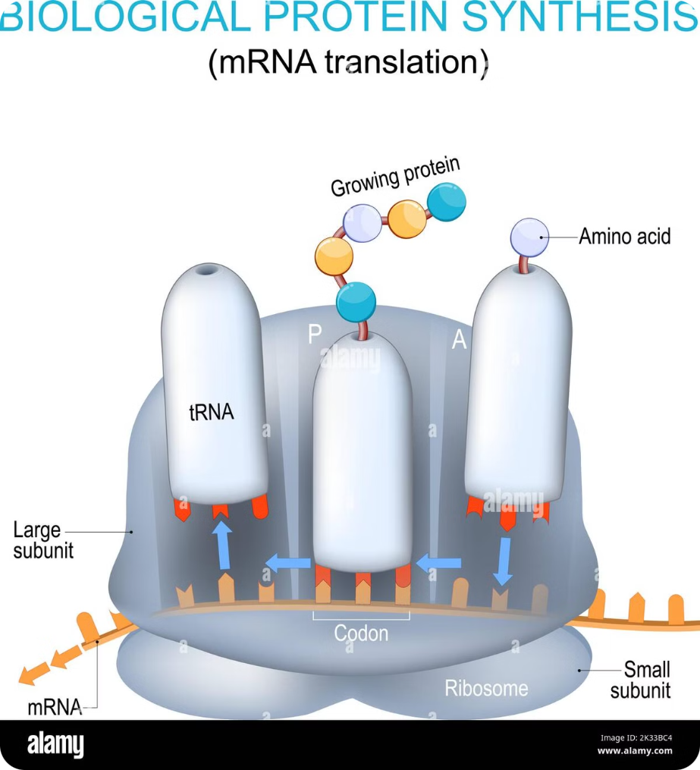
Translation: From mRNA to Proteins
1
Initiation
Translation begins when a ribosome binds to the mRNA at the start codon (usually AUG). The initiator tRNA, carrying the amino acid methionine, attaches to this codon, setting the stage for protein synthesis.
2
Elongation
The ribosome moves along the mRNA, reading each codon and matching it with the appropriate tRNA carrying the corresponding amino acid. These amino acids are linked together, forming the growing polypeptide chain.
3
Termination
When the ribosome encounters a stop codon, the completed polypeptide chain is released. This newly synthesized protein will then undergo folding and possible modifications to become fully functional.

Slide 6
The Role of Ribosomes
Structure
Function
Ribosomes are complex molecular machines composed of both RNA and proteins. They consist of two subunits - a large and a small subunit - that come together during translation to form the complete ribosome.
The primary function of ribosomes is to synthesize proteins by translating the genetic code carried by mRNA. They act as a workbench where amino acids are assembled into polypeptide chains according to the mRNA sequence.
Catalytic Activity
Regulation
Ribosomes are ribozymes, meaning their catalytic activity comes from RNA, not protein. The peptidyl transferase activity, which forms peptide bonds between amino acids, is carried out by ribosomal RNA.
Ribosome assembly and activity are tightly regulated processes. This regulation ensures that protein synthesis occurs at the right time and place within the cell, contributing to overall cellular homeostasis.

Slide 7
The Process of Protein Folding
1
Primary Structure
The linear sequence of amino acids, determined by the genetic code, forms the primary structure of a protein. This sequence contains all the information necessary for the protein to fold into its final, functional shape.
2
Secondary Structure
Local interactions between amino acids lead to the formation of secondary structures such as alpha helices and beta sheets. These structures are stabilized by hydrogen bonds between the amino acid backbones.
3
Tertiary Structure
The overall three-dimensional shape of the protein, or its tertiary structure, is formed as the protein continues to fold. This structure is stabilized by various interactions including hydrophobic effects, salt bridges, and disulfide bonds.
4
Quaternary Structure
Some proteins consist of multiple polypeptide chains that come together to form a functional unit. This arrangement of multiple folded protein subunits is called the quaternary structure.

Slide 8
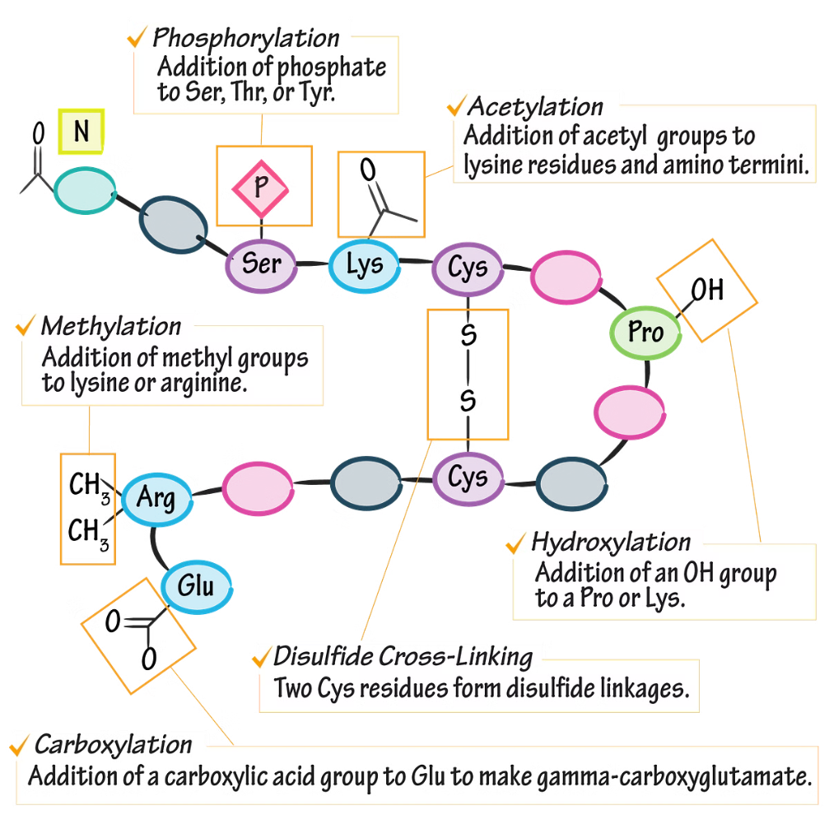
Post-Translational Modifications
Phosphorylation
Glycosylation
The addition of a phosphate group to specific amino acids, often used in cell signaling and regulation of protein activity.
The attachment of sugar molecules to proteins, crucial for protein folding, stability, and cell-cell recognition.
Ubiquitination
Methylation
The addition of ubiquitin molecules, often signaling proteins for degradation or altering their cellular location.
The addition of methyl groups, important in regulating gene expression and protein function.

Slide 9
Protein Transport and Localization
Signal Sequences
Membrane Transport
Nuclear Transport
Many proteins contain specific amino acid sequences that act as "address tags," directing them to their correct cellular locations. These signal sequences are recognized by transport machinery within the cell, ensuring proper protein distribution.
Proteins destined for secretion or insertion into cellular membranes are transported through the endoplasmic reticulum and Golgi apparatus. This process involves complex sorting mechanisms and vesicular transport systems.
Proteins that function in the nucleus, such as transcription factors, must be transported through nuclear pores. This process is tightly regulated and often involves specific nuclear localization signals within the protein sequence.

Slide 10
Protein Degradation and Recycling
1
Ubiquitin-Proteasome System
2
Lysosomal Degradation
This is the primary mechanism for protein degradation in eukaryotic cells. Proteins targeted for degradation are tagged with ubiquitin molecules and then broken down by the proteasome, a large protein complex that acts like a cellular garbage disposal.
Some proteins, especially those taken up from outside the cell or those in membrane-bound organelles, are degraded in lysosomes. These organelles contain a variety of hydrolytic enzymes that break down proteins into their constituent amino acids.
3
Autophagy
4
Amino Acid Recycling
This process involves the degradation of cellular components, including proteins, by the lysosome. It's crucial for recycling cellular materials and maintaining cellular health, especially during times of stress or nutrient deprivation.
The amino acids resulting from protein degradation are not wasted. They can be reused to synthesize new proteins or converted into other molecules, ensuring efficient use of cellular resources.

