Slide 1
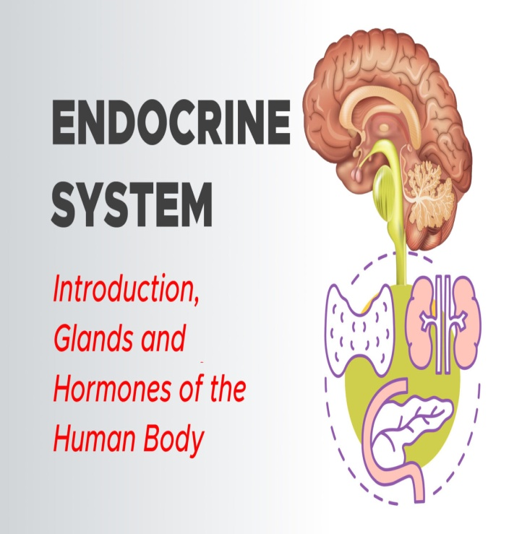
THE ENDOCRINE SYSTEM
A chapter on Endocrine System
Diabetes mellitus
History
Thyroid gland
Other endocrine conditions
Hypothalamus- pituitary axis
-Thyroid gland/ Parathyroid glands
-Investigations

Slide 2
The main objectif
We are going to learn about a body system that is all about communication (i.e, it helps the body communicate signals). The one which is called the ENDOCRINE SYSTEM​

Slide 3
Introduction
What is the endocrine system ?
What are hormones ? What do they do ?
What are the major glands found in humans and what do they regulate ?

Slide 4
DEFINITIONS
The Endocrine system (along with the nervous system) controls and regulates the complex activities of the body. It regulates the activities of the body by secreting complex chemical substances (hormones) into the bloodstream. These secretions come from a variety of glands which control various organs of the body. ​
The Endocrine system helps carry messages throughout your body to tell it what to do.
It’s a giant mail system

Slide 5
The key functions of the endocrine system are:​
To regulate the metabolic functions of the body.​
To regulate the rate of chemical reactions in various cells.​
To influence the ability of substances to transport themselves through cell membranes.​

Slide 6
How it works?
The hormones are secreted by the endocrine glands into the blood
The hormones are carried through the bloodstream to a specific place (an organ or a receptor)
Special instructions ,then are given to the body such as cell division and growth, acid secretion…

Slide 7
Comparison
Endocrine system
Mail system
The endocrine gland
The bloodstream
Reception of hormones (organ or receptor)
Doing what the hormone suggets to do
The letter in the mailbox
The mail carrier
Reception of the mail (letter/message)
Reading the message / Reaction

Slide 8
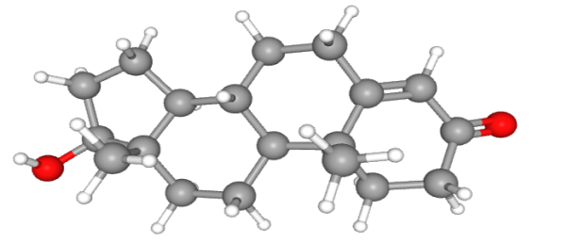
Hormones & Glands
1- Hormones : are endogenous messengers secreted from the glands of the endocrine system, they are specific in that, each hormone causes a response in a specific target organ or group of cells rather than on the body as a whole.
Exocrine hormones are secreted via a duct into the blood and usually effect a distant organ or tissue.
Endocrine hormones are secreted within the tissue (rather than via a duct) and enter the blood stream via capillaries.

Slide 9
2- Glands: discharge hormones directly into the bloodstream. They have built in feedback mechanisms that maintain a proper balance of hormones, and prevent excess hormone secretion.

Slide 10
The major endocrine glands
Pituitary gland: regulates other endocrine glands (master gland); secretes growth hormone
Thyroid: regulates metabolic rate
Thymus: assists in development of immune system
Adrenal gland: small caps perched on top of each kidney. The Adrenal is actually a combination of two glands the adrenal cortex and the adrenal medulla

Slide 11
The gonads consist of ovaries in the female and testes in the male. These glands produce hormones important in the development and functioning of the reproductive organs. they are under the control of the pituitary gland, and produce the secondary sexual traits.
The pancreas (Pancreatic islets): helps regulate blood sugar
Pineal gland: believed to regulate biorhythms and moods and stimulate the onset of puberty

Slide 12
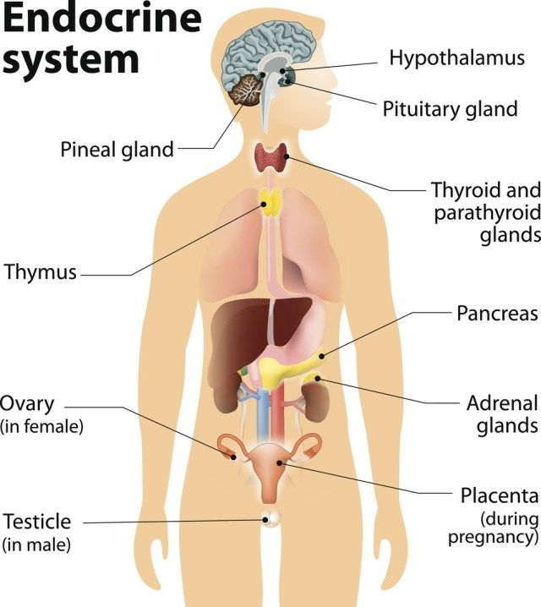

Slide 13
References
https://www.epa.gov/endocrine-disruption/overview-endocrine-system
Fox, Stuart Ira. Human Physiology. Seventh Edition. New York, NY: McGraw Hill, 2002.
U.S. Department of Health and Human Services, The National Women's Health Information Center (NWHIC), Office on Women's Health, GirlsHealth.gov, Body – Becoming a Woman, Learn about your whole body – from your heart to your bones," March 2006.
U.S. National Cancer Institute's Surveillance, Epidemiology and End Results (SEER) Program, "Introduction to the Endocrine System."
U.S. National Library of Medicine, Genetics Home Reference,
"Growth Hormone,“ May 30, 2006. ghr.nlm.nih.gov Accessed May 31,
2006
https://surgmedia.com/endocrine-system-1-glands-hormones/

