Slide 1
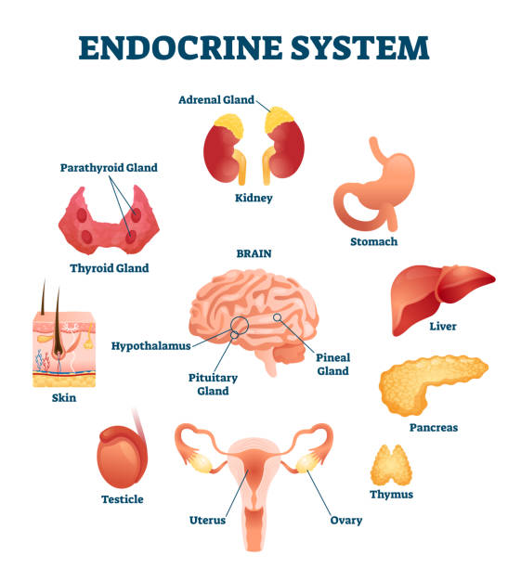
THE ENDOCRINE DISORDERS
Causes, Risk factors & Investigations

Slide 2
What are endocrine disorders?
Your endocrine glands are responsible for making the hormones your body needs and regulating how they work.
These glands include your thyroid gland, pituitary gland and adrenal glands.
Endocrine disorders happen when your endocrine glands produce too many – or not enough – of the hormones that keep your body functioning correctly.
Hormonal imbalance can lead to various endocrine disorders.

Slide 3
Some Types of Endocrine Disorders
Adrenal Insufficiency : the body's adrenal glands produce too little cortisol and aldosterone.
Diabetes: A chronic condition when the pancreas fails to produce adequate insulin to regulate blood glucose levels.
Hyperthyroidism: An immune system disorder that affects the production of thyroid hormones.
Hypothyroidism: A condition that causes an underactive thyroid gland.

Slide 4
Causes of Endocrine Disorders
There are various causes of endocrine disorders.
Hormonal Imbalance: Too much or too little hormone production from the glands leads to a hormonal imbalance.
Infection or Disease: A benign growth in any gland.
Genetic Disorder: A genetic factor that stops the cells from properly functioning.

Slide 5
Risk Factors Associated with Endocrine Disorder
Endocrine disorders, if untreated, can lead to life-threatening conditions. The patient must receive immediate medical attention if the symptoms persist for more than three days. Some of the risk factors associated with endocrine disorders include:
A low heart rate may lead to heart failure
Fatigue
Myopathy (weakening of muscle fibers leading to neuromuscular disorder)
Encephalopathy (an acute confusional state and delirium.)
Coma
Paralysis
Stroke

Slide 6
Investigations
1- What is an endocrine test?
An endocrinologist uses diagnostic tests for various reasons:
To find out the levels of various hormones in a patient's body.
To check if the endocrine glands are working correctly.
To identify the cause of an endocrinological problem
To confirm an earlier diagnosis

Slide 7
2- Some Types of Endocrine Tests
A- Cortisol Blood Test: The hormone cortisol helps your body handle physical stress from illness, injury or another cause
B- Thyroid Gland Tests: We use thyroid gland tests to check for thyroid disorders such as hypothyroidism or hyperthyroidism. Primarily a thyroid stimulating hormone (TSH) assessment, can show how well your thyroid is working
C- Tests to detect diabetes: include the blood glucose test and the glycosylated hemoglobin test (A1c).

Slide 8
Prevention of Endocrine Disorders
There are several ways to maintain a healthy endocrine system.
Nutrition: What and when you eat matters. Try to eat healthy food at regular times and avoid late-night snacks and junk food.
Exercise: A healthy body can help you resist diseases; regular exercise can strengthen your body system and facilitate normal functioning.

Slide 9
Avoid Endocrine Disruptors: These chemicals interrupt the endocrine glands' normal functioning. Avoid packed and processed food that are the primary sources of endocrine disruptors.
Monitoring and Medical Assistance: regular check-ups and advice from an expert doctor can help you track the performance of your endocrine system and maintain its healthy functioning.

Slide 10
references
https://www.farnorthsurgery.com
https://www.southsydneymedicalspecialists.com.au/general-endocrine-conditions
https://www.mercy.net/service/endocrine-disorder-tests/
https://www.farnorthsurgery.com/blog/endocrine-disorders-causes-risk-factors-and-prevention
https://www.istockphoto.com/photos/endocrine-system

