Slide 1
Chapter 3
Shear

Slide 2
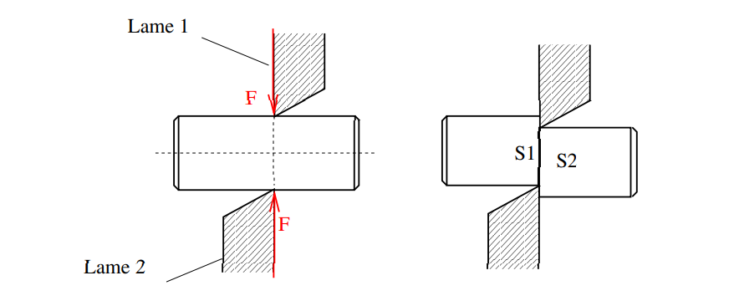
Example 1: Sheared workpiece
Blade 1
Blade 2
the shearing of the piece results in the sliding of the straight section S1 against the straight section S2 which is in direct contact with it.

Slide 3
1.Definition:
A beam is subjected to pure shear stress when the cohesive torsor at the centre of gravity of a section has the form
0 | 0
𝑇_{𝑦} | 0
𝑇_{𝑧} | 0
^{𝜏}𝑐𝑜ℎ ⁼

Slide 4
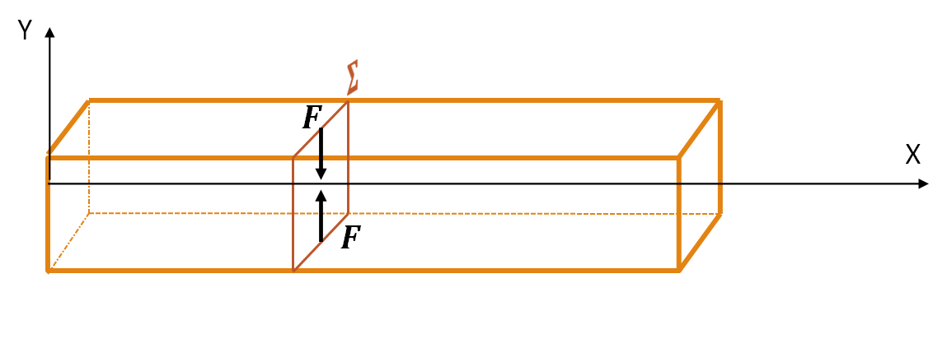
1.Definition :
Shear stress occurs when a beam is subjected to two equal and directly opposed forces whose support is in a plane perpendicular to the mean line.

Slide 5
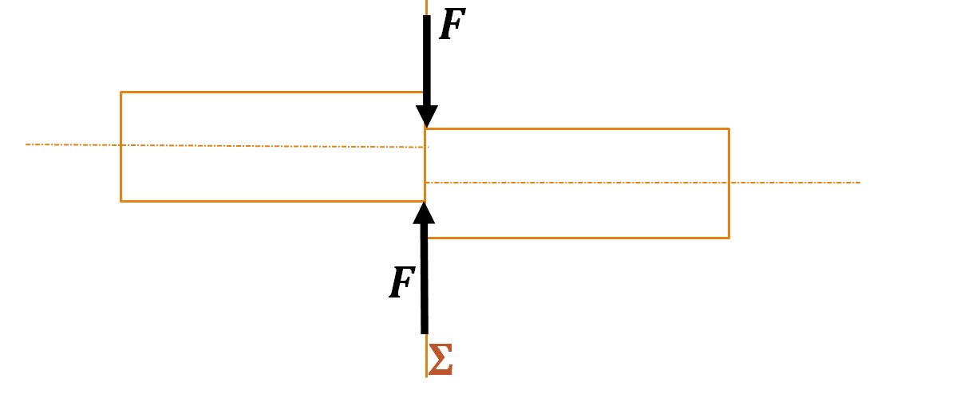
1.Definition :
Under the action of these two forces, the beam tends to separate into two parts sliding relative to each other in the plane of the straight section (Σ)

Slide 6
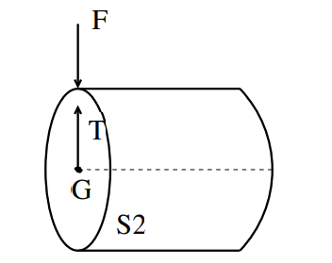
2.Shear force T
The only internal force is T (N = Mf = 0).According to the equilibrium T=F.

Slide 7
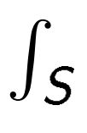
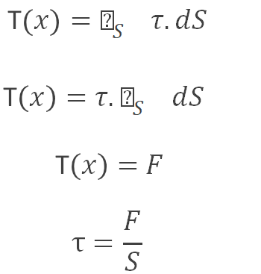
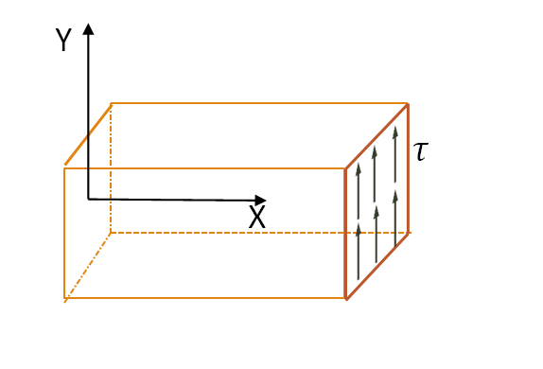
3.State of constraint
Each surface element 𝒅𝑺 supports a shear stress 𝝉 contained in the sheared section 𝑺 .

Slide 8
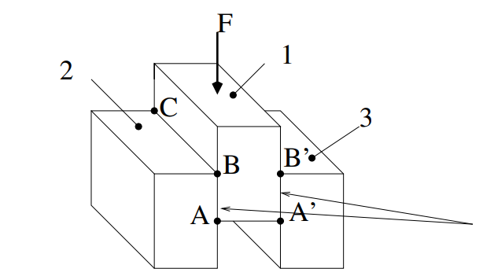
Example 2
Three identical blocks of wood (1), (2) and (3) are glued together. The assembly supports a load F along its axis of symmetry. The glued surfaces are ABCD and A'B'C'D'.
glued surfaces

Slide 9
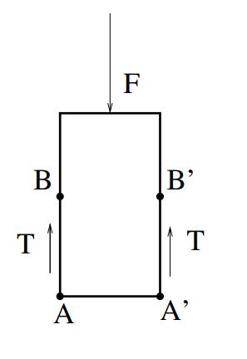
To calculate T, we isolate block (1) and study its equilibrium.
Note
A simple relationship can be deduced between the applied force F and T :
Where n is the number of sheared surfaces.

Slide 10
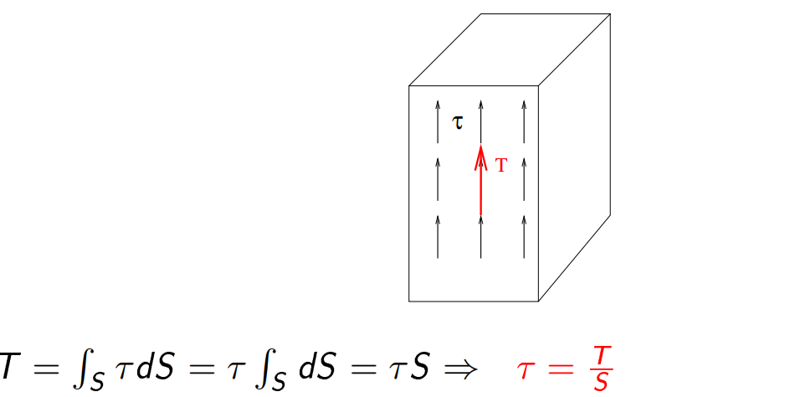
4.Shear stress τ
In shear, normal stresses are null. It is supposed that all tangential stresses are the same. In other words, there is a uniform stress distribution in the sheared section.

Slide 11
Example 2
Take example 2 with F=200 daN, AB=CD=3 cm, AD=BC=10 cm. Calculate τ in the glued joint.

Slide 12
Solution

Slide 13
5.Resistance condition
R_{ps}: practical resistance to sliding or shearing (permissible stress). R_{es}: elastic limit in shear. s: safety coefficient.
Example 3 Let's return to example 2.
If the admissible stress in the glued joint is 900 kPa, determine the maximum load F that can be supported
(Admissible stress)

Slide 14
Solution

Slide 15
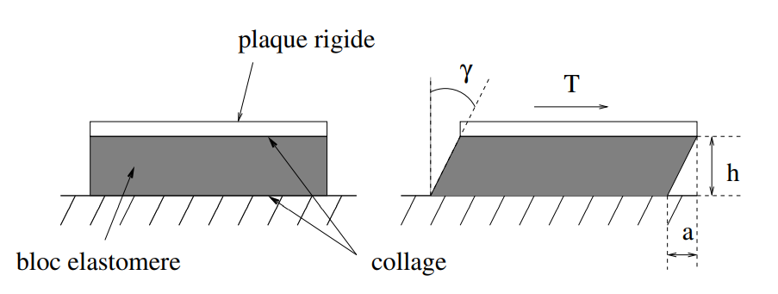
6. Deformation - Sliding angle γ
Rigid plate
Elestometer block
gluing
Deformation can be characterized by the angle γ, known as the angle of sliding angle.
if γ is small

Slide 16
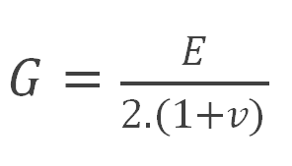
7.Relation between τ and γ
As in the case of tension, in the elastic domain, the relationship between τ and γ is linear.
τ = G.γ
γ: sliding angle (radian)
G: transverse modulus of elasticity (MPa)
Coulomb Modulus G
Where 𝜈 is the Poisson coefficient

Slide 17
Example 4
Let's take the example of the elastomer block (c × b × h) with c=50mm, b=100 mm and G=800 kPa. Determine γ if T=100 daN and h=25 mm. calculate a.

Slide 18
Solution

Slide 19
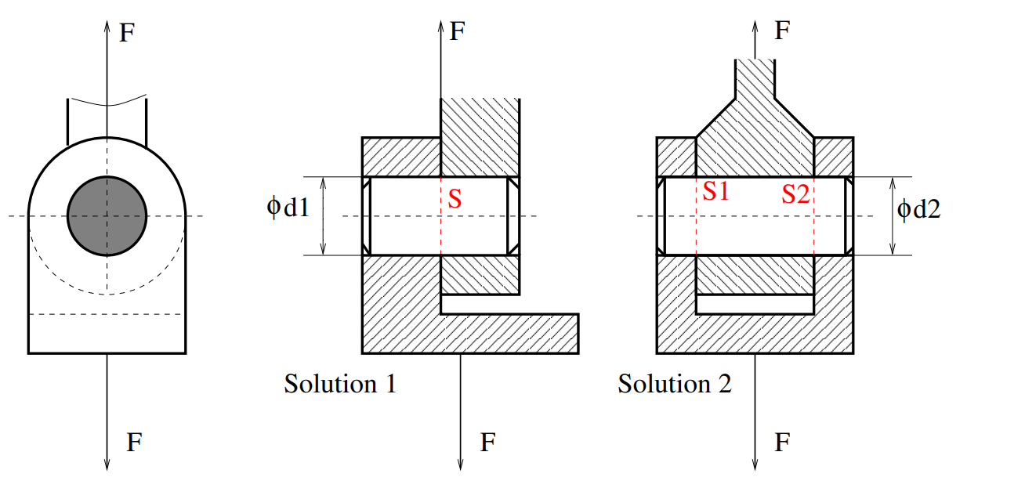
Example 5
F=10000 daN, the axes are made from the same steel with an admissible shear stress of 5 daN/mm2.

Slide 20
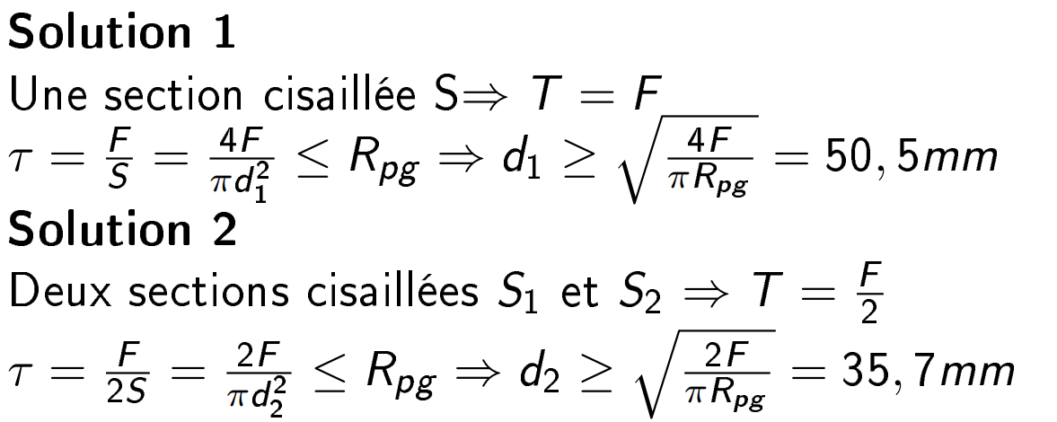
one sheared section
Two sheared section

Slide 21
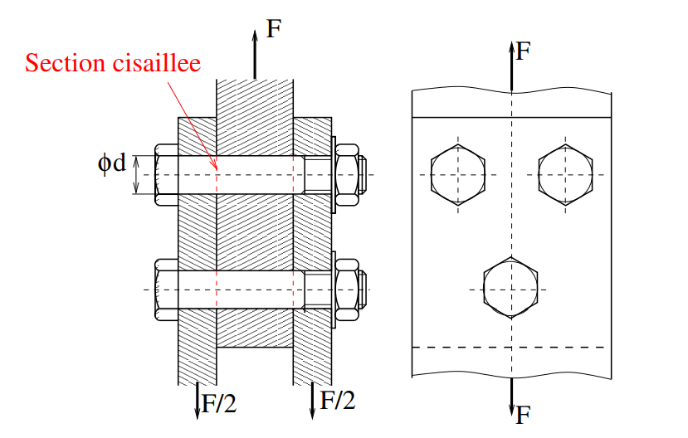
Example 6
For the above connection with three steel bolts, d= 12mm, the permissible shear stress is R_{ps} = 30 daN/mm2
Determining the admissible force

Slide 22
20358

