Slide 1
Tenses
Chapter II

Slide 2
Tenses are … ?
Tenses are represented by the changing forms of a verb that show the time, continuance or completion of an action.
There are three main tenses: the present, the past, and the future.
For each of the tenses, there are three aspects: simple, continuous or progressive, perfect.

Slide 3
The Time Frame
The present tense is used to refer to something that happens or exists now.
The past tense is used to refer to something that happened or existed in the past.
The future tense refers to something that hasn’t happened at the time of speaking.

Slide 4
The Aspects
The simple aspect is used to express a fact.
The continuous aspect indicates an ongoing, or progressive action.
The perfect aspect shows that an action has continued up to the present.

Slide 5
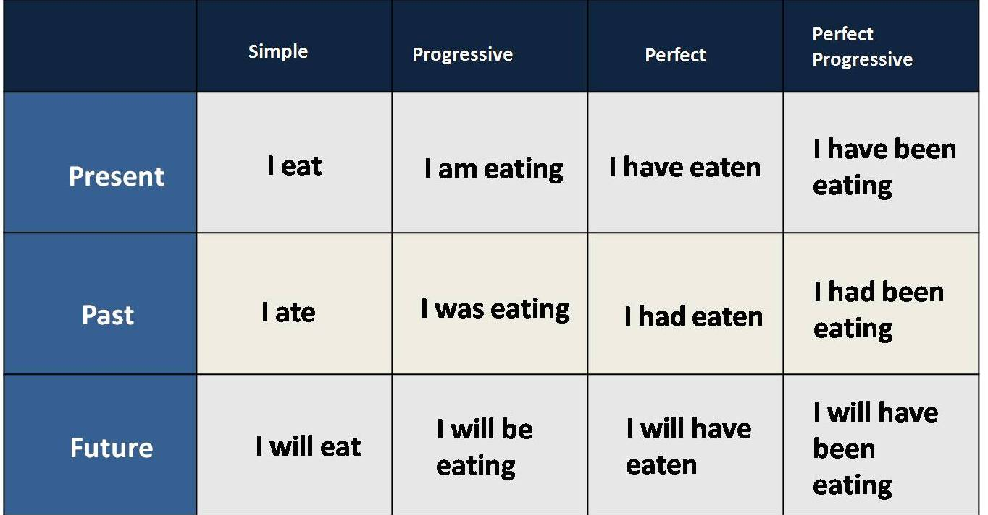
The Twelve English Tenses

Slide 6
Present Tense
Explanations | Present Simple | Form + Signal Words
Habitual action. Action that is repeated every particular time. | I always scan my USB flash drive. | Infinitive He/She/It + Verb Infinitive + S
Facts that are believed to be true. Generalizations | Cats hate mice. The sun rises in the morning. | Every (day/week/month), Sometimes, Always, Often, Usually, Rarely, Never, First, Then
Scheduled events in the near future | The plane takes off at 10 o'clock tonight.
Explanations | Present Progressive | Form + Signal Words
Ongoing action that takes place now / at the moment | I am working on my computer. | To be ‘present simple’ (am/are/is) + Verb ‘Infinitive’ + ing
Near future | I am meeting some friends tonight. | At the moment, Now (right now, just now), tomorrow.

Slide 7
Present Tense
Explanations | Present Perfect Simple | Form + Signal Words
To talk about experiences | I have been to Italy. | To have ‘present simple’ (have/has) + Verb ‘Past Participle’
Past action that has the result in the present. | She has finished the exercise. He has started. | Just, Yet, Never, Ever, Already, So far, Up to now, Recently, Since, For (a certain period of time)
Action which started in the past and continued up to now. | I have worked in this firm for nine years.

Slide 8
Exercise N°1:
She usually (to put) on black shoes, but now she (to wear) white trainers.
Microsoft Windows (to be) a very popular OS.
I (to repair) many computers when I was a teenager.
Put the verbs between brackets into the correct form.

Slide 9
Past Tense
Explanations | Past Simple | Form + Signal Words
Completed action in the past. | It started yesterday. She woke up, had a shower and went to work. | Regular : Verb ‘Infinitive’ + ed Irregular: 3rd column of the table of irregular verbs.
 |  | Yesterday, In (1990), (one week, two years ago) Ago, Last (week, month, year, decade),
An action taking place in the middle of another action. | She was writing when her computer crashed.

Slide 10
Past Tense
Explanations | Past Progressive | Form + Signal Words
Actions happening at the same time in the past. | He was reading a newspaper while his wife was preparing dinner. | To be ‘past simple’ (was/were) + Verb ‘Infinitive’ + ing
Interrupted action in the past. | While he was reading the newspaper, the light went off. | While
Explanations | Past Perfect Simple | Form + Signal Words
Completed action before another action in the past. | She had left when I arrived. I had already told her. | To have ‘past simple’ (had) + Verb ‘Past Participle’
 |  | Already, Just, Never

Slide 11
Exercise N°2:
When he (to create) the electric light-bulb, Thomas Edison (to be) only thirty-two years old. He (to invent) the phonograph two years earlier.
My computer (to crash) again, while I (to download) the files.
Put the verbs between brackets into the correct form.

Slide 12
Future Tense
Explanations | Future Simple | Form + Signal Words
Instant decisions | I've left the door open; I'll close it. | Will + Verb ‘Infinitive’
We use the simple future , when we predict a future situation | She'll pass the exam. She's hardworking.
We use the simple future with: ‘I (don't) think...’, ‘perhaps...’, ‘I am sure...’, ‘I wonder...’, "probably". | It will probably rain tonight. I am sure she will come. | In (a week, a year; 2040), Next (winter, holiday, year), Tomorrow,
Conditional sentence type one | If I have enough time, I'll watch the film.

Slide 13
Future Tense
Explanations | Future Progressive | Form + Signal Words
Action that will be taking place at some time in the future. | When you arrive, I'll be sleeping. I will be travelling around the world, next year. | Will + Be + Verb ‘Infinitive’ + ing
 |  | In (a week, a year; 2040), Next (winter, holiday, year),

Slide 14
Exercise N°3:
He said that one day he (to retire) from teaching and (to spend) his new free time learning about computers.
I am sorry, I cannot go out later. I (to revise) all night.
Put the verbs between brackets into the correct form.

