Slide 1
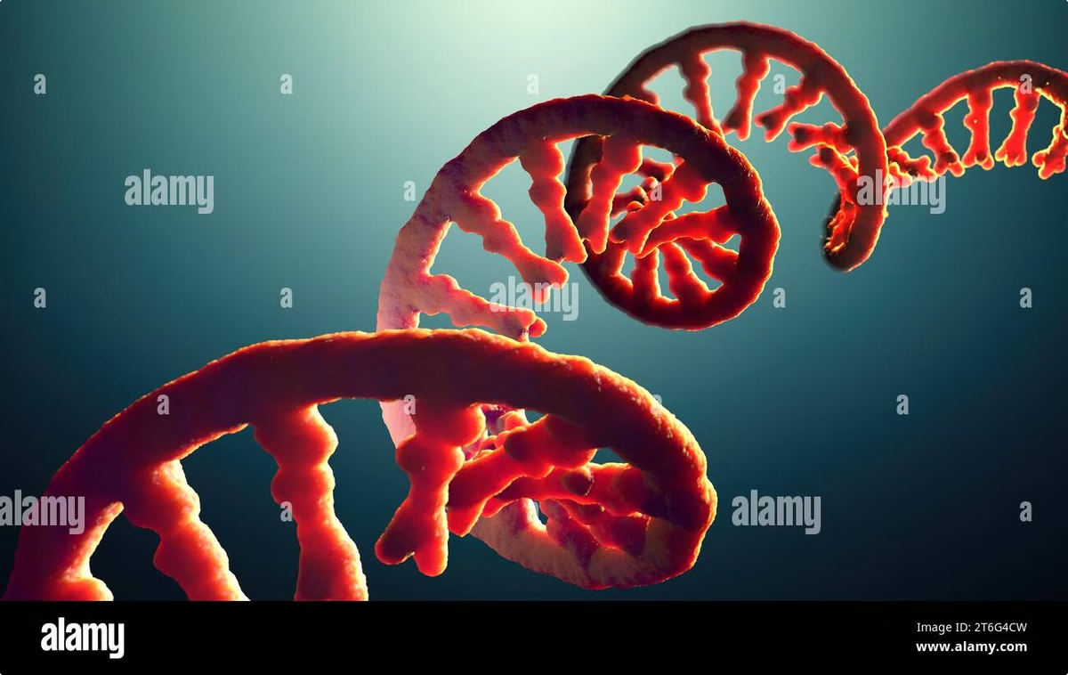
RNA (Ribonucleic Acid): The Molecule of Life
Ribonucleic acid (RNA) is a remarkable molecule that plays a pivotal role in the intricate dance of life. Often overshadowed by its more famous cousin, DNA, RNA is the unsung hero of cellular processes, carrying out a myriad of essential functions. From conveying genetic information to regulating gene expression and catalyzing biochemical reactions, RNA is a versatile and indispensable component of all living organisms.
In this comprehensive exploration, we'll delve into the fascinating world of RNA, uncovering its structure, types, and the crucial roles it plays in the central dogma of molecular biology. We'll also examine how RNA is revolutionizing modern medicine and shaping the future of biotechnology.

Slide 2
What is RNA?
Definition
Composition
Function
RNA, or ribonucleic acid, is a single-stranded nucleic acid molecule composed of nucleotides. It plays a crucial role in various biological processes, including the coding, decoding, regulation, and expression of genes.
RNA is made up of four nitrogenous bases: adenine (A), guanine (G), cytosine (C), and uracil (U). Unlike DNA, RNA uses uracil instead of thymine. The sugar in RNA is ribose, which has an additional hydroxyl group compared to the deoxyribose in DNA.
RNA serves as a versatile molecule in cellular processes. It acts as a messenger carrying genetic information, a template for protein synthesis, and even as a catalyst in certain biochemical reactions. Its ability to form complex structures allows it to perform a wide range of functions within cells.

Slide 3
The Structure of RNA
1
Primary Structure
The primary structure of RNA is a linear sequence of nucleotides connected by phosphodiester bonds. This sequence is determined by the order of bases (A, U, G, C) along the RNA strand.
2
Secondary Structure
RNA can fold back on itself, forming hydrogen bonds between complementary base pairs. This creates various structural elements such as hairpin loops, bulges, and internal loops. The most common secondary structure is the stem-loop or hairpin structure.
3
Tertiary Structure
The tertiary structure refers to the three-dimensional arrangement of RNA molecules. It involves interactions between different secondary structure elements, creating complex 3D configurations. This level of structure is crucial for the function of many RNA molecules, such as ribozymes and tRNA.

Slide 4
Types of RNA
1
Messenger RNA (mRNA)
2
Transfer RNA (tRNA)
mRNA carries genetic information from DNA to the ribosome, where it serves as a template for protein synthesis. It undergoes processing in eukaryotes, including the addition of a 5' cap and a poly-A tail.
tRNA molecules act as adapters during protein synthesis, bringing specific amino acids to the ribosome. They have a distinctive cloverleaf secondary structure and L-shaped tertiary structure.
3
Ribosomal RNA (rRNA)
4
Non-coding RNAs
rRNA is a structural component of ribosomes, the cellular machines responsible for protein synthesis. It also plays a catalytic role in peptide bond formation during translation.
This diverse group includes microRNAs (miRNAs), small interfering RNAs (siRNAs), and long non-coding RNAs (lncRNAs). They play various regulatory roles in gene expression and cellular processes.

Slide 5
Transcription: From DNA to RNA
1
2
3
4
Initiation
Elongation
Termination
Post-transcriptional Modifications
Transcription begins when RNA polymerase binds to a promoter region on the DNA. In eukaryotes, this process involves additional transcription factors that help position the polymerase correctly.
As RNA polymerase moves along the DNA template strand, it adds complementary RNA nucleotides to the growing RNA chain. This process continues until the polymerase reaches a termination signal.
In prokaryotes, termination occurs when the polymerase encounters a specific sequence or a terminator protein. In eukaryotes, the process is more complex and often involves the recognition of specific sequences and the action of termination factors.
In eukaryotes, the primary transcript undergoes several modifications, including the addition of a 5' cap, 3' polyadenylation, and splicing to remove introns and join exons.

Slide 6
Translation: From RNA to Proteins
Initiation
Elongation
Termination
Post-translational Modifications
Translation begins when the small ribosomal subunit binds to the mRNA's start codon (AUG). The initiator tRNA, carrying methionine, also attaches to this site. The large ribosomal subunit then joins to form the complete ribosome.
The ribosome moves along the mRNA, reading each codon and matching it with the appropriate amino acid brought by tRNA molecules. Peptide bonds form between amino acids, gradually building the polypeptide chain.
When the ribosome encounters a stop codon (UAA, UAG, or UGA), release factors trigger the release of the completed polypeptide chain. The ribosomal subunits then dissociate from the mRNA.
After translation, many proteins undergo further modifications, such as folding, glycosylation, or phosphorylation, to become fully functional.

Slide 7
The Central Dogma of Molecular Biology
DNA
The genetic blueprint of life, DNA stores hereditary information in the form of a double-stranded molecule. It serves as the template for RNA synthesis during transcription.
RNA
RNA acts as the intermediary between DNA and proteins. It carries genetic information from DNA to the ribosomes and participates in protein synthesis as both a template and a structural component.
Protein
The final product of gene expression, proteins are the workhorses of cells, performing a vast array of functions from catalyzing chemical reactions to providing structural support.

Slide 8
RNA and Genetic Information
RNA as Genetic Material
RNA Editing
While DNA is the primary genetic material in most organisms, some viruses use RNA as their genetic material. These RNA viruses, such as influenza and HIV, store their entire genome in RNA molecules.
RNA editing is a process that can alter the nucleotide sequence of an RNA molecule after transcription. This mechanism allows for increased diversity of gene products and can be crucial for proper protein function in some organisms.
RNA Interference
Epigenetic Regulation
RNA interference (RNAi) is a biological process in which RNA molecules inhibit gene expression by neutralizing targeted mRNA molecules. This mechanism plays a crucial role in defending cells against parasitic genes and regulating gene expression.
Non-coding RNAs play important roles in epigenetic regulation, influencing gene expression without changing the underlying DNA sequence. These RNAs can modify chromatin structure and affect DNA methylation patterns.

Slide 9
RNA-based Therapies and Applications
Application
Description
Example
RNA Vaccines
Use mRNA to instruct cells to produce specific proteins, triggering an immune response
COVID-19 mRNA vaccines
RNA Interference Therapy
Utilize small RNAs to silence specific genes associated with diseases
Treatment for hereditary transthyretin amyloidosis
Antisense Oligonucleotides
Short, synthetic RNA or DNA molecules that can modulate gene expression
Treatment for spinal muscular atrophy
CRISPR-Cas9 Gene Editing
Uses guide RNAs to direct gene editing enzymes to specific DNA sequences
Experimental treatments for genetic disorders

Slide 10
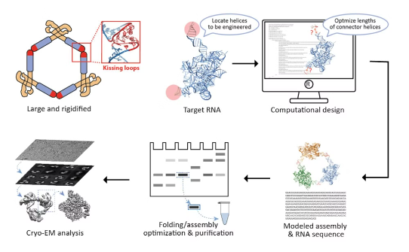
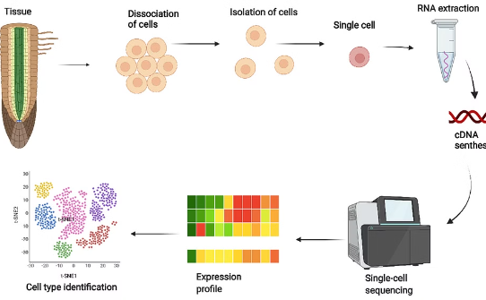
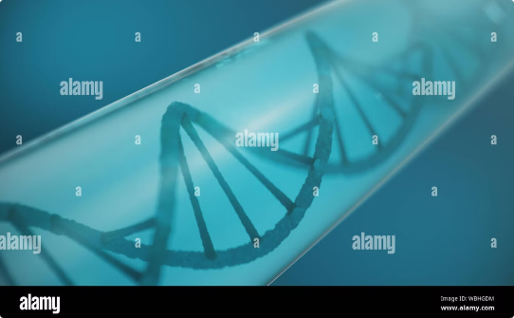
The Future of RNA Research
RNA Nanotechnology
Single-cell RNA Sequencing
Synthetic Biology
Researchers are exploring the use of RNA molecules to create nanoscale structures and devices. These RNA-based nanoparticles could be used for targeted drug delivery, molecular computing, and the development of new biosensors.
Advancements in single-cell RNA sequencing technologies are allowing scientists to study gene expression patterns at unprecedented resolution. This technique is revealing new insights into cellular heterogeneity and developmental processes.
The field of synthetic biology is leveraging our understanding of RNA to create artificial RNA molecules with novel functions. These engineered RNAs could lead to new biotechnology applications and therapeutic strategies.

