Slide 1
محاضرات في مقياس اقتصاديات التأمينات Insurance Economics
Abu Bakr Belkaid University of Tlemcen,
Department of Economic Sciences
DR Benazza IKRAM
Department of Economic Sciences
الأستاذة بن عزة إكرام
Insurance Economics Course, Business Economics Specialization, Second Year Master's

Slide 2
The Seventh Topic: Concept, Types, and Requirements of Insurable Risks
The Seventh
Topic
Risk Concept: Emmett Vaughn's Definition:
Risk is the deviation in outcomes that may occur within a limited period in a given situation. This deviation refers to an unwanted or opposite deviation from the expected or desired outcomes, while a desirable deviation does not represent a risk.
Mamdouh Hamza's Definition: Risk is the fear of the actual material losses exceeding the expected losses resulting from an unexpected incident. This definition emphasizes that risk is represented by the actual material loss exceeding the expected loss (positive deviation).

Slide 3
The Seventh Topic: Concept, Types, and Requirements of Insurable Risks
The Seventh
Topic
From the above definitions, we can infer several characteristics of risk:Risk is a state of uncertainty: The definition of risk within the concept of uncertainty about the occurrence of a loss.
It is important to distinguish between two types of risk: objective risk and random risk.
Objective Risk: This refers to the measurable, quantifiable aspect of risk, based on statistical analysis and probability.
Objective Risk: Objective risk refers to the relative change between the actual loss and the expected loss. For example

Slide 4
The Seventh Topic: Concept, Types, and Requirements of Insurable Risks
The Seventh
Topic
if an insurance company has specific statistics indicating that the probability of a fire occurring in a certain geographical area is 1% annually, and there are 1,000 homes in the area, statistically, it is expected that 100 homes will be destroyed by fire each year. However, this percentage may not hold true in a given year; for instance, 90 homes may burn in one year, or 110 homes may burn in another. This represents a deviation of ±10 homes, and this relative change between actual losses and expected losses is defined as objective risk.Objective risk is measured using measures of dispersion, such as the standard deviation, variance, range, and coefficient of variation, which quantify the difference between actual results and expected outcomes. The severity of risk decreases as the sample size increases, a principle known as the Law of Large Numbers. This means that as the sample size increases, actual results tend to converge toward expected outcomes.

Slide 5
The Seventh Topic: Concept, Types, and Requirements of Insurable Risks
The Seventh
Topic
if an insurance company has specific statistics indicating that the probability of a fire occurring in a certain geographical area is 1% annually, and there are 1,000 homes in the area, statistically, it is expected that 100 homes will be destroyed by fire each year. However, this percentage may not hold true in a given year; for instance, 90 homes may burn in one year, or 110 homes may burn in another. This represents a deviation of ±10 homes, and this relative change between actual losses and expected losses is defined as objective risk.Objective risk is measured using measures of dispersion, such as the standard deviation, variance, range, and coefficient of variation, which quantify the difference between actual results and expected outcomes. The severity of risk decreases as the sample size increases, a principle known as the Law of Large Numbers. This means that as the sample size increases, actual results tend to converge toward expected outcomes.

Slide 6
The Seventh Topic: Concept, Types, and Requirements of Insurable Risks
The Seventh
Topic
Chance of Loss:
The probability of a loss (the likelihood of a loss occurring).
Risk is the difference between actual outcomes and expected outcomes

Slide 7
The Seventh Topic: Concept, Types, and Requirements of Insurable Risks
The Seventh
Topic
While Subjective Risk :
Subjective risk refers to the uncertainty or lack of certainty based on an individual's mental state. A person may act differently from another person, even though both are exposed to the same risk. This type of risk is linked to an individual's mental state, habits, traditions, and culture. In other words, subjective risk is measured by the degree of belief or perception an individual has regarding the risk, and it varies from person to person.

Slide 8
The Seventh Topic: Concept, Types, and Requirements of Insurable Risks
The Seventh
Topic
.
For example
the probability of a fire occurring in a certain building is 0.001, while the probability of a glass door breakage occurring in the same building is 95%. Despite the very high likelihood of the glass breakage, it is not considered a significant risk. Why?This is because the financial loss resulting from this risk is minor. In contrast, the potential financial loss from the occurrence of a fire is substantial. Hence, while the probability of an event (like the glass breakage) may be high, the severity of the loss is low, making it less of a risk compared to an event with a lower probability but a much higher potential financial loss, such as a fire.

Slide 9
The Seventh Topic: Concept, Types, and Requirements of Insurable Risks
The Seventh
Topic
The Basic Classifications of Risk:
Risk can be divided into several groups. We will discuss two main groups:
First Group: Moral Hazards and Economic Risks.
Moral Hazards: These are risks that arise from the behavior, intentions, or actions of individuals that may influence the likelihood or severity of a loss. Moral hazard occurs when a person or entity takes on more risk because they do not have to bear the full consequences of that risk. For example, someone may take more risks in their behavior if they know they are covered by insurance.
.

Slide 10
The Seventh Topic: Concept, Types, and Requirements of Insurable Risks
The Seventh
Topic
2. Economic Risks: These are risks that stem from changes or uncertainties in economic factors, such as inflation, market fluctuations, or economic recessions. Economic risks can affect individuals, businesses, and entire economies, often leading to financial losses due to factors outside the control of the affected parties.
These two types of risks highlight how both human behavior (moral hazards) and external economic conditions (economic risks) can influence the probability and impact of potential losses.
.

Slide 11
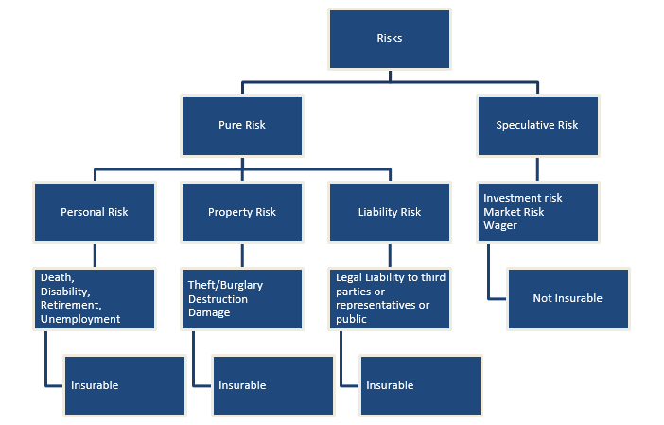
The Seventh Topic: Concept, Types, and Requirements of Insurable Risks
The Seventh
Topic

Slide 12
The Seventh Topic: Concept, Types, and Requirements of Insurable Risks
The Seventh
Topic
الأخطار الاقتصادية تنقسم إلى :
الأخطار البحتة : pure Risks يمكن تصنيف الأخطار البحتة إلى مجموعة الثانية وهي الأخطار العامة و الأخطار الخاصة fundamental risks
Particulas risks و تنقسم الأخطار الخاصة إلى
أخطار الأشخاص personal risks
أخطار الممتكات properly risks
أخطار المسؤولية المدنية liability risks
Non insurable risks and insuranle risks

Slide 13
The Seventh Topic: Concept, Types, and Requirements of Insurable Risks
The Seventh
Topic
Main Sources of Risk (Causes) and Influencing Factors (Contributing Factors):
Source of Risk (Perils):A peril is the primary cause or source of a risk, specifically the main factor responsible for a potential material loss. Perils can vary depending on the type of risk. For example:Fire is the peril in the case of fire risk.Theft is the peril in the case of theft risk.Negligence is the peril in the case of liability risk.

Slide 14
The Seventh Topic: Concept, Types, and Requirements of Insurable Risks
The Seventh
Topic
Hazards (Contributing Factors):
Hazards are factors that can increase the frequency or likelihood of a loss occurring, or that may enhance the severity of the potential material loss arising from a peril. Hazards can either amplify or reduce the impact of a risk.
Examples include:Smoking is a hazard that increases the likelihood of a fatal loss, as it increases the risk of death from fire-related incidents.Stockpiling goods is a hazard that increases the severity of a fire loss, as the amount of inventory can contribute to larger damage in the event of a fire.Building a factory next to a fire station reduces the potential loss from a fire, as the proximity to firefighting resources can mitigate damage. In contrast, constructing a building next to a gas station would increase the risk of significant damage in the event of a fire.In essence, perils are the direct causes of loss, while hazards are contributing factors that either increase or decrease the risk's likelihood or severity.

Slide 15
The Seventh Topic: Concept, Types, and Requirements of Insurable Risks
To clarify the difference between perils (causes of risk) and hazards (contributing factors), we can say that fire is the peril, as it is the direct cause of the loss. On the other hand, the structure of the building is a hazard because it can influence the extent of the damage if the loss occurs. For example, if we have two buildings, one made of brick and the other made of wood, it is clear that the wooden building presents a greater fire risk. While neither brick nor wood will spontaneously cause a fire, in the event of a fire (the peril), the wooden building will suffer much greater damage.Thus, the building structure is a hazard because it affects the outcome, but it does not cause the loss. In contrast, fire is the peril because it is the direct cause of the loss.
The Seventh
Topic

Slide 16
The Seventh Topic: Concept, Types, and Requirements of Insurable Risks
The Seventh
Topic
Basic Classifications of Hazard Factors:
Hazard factors can be divided into two main categories:
Objective or Material Hazards: These are physical factors that increase the likelihood or severity of a loss. They are external and can be measured or observed. Examples include:
Building materials: The type of material used in a building (e.g., wood vs. brick) affects the extent of damage during a fire.
Location: Proximity to dangerous areas, such as flood zones or industrial sites, can increase the risk.
Environmental factors: Such as climate conditions (e.g., high winds or extreme heat) that may increase the risk of certain events, like fires or storms.

Slide 17
The Seventh Topic: Concept, Types, and Requirements of Insurable Risks
The Seventh
Topic
Personal Hazards: These are factors related to individuals' behaviors, habits, and decisions that can influence the likelihood or severity of a loss. They are subjective and vary from person to person. Examples include:
Smoking: An individual's habit of smoking increases the likelihood of a fire.
Negligence or carelessness: Personal behavior, such as leaving flammable materials near heat sources, can contribute to accidents.
Health habits: Poor health practices, such as not maintaining equipment, can increase the risk of accidents or failures.

Slide 18
The Seventh Topic: Concept, Types, and Requirements of Insurable Risks
The Seventh
Topic

Slide 19
The Seventh Topic: Concept, Types, and Requirements of Insurable Risks
The Seventh
Topic

Slide 20
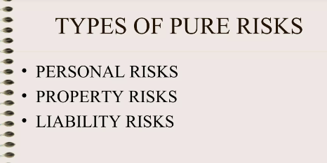
The Seventh Topic: Concept, Types, and Requirements of Insurable Risks
The Seventh
Topic

Slide 21
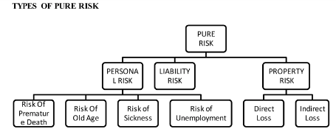
The Seventh Topic: Concept, Types, and Requirements of Insurable Risks
The Seventh
Topic

Slide 22
The Seventh Topic: Concept, Types, and Requirements of Insurable Risks
The Seventh
Topic
العوامل المساعدة للخطر
Contributing Factors
عوامل مساعدة شخصية
Moral Hazards
عوامل مساعدة موضوعية
Physical hazards
Personal Hazards
: Voluntary and Involuntary

