Slide 1
The Urinary system
2nd year Medicine 2023/2024

Slide 2
Introduction
The Urinary, or Excretory System: is another system by which the body rids itself of unwanted Toxins or waste
The basic purpose for this system is to cleanse the blood

Slide 3
Structures
2 Kidneys
2 Ureters
1 Bladder
1 Urethra
1 Urethra Meatus

Slide 4
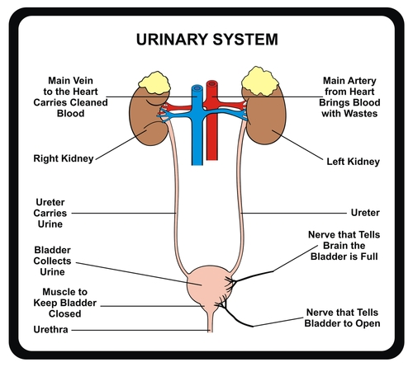

Slide 5
Together these structures purify the blood by removing excess water, salt, sugar, metabolic products, and other substances the body needs to purge in order to maintain the ph acid-base balance and thus the «homeostasis» of the body

Slide 6
Characteristics
Kidneys
Bean Shaped
Located on each side of vertebral column
Protected by Ribs and adipose Capsule
Suspended (Unattached)

Slide 7
The Kidneys are divided into 2 main sections:
Cortex: the outer section of the Kidney
Nephrons: microscopic filtering units
Medulla: the inner section of the Kidney

Slide 8
Ureters
2 muscular tubes
Approximately 10 to 12 inches long

Slide 9
Bladder
A pyramid-shaped organ
It holds up to one cup of urine

Slide 10
Urethra
Urethra Tube
Carries the urine from the bladder to outside the body
Urethra Meatus
Is the external Opening of Urethra

Slide 11
Whats is Urine?
It is the waste product that the Urinary system is responsible for eliminating from the body
95% water & other 5% is made of : urea, uric acid, creatinine, mineral salts, various pigments and sugar.

Slide 12
Some Clinical Terms
Cystectomy: surgical removal of the urinary bladder.
Dysuria: painful or difficult urination.
Hematuria: blood in the urine.
Nephrectomy: surgical removal of a kidney.
Acute glomerulonephritis: inflammation of the glomeruli.

Slide 13
Uremia: condition in which substances ordinarilyexcreted in the urine accumulates in the blood.
Incontinence: inability to control urination.
Urinalysis: analysis of urine to diagnose health or disease(to detect protein, glucose, blood or pus).
Urologist: physician who specializes in diseases of theurinary structures in both male and female.

