Slide 1
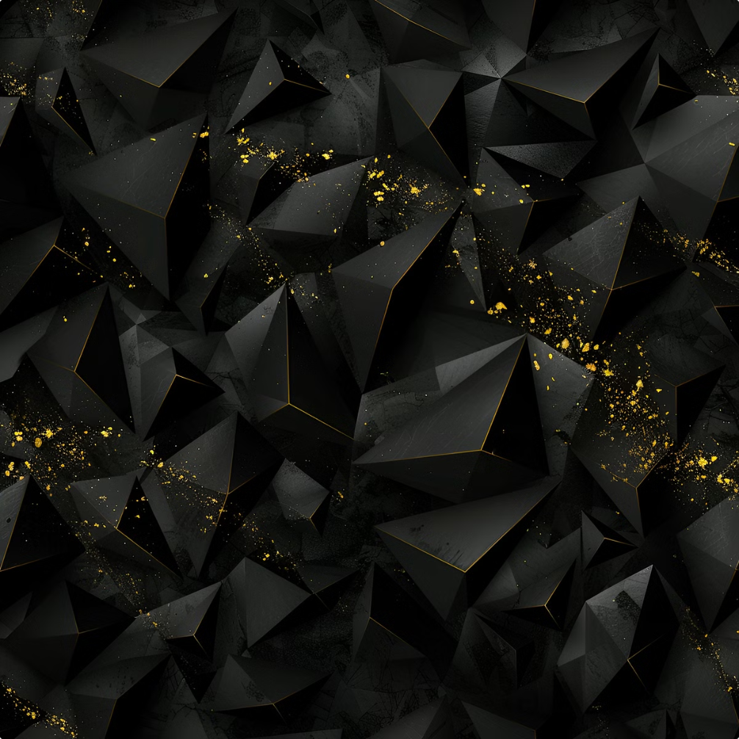
Prokaryotic Cells: An Introduction
Prokaryotic cells are the most abundant and ancient form of cellular life on Earth. These microscopic organisms, which include bacteria and archaea, are fundamentally different from the more complex eukaryotic cells found in plants, animals, and fungi. Understanding the structure and function of prokaryotic cells is crucial, as they play vital roles in ecosystems, human health, and biotechnology.
by Mouderas F.

Slide 2
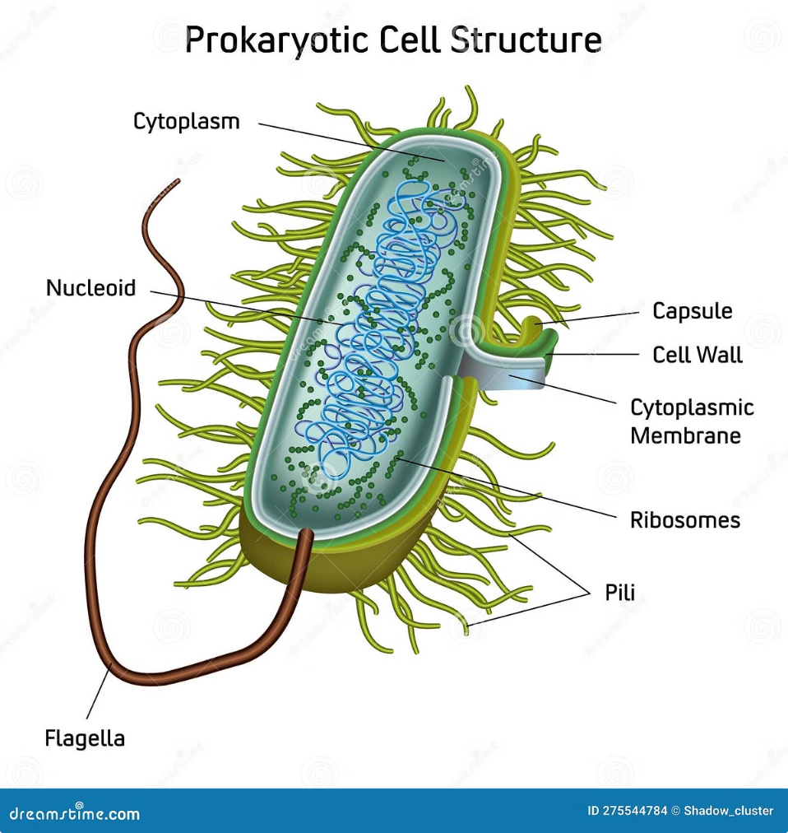
Structure of Prokaryotic Cells
1
Small Size
2
Lack of Membrane-Bound Organelles
Prokaryotic cells are typically much smaller than eukaryotic cells, with diameters ranging from 0.1 to 10 micrometers. This compact size allows for efficient nutrient transport and rapid reproduction.
Unlike eukaryotic cells, prokaryotes do not have membrane-bound structures like the nucleus, mitochondria, or chloroplasts. Their cellular functions are carried out in the cytoplasm and on the cell membrane.
3
Circular Genetic Material
Prokaryotic DNA is typically organized into a single, circular chromosome that is not enclosed within a nuclear membrane. This genetic material is referred to as the nucleoid.
by Mouderas F.

Slide 3
Cell Wall and Capsule
Cell Wall
Capsule
Prokaryotic cells are surrounded by a rigid cell wall that provides structural support, protection, and shape. The composition of the cell wall varies among different types of prokaryotes, with peptidoglycan being a common component.
Many prokaryotes also possess an additional layer outside the cell wall called a capsule. Capsules are made of polysaccharides and can help protect the cell from the environment, enhance pathogenicity, and prevent desiccation.
by Mouderas F.

Slide 4
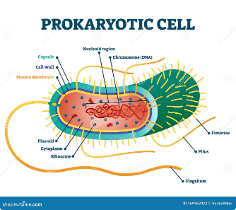
Cell Membrane
Phospholipid Bilayer
Embedded Proteins
Unique Lipid Composition
The cell membrane of prokaryotes is a phospholipid bilayer that acts as a selective barrier, controlling the movement of substances in and out of the cell.
The membrane contains various proteins that serve as transporters, receptors, and enzymes, enabling the cell to communicate with its environment and carry out essential metabolic processes.
Prokaryotic cell membranes often have a different lipid composition compared to eukaryotic membranes, which can contribute to their unique properties and adaptations.

Slide 5
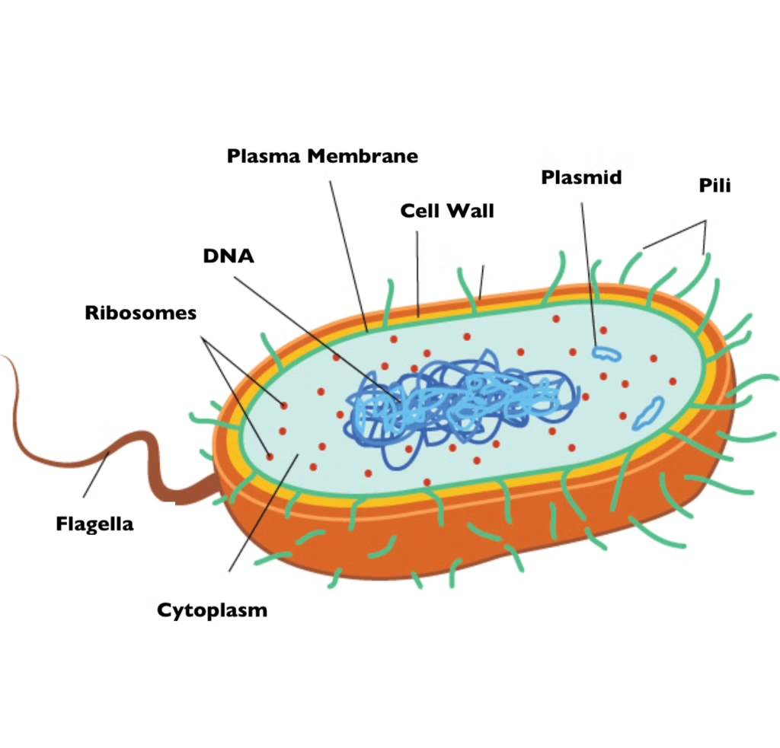
Cytoplasm and Organelles
1
Cytoplasm
The cytoplasm of a prokaryotic cell is the gel-like substance that fills the cell and contains the necessary components for life, such as enzymes, ribosomes, and the genetic material.
2
Ribosomes
Prokaryotic cells contain 70S ribosomes, which are smaller than the 80S ribosomes found in eukaryotic cells. These ribosomes are the sites of protein synthesis within the cell.
3
Inclusion Bodies
Prokaryotes can also contain specialized structures called inclusion bodies, which are used to store nutrients, metabolic byproducts, or other important materials within the cell.

Slide 6
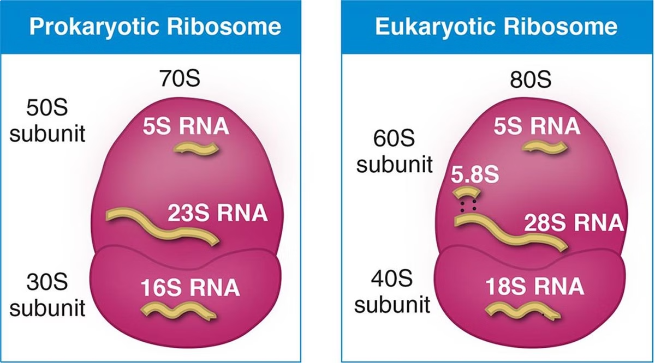
Ribosomes and Protein Synthesis
Transcription
The genetic information stored in the prokaryotic DNA is transcribed into messenger RNA (mRNA) molecules, which serve as templates for protein synthesis.
Translation
The mRNA molecules are then transported to the ribosomes, where the genetic code is translated into the synthesis of specific proteins required by the cell.
Post-Translational Modifications
After synthesis, some prokaryotic proteins may undergo additional processing and modifications to become fully functional within the cell.

Slide 7
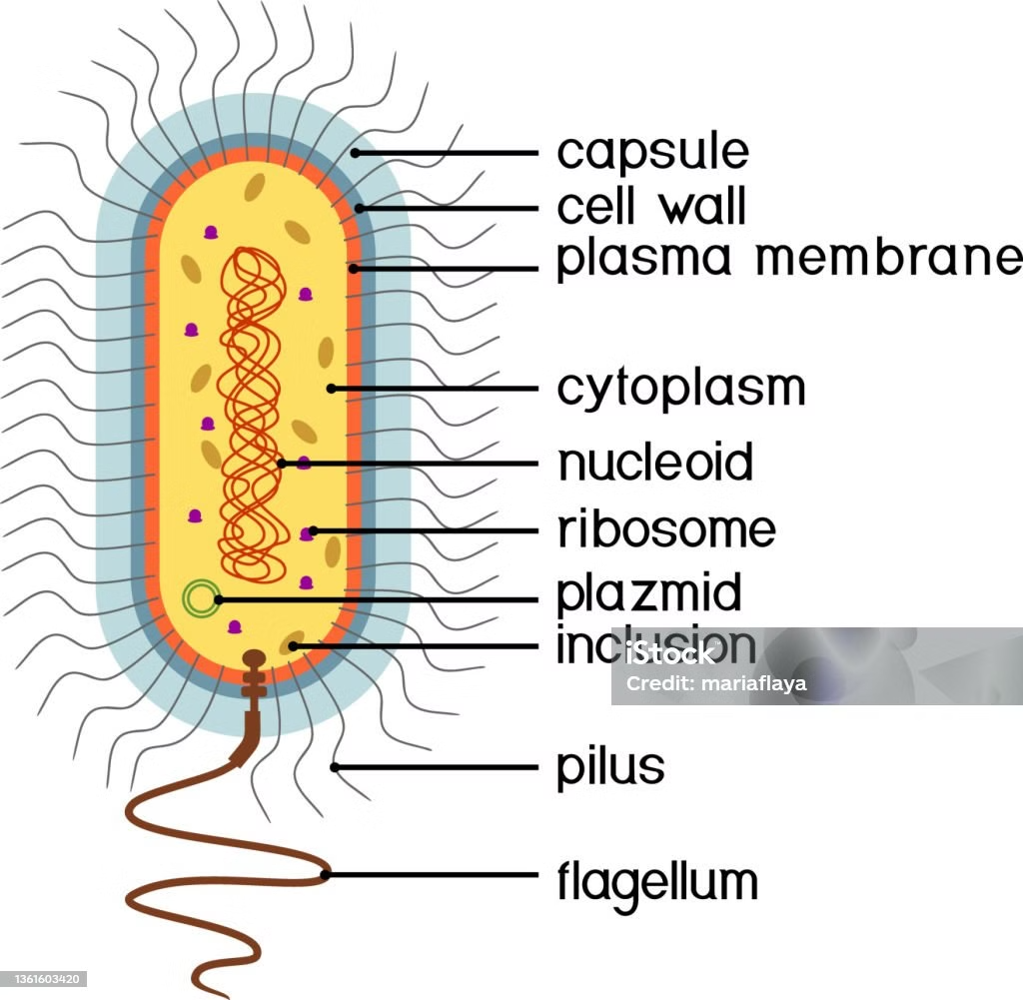
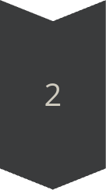
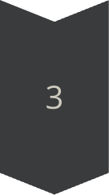
Nucleoid and Genetic Material
Circular Chromosome
The genetic material of prokaryotes is typically organized into a single, circular chromosome that is located in the cytoplasm, not enclosed in a nucleus.
Plasmids
In addition to the main chromosome, many prokaryotes also contain smaller, circular DNA molecules called plasmids, which can carry genes for additional traits or functions.
Genomic Diversity
Prokaryotic genomes can vary greatly in size and complexity, reflecting the diverse adaptations and capabilities of different species and strains.

Slide 8
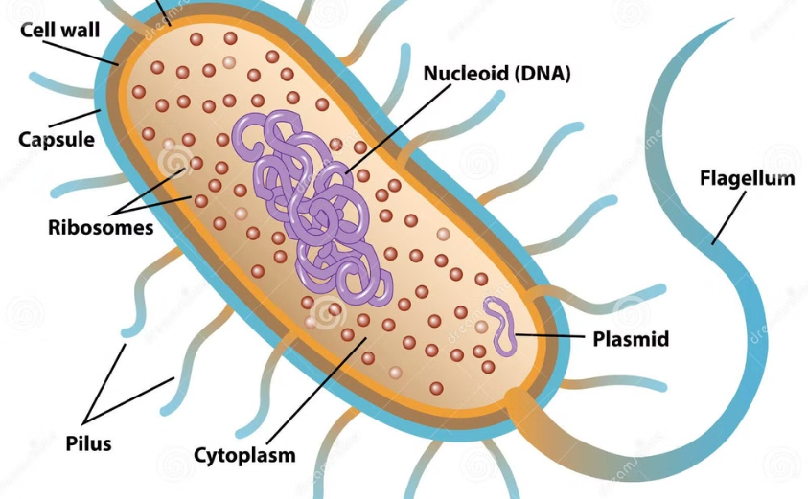
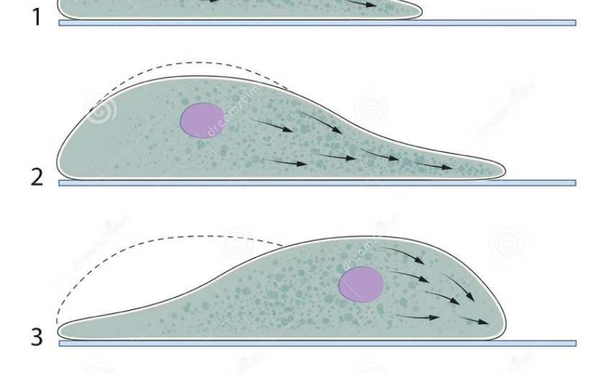
Flagella and Motility
Flagella Structure
Motility and Chemotaxis
Many prokaryotes use flagella, which are long, thin, and rotating appendages, to propel themselves through their environment. Flagella are composed of a filament, a hook, and a motor structure that generates the rotational force.
The rapid rotation of flagella allows prokaryotes to swim towards favorable conditions, such as higher nutrient concentrations or more optimal temperatures, through a process called chemotaxis. This ability to sense and respond to their environment is crucial for their survival and success.

Slide 9
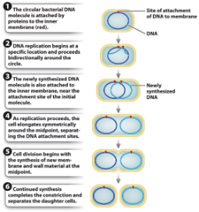
Reproduction in Prokaryotes
Asexual Reproduction
Prokaryotes primarily reproduce asexually through a process called binary fission, where a single cell divides into two genetically identical daughter cells. This rapid mode of reproduction allows prokaryotes to quickly adapt and colonize new environments.
Horizontal Gene Transfer
Prokaryotes can also exchange genetic material through mechanisms like conjugation, transformation, and transduction, which can introduce new traits and contribute to their remarkable genetic diversity and adaptability.

Slide 10
Importance and Applications of Prokaryotes
1
Ecological Significance
2
Medical and Biotechnological Uses
3
Challenges and Concerns
Prokaryotes play vital roles in ecosystems, participating in nutrient cycling, decomposition, and symbiotic relationships with other organisms. They are the most abundant life forms on the planet and are essential for maintaining the balance of the biosphere.
Prokaryotes have numerous applications in medicine, agriculture, and biotechnology. They are used to produce important drugs, enzymes, and other compounds, and are also employed in bioremediation and the development of renewable energy sources.
While prokaryotes are vital to many processes, some can also be pathogenic, causing diseases in humans, animals, and plants. Understanding the diversity and roles of prokaryotes is crucial for addressing public health issues and developing effective strategies for their control and management.

