Slide 1
The Immune System
2nd Year Medicine
Academic Year 2023/2024

Slide 2
Purpose
Students will be able to explain what pathogens are and identify the parts of the immune system using English Medical terms.
The use of EMP (English for Medical Purpose)

Slide 3
Essential Question
In order to make use of medical terms and to express yourself, you have to start with an essential question which is:
What made me sick?

Slide 4
Frequent Vocabulary in Immunology
Immune System | Immunology | Innate Immune system | Adaptive Immune system | Immuno-deficiency | Auto-immune Disease
Virus | Bacteria | Inflamation | Infection | Phagocyte | Lymphocyte
Pathogen | Neutrophil | Macrophage | Parasite | Allergy | Antibody
White Blood Cell (WBC) | T-cells | B-cells | Lymphatic System | Lymph Nodes | Lymphatic vessels
Vaccine | Fungus | Spleen | Appendix | Bone marrow | Disease / Sikness
Thymus | Skin | Tissue | Organs | Leukocyte | Fever

Slide 5
Some Definitions
Immune system: a system that has fights off invading pathogens and preventing spread of cancer.
The skin is the body’s first line of defense. Without the skin, pathogens would have free access to many tissues of the body.
A fever is the body’s way of fighting infection by creating an inhospitable environment for infectious agents.

Slide 6
Pathogen: an organism that causes disease
Lymph: fluid found in the lymphatic system
Lymph nodes: filter lymph for bacteria and tumor cells
Phagocytes: a cell that engulfs large particles or the whole cells
Macrophage: a large WBC that engulfs pathogens and cellular debris

Slide 7
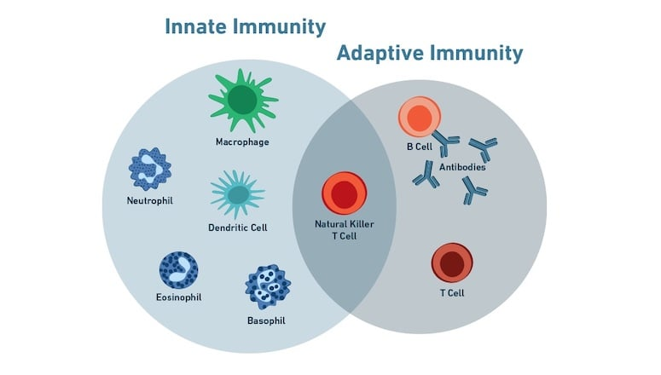
Antigens: a substance that stimulates an immune response
T-cells: stimulates an immune response against antigen
B-cells: produces antibodies in response to antigens

Slide 8
references
https://blog.cellsignal.com/immunology-overview-how-does-our-immune-system-protect-us

