Slide 1
DNA Replication in Eukaryotes:
DNA replication is a fundamental process that ensures the accurate transmission of genetic information from one generation to the next. In eukaryotic organisms, this intricate molecular dance unfolds within the nucleus of each cell, orchestrating the faithful duplication of the entire genome before cell division occurs. This process is essential for growth, development, and the maintenance of all living organisms.
Understanding DNA replication in eukaryotes not only provides insights into the basic mechanisms of life but also has far-reaching implications for fields such as medicine, biotechnology, and evolutionary biology. As we delve into the complexities of this process, we'll uncover the molecular players, the precise steps, and the regulatory mechanisms that ensure the integrity of our genetic material.
By Mouderas F.

Slide 2
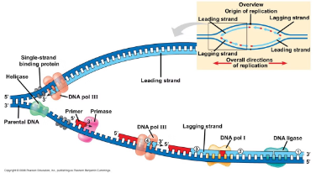
4
By Mouderas F.

Slide 3
The Initiation of DNA Replication
1
Origin Recognition
The process begins with the identification of specific DNA sequences called origins of replication. In eukaryotes, these origins are scattered throughout the genome, allowing for multiple replication start points.
2
Pre-Replication Complex Formation
Proteins known as the Origin Recognition Complex (ORC) bind to these origins, serving as a landing pad for additional proteins that form the pre-replication complex (pre-RC).
3
Helicase Loading
The MCM2-7 helicase complex is loaded onto the DNA, primed to unwind the double helix and initiate replication when activated.
4
Origin Firing
Upon receiving cellular signals, the pre-RC is activated, leading to the unwinding of DNA and the recruitment of replication machinery.

Slide 4
The Replication Fork: Where the Action Happens
Leading Strand Synthesis
Lagging Strand Synthesis
Primase Activity
On the leading strand, DNA polymerase ε continuously synthesizes new DNA in the 5' to 3' direction, keeping pace with the unwinding helicase.
The lagging strand is synthesized discontinuously by DNA polymerase δ, creating short Okazaki fragments that are later joined together by DNA ligase.
RNA primers are laid down by primase to initiate DNA synthesis on both strands, as DNA polymerases cannot start chains de novo.

Slide 5
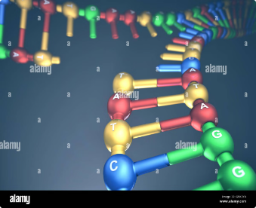
Key Players in Eukaryotic DNA Replication
1
DNA Polymerases
2
Helicases and Topoisomerases
3
Accessory Proteins
Eukaryotes employ multiple specialized DNA polymerases. Polymerase α initiates synthesis, while polymerases δ and ε are responsible for the bulk of DNA replication on the lagging and leading strands, respectively.
PCNA (Proliferating Cell Nuclear Antigen) acts as a sliding clamp, enhancing the processivity of DNA polymerases. RPA (Replication Protein A) coats and stabilizes single-stranded DNA during replication.
The MCM2-7 complex serves as the main replicative helicase, unwinding the DNA ahead of the replication fork. Topoisomerases relieve the supercoiling stress caused by this unwinding.

Slide 6
Ensuring Accuracy: Proofreading and Repair
Polymerase Proofreading
Mismatch Repair
DNA polymerases δ and ε possess 3' to 5' exonuclease activity, allowing them to detect and remove incorrectly incorporated nucleotides immediately during synthesis.
After replication, the mismatch repair system scans the newly synthesized DNA for errors that escaped proofreading, significantly enhancing overall replication fidelity.
Base Excision Repair
Nucleotide Excision Repair
This system removes and replaces damaged bases that could lead to mutations if left unrepaired during subsequent rounds of replication.
For larger DNA lesions, this pathway excises and replaces entire sections of damaged nucleotides, maintaining genome integrity.

Slide 8
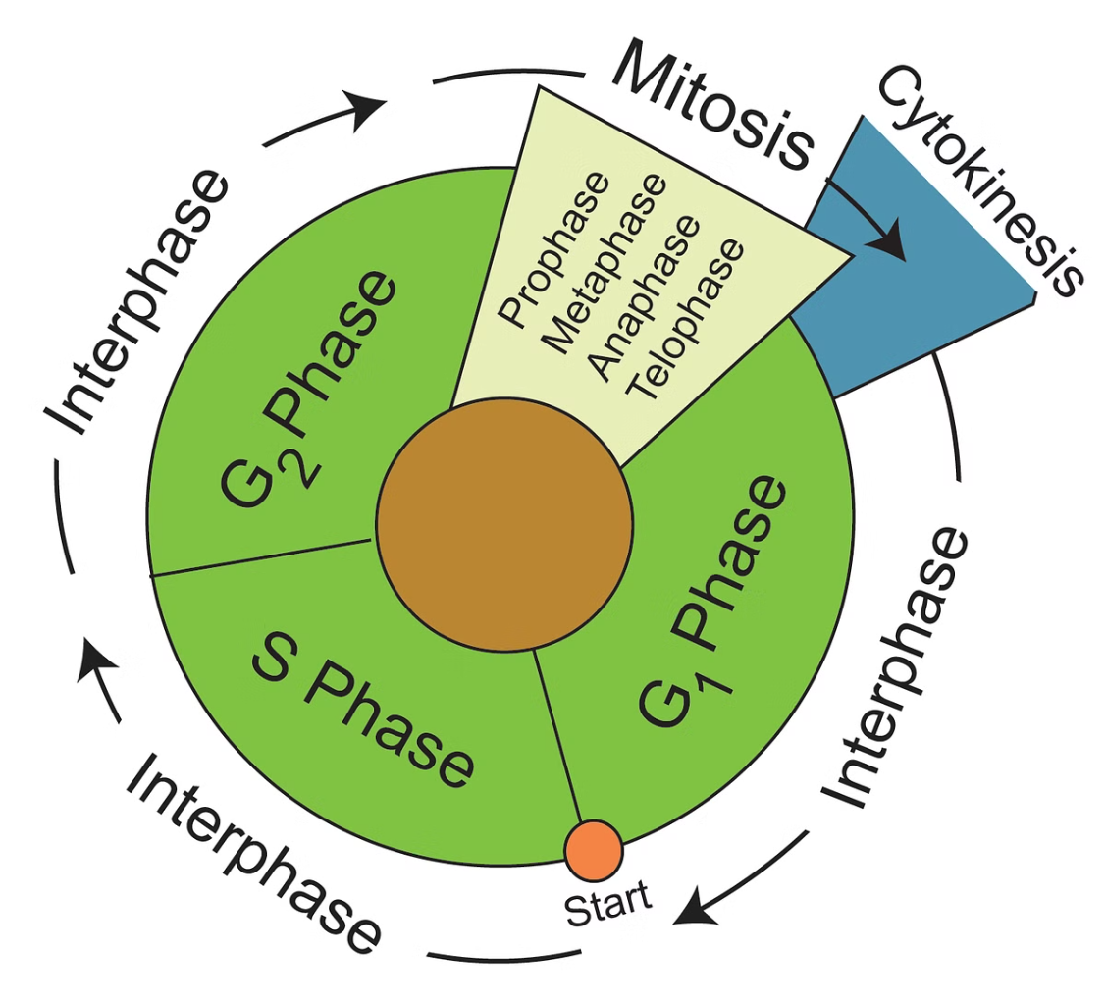
Replication Timing and Regulation
1
G1 Phase
Origins are licensed by the assembly of pre-replication complexes, but actual replication is prevented by low CDK activity.
2
S Phase Entry
Rising CDK and DDK levels activate origins, initiating replication. Early and late-replicating regions are established.
3
S Phase Progression
Replication proceeds with a defined temporal program. Origin firing is regulated to prevent re-replication and manage replication stress.
4
G2 Phase
Replication completion is verified. Any unreplicated regions are resolved before mitosis to maintain genome stability.

Slide 9
Challenges in Eukaryotic DNA Replication
Replication-Transcription Conflicts
Replication Barriers
Certain DNA sequences or structures, such as G-quadruplexes or tightly bound proteins, can impede replication fork progression, requiring specialized mechanisms for bypass.
Collisions between replication and transcription machinery can lead to genomic instability. Cells employ various mechanisms to prevent and resolve these conflicts.
Replication Stress
Telomere Replication
Factors like nucleotide depletion or DNA damage can cause replication fork stalling or collapse. Cells activate checkpoint responses to stabilize forks and prevent genomic instability.
The ends of linear chromosomes pose unique challenges for replication. Telomerase and ALT mechanisms are employed to maintain telomere length and prevent end-to-end fusions.

Slide 10
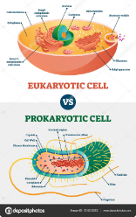
Differences Between Prokaryotic and Eukaryotic DNA Replication
Feature
Prokaryotes
Eukaryotes
Origin of Replication
Single origin
Multiple origins
Replication Speed
Faster (~1000 nucleotides/sec)
Slower (~50 nucleotides/sec)
Main DNA Polymerase
DNA Polymerase III
DNA Polymerases δ and ε
Replication Timing
Throughout cell cycle
Restricted to S phase
Chromosome Structure
Circular
Linear

Slide 11
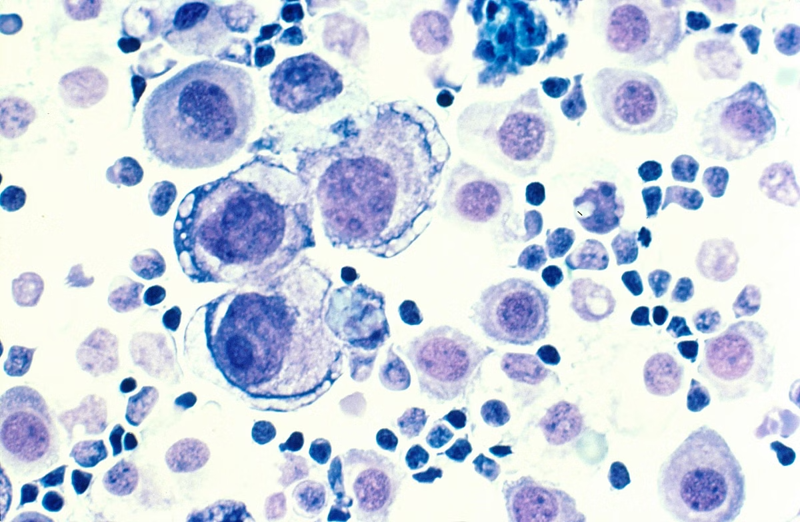
DNA Replication and Disease
Replication Errors
Mutations in genes encoding replication machinery or DNA repair proteins can lead to increased mutation rates and genomic instability, contributing to various diseases, including cancer.
Replication Stress
Chronic replication stress, often seen in pre-cancerous lesions, can drive genomic instability and tumor progression. Understanding these mechanisms is crucial for developing new cancer therapies.
Developmental Disorders
Defects in replication timing or origin usage can lead to developmental abnormalities. For example, mutations in ORC genes are associated with Meier-Gorlin syndrome, characterized by growth retardation.
Aging
Accumulation of replication errors over time contributes to the aging process. Telomere shortening, a consequence of the end-replication problem, is also linked to cellular senescence and aging-related diseases.

Slide 12
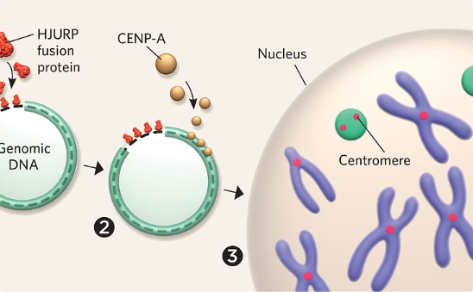
Future Directions in DNA Replication Research
Single-Molecule Studies
Genome Editing Technologies
Synthetic Biology Approaches
Advanced techniques like single-molecule real-time sequencing are providing unprecedented insights into the dynamics of individual replication forks, revealing heterogeneity in replication processes that were previously obscured in bulk studies.
CRISPR-Cas9 and other genome editing tools are enabling precise manipulation of replication factors and origins, allowing researchers to study the consequences of specific alterations in replication dynamics on genome stability and cell fate.
The creation of artificial chromosomes and minimal genomes is pushing the boundaries of our understanding of replication requirements and may lead to new applications in biotechnology and medicine.

