Slide 1
محاضرات في مقياس اقتصاديات التأمينات Insurance Economics
Abu Bakr Belkaid University of Tlemcen,
Department of Economic Sciences
DR Benazza IKRAM
Department of Economic Sciences
الأستاذة بن عزة إكرام
Insurance Economics Course, Business Economics Specialization, Second Year Master's

Slide 2
Topic 10: Life Insurance and Reinsurance
Tenth Axis
Life Insurance:
Definition: Life insurance is a contract between a person (the policyholder) and an insurance company, where the company pays a certain amount to the beneficiaries in the event of the policyholder's death or in other specified cases, such as permanent disability.
Types: Term Life Insurance: Paid only if death occurs within a certain period.
Whole Life Insurance: Covers the policyholder's entire life, with payouts after death.
Mixed Insurance: Combines life insurance and accident protection.

Slide 3
Topic 10: Life Insurance and Reinsurance
Tenth Axis
.
Special Characteristics of Life Risks
The risks covered by life insurance policies have several unique characteristics that distinguish them from other types of insurance policies. Here are the key characteristics:
Coverage of Death Risk: In the case of death risk coverage, the policy does not cover the incident of death itself but rather the date of the occurrence of the event. While the risk of death is certain to happen in the long run, the occurrence of death at a specific time is probabilistic and can happen at any moment.
Relating to the Person's Life or Income: Life risks are associated with a person’s life or the reduction of their income, typically in the event of death, disability, or old age.
Increased Probability of Death with Age: The likelihood of death increases for any individual as they age due to the weakening of the body and increased vulnerability to diseases, especially those related to old age. Thus, the relationship between the probability of death and a person's age is directly proportional, particularly after a certain age.
Total Loss in Life Risks: The loss resulting from life risks and death is always a total loss. This means that when such a risk occurs, it typically leads to a complete loss, especially in the case of death.
Difficulty in Valuing Human Life: It is difficult to estimate the value of a human being, so the insured person is given the freedom to determine the amount of insurance according to their ability to pay the premiums on time.

Slide 4
Topic 10: Life Insurance and Reinsurance
Tenth Axis
.
Special Characteristics of Life Risks
The risks covered by life insurance policies have several unique characteristics that distinguish them from other types of insurance policies. Here are the key characteristics:
Coverage of Death Risk: In the case of death risk coverage, the policy does not cover the incident of death itself but rather the date of the occurrence of the event. While the risk of death is certain to happen in the long run, the occurrence of death at a specific time is probabilistic and can happen at any moment.
Relating to the Person's Life or Income: Life risks are associated with a person’s life or the reduction of their income, typically in the event of death, disability, or old age.
Increased Probability of Death with Age: The likelihood of death increases for any individual as they age due to the weakening of the body and increased vulnerability to diseases, especially those related to old age. Thus, the relationship between the probability of death and a person's age is directly proportional, particularly after a certain age.
Total Loss in Life Risks: The loss resulting from life risks and death is always a total loss. This means that when such a risk occurs, it typically leads to a complete loss, especially in the case of death.
Difficulty in Valuing Human Life: It is difficult to estimate the value of a human being, so the insured person is given the freedom to determine the amount of insurance according to their ability to pay the premiums on time.

Slide 5
Topic 10: Life Insurance and Reinsurance
Tenth Axis

Slide 6
Topic 10: Life Insurance and Reinsurance
Tenth Axis

Slide 7
Topic 10: Life Insurance and Reinsurance
Tenth Axis
Types Of Life Insurance
Term life insurance
Whole life insurance
Universal life insurance

Slide 8
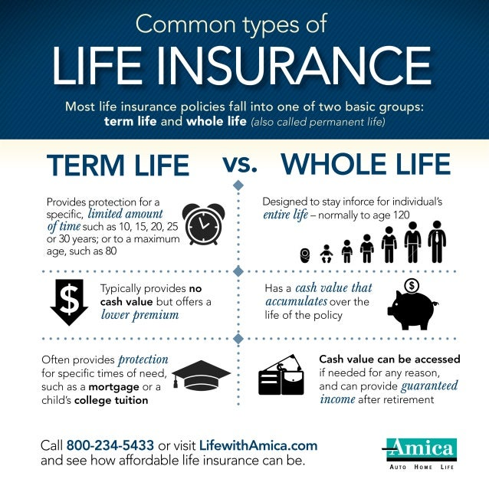
Topic 10: Life Insurance and Reinsurance
Tenth Axis

Slide 9
Topic 10: Life Insurance and Reinsurance
Tenth Axis

Slide 10
Topic 10: Life Insurance and Reinsurance
Tenth Axis
What Is Reinsurance?
Reinsurance, often referred to as insurance for insurance companies, is a contract between a reinsurer and an insurer. In this contract, the insurance company—known as the ceding party or cedent—transfers some of its insured risk to the reinsurance company. The reinsurance company then assumes all or part of one or more insurance policies issued by the ceding party.
Key Takeaways
Reinsurance, or insurance for insurers, transfers risk to another company to reduce the likelihood of large payouts for a claim.
Reinsurance allows insurers to remain solvent by recovering all or part of a payout.
Companies that seek reinsurance are called ceding companies.
Types of reinsurance include facultative, proportional, and non-proportional

Slide 11
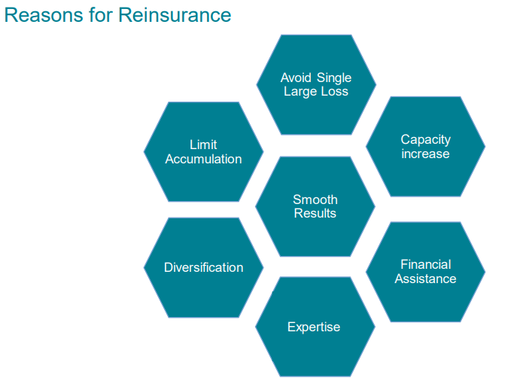
Topic 10: Life Insurance and Reinsurance
Tenth Axis
Why Should Insurance Companies Have Reinsurance?
Several common reasons that insurers obtain
reinsurance include:
expanding an insurance company's capacity,
stabilizing its underwriting results, financing,
gaining catastrophe protection,
spreading an insurer's risk, and acquiring expertise.

Slide 12
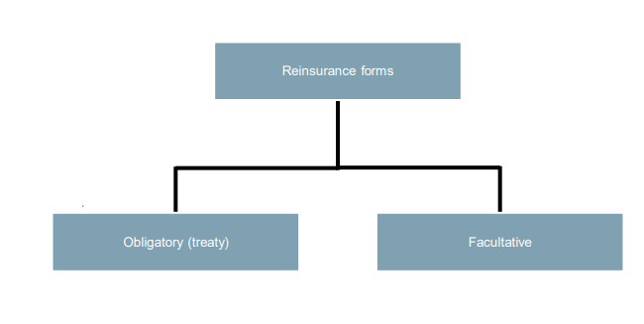
Topic 10: Life Insurance and Reinsurance
Tenth Axis
Reinsurance Types

Slide 13
Topic 10: Life Insurance and Reinsurance
Tenth Axis

Slide 14
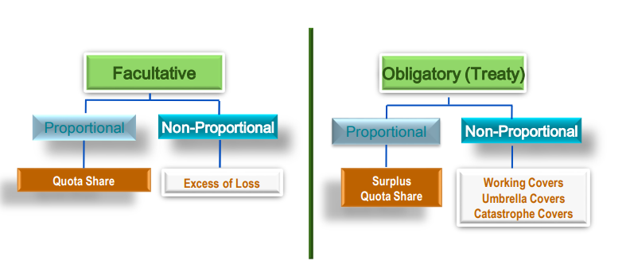
Topic 10: Life Insurance and Reinsurance
Tenth Axis

Slide 15
Topic 10: Life Insurance and Reinsurance
Tenth Axis

