Slide 1
Hello dear learners,
chapter one

Slide 2
English language
English language is the second language in Algeria. Many countries include English in their school syllabus and children are starting to learn English at a younger and younger age.

Slide 3
Why is English a global language ?
Many consider English as a global language because it is the one language that the majority of the population in almost every region of the world can speak and understand. Furthermore, the language enjoys worldwide acceptance and usage by every nation of the world.

Slide 4
Why do we study English?
English is the language of science, aviation, computers, diplomacy, and tourism. Knowing English increases your chances of getting a good job in a multinational company within your home country or of finding work abroad.

Slide 5
Studying a language gives you skills which can help you do well in other subjects. It improves your understanding of how English works, and enables you to hone problem-solving and analytical skills which are naturally applied to other subjects you are studying.

Slide 6
English programme
1- English language between American US and British UK.
2- the use of the common tenses in an academic
writing .
+ passive voice and active voice
3- the use of the connectors.

Slide 7
British English VS American one
Answer these two questions :
How are you?
I am well , good fine, great
How are you doing?
I am doing well ,
How do you do?
How do you do

Slide 8
Formality and informality
Formality : is all about your relationship with the person you are speaking or writing to. If you use fromal language, it may be because you wish to show respect, politness or to put yourself at a distance for example : official language
informal language : can show equality or a feeling of closeness and solidarity with someone.
You should never use this last just to sound fluent and clever

Slide 9
The main think to remember is that both of them are correct. It is just matter of tone and setting
Formal English is used mainly in academic writing and business commuication.
Informal English is casual and it is appropriate when communicating with friends and other close ones .
Choose the style of writing but never mixed the two.
Keep in mind what you are writing and to whom but whatever style you write wether is forml or infomal one .

Slide 10
British English (BrE) or UK English is the standard dialect of the English language as spoken and written in the United Kingdom.
American English is a language spoken in the
U.S. United State .

Slide 11
The difference between BE and AE
Both of them have different varieties.
Vocabulary , accent , spelling and grammar

Slide 12
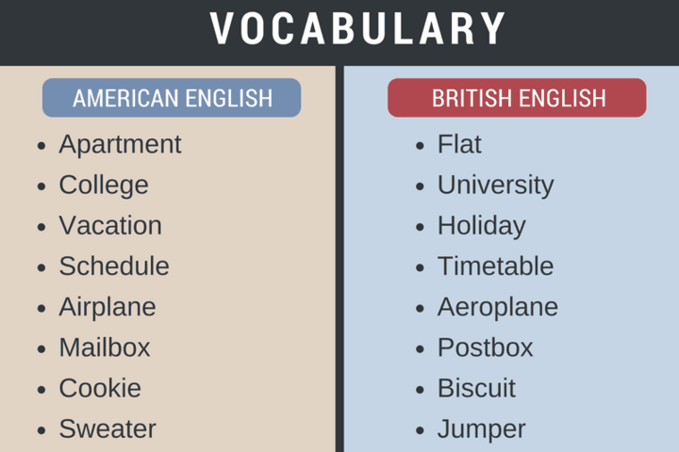
1- vocabulary :

Slide 13
Amrican English British English
Soccer football
Store shop
French fries chips
Mailbox postbox
Fall autumn
resume CV
Movie film
Truck lorry
Gaz petrol
Elementary school primay school

Slide 14
High school secondary school
Cell phone mobile
Cigarettes fags
Subway /metro underground / tube
Baggage luggage
Cab taxi
Bathroom loo/ W.C
Eraser rubber
Garbage rubbish
Check bill
Elevator lift
period full stop
Engaged busy

Slide 15
3- Accent:
There is a lot of discussion in respect to the British accent and American accent. Which the most correct? Which is the best to communicate? Which is the easiest to understand and learn? These are just some of the questions that arise and there is not a definite answer to any of them.
Today we are going to focus on the pronunciation. Have you ever been confused by the difference between the British and American accent?

Slide 16
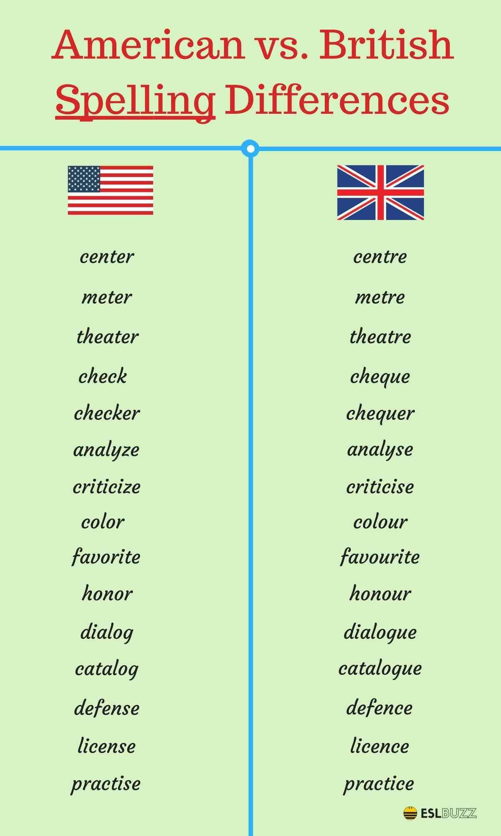
2- spelling :

Slide 17
UK US
Labour labor
Humour humor
Behaviour behavior
Apologise / apologize apologize
Recognise/ ze recognize
Gray grey
Practise (verb) practice (verb)
Programme program
Travelled traveled

Slide 18
1.Intonation
This is the most obvious difference. In the United States, English speakers talk very slowly and much more monotonously.
However, the English are much more expressive and they lengthen the vowels a lot more. This makes it easier for those who are learning English to understand.
Improving your listening comprehension is a lot easier when confronted by a British accent.
What do you do?
Often t is silent in British
Often t is not silent I American

Slide 19
2.Vowels
Americans tends to simplify their language, specifically the pronunciation of vowels.
British English has 12 vowel and diphthong sounds, while American English eliminates the odd ones.
The short ‘a’ in words such as cup is replaced by the sound ‘schwa’ or /ə/ which is the neutral vowel. This ‘a’ is pronounced as the ‘i’ in animal.
The sound /ɒ/ which can be found in words such as ‘what’ or ‘box’. Americans replace it with an open ‘o’ or a long ‘a’.
Diphthongs that end in ‘schwa’ do not exist in the American accent. The diphthong /ɪə/ that is found in the word ‘beer’ would be pronounced /bɪr/.

Slide 20
3.The pronunciation of the letter ‘R’
This is the most visible difference between the British accent and the American accent. American English has what we call the ‘rhotic’ pronunciation of the letter R.
This means that the “r” is pronounced at the end of the syllable, for example in the word art.
According to the ‘Received Pronunciation’ standard, the ‘r’ must not be pronounced and the vowel before it must be emphasised more. A good example of model English would be the word car which is pronounced “Caa” it may sound a bit strange, but this how the British pronounce it.

Slide 21
https://www.youtube.com/watch?v=71HZyrjx_jI&t=337s accent
https://www.youtube.com/watch?v=saTZ6TRS_HE&t=115s accent
https://www.youtube.com/watch?v=MRXv3taXkAg
https://www.youtube.com/watch?v=fO0cVKnGsgE ( grammar)

Slide 22
To be continued
Kherrous fatiha

