Slide 1
الجـــــــــــــــــــــــــــــــــــــــــــــــــــــــــــــــــــــــــــــــــــــــــــــــــــــــمــــهـــــوريـــــــــــــــــــة الجـــــــــــــــــــــــــــــــــــــــــــــــــــــــــــــزائـــريـــــة
الديمـــــــــــــــــــــــــــــقـــراطــيـــــة الـــشـــــــــــــــــــــــــــــــــــــــــعـــبـــيـــــة
REPUBLIQUE ALGERIENNE DEMOCRATIQUE ET POPULAIRE
وزارة التـــــــــــــــــــــــــــــــــــــــــــــــــــــــــــــــــــــــــــــــــــــــــــــــــــــــــــــــــــــــــــــــــــــــــــــــعــــــليـــــــــم العــــــــــــــــــــــــــــــالي و
البــــــــــــــــــــــــــــــــــــــــــــحث العــــــــــــــــــــلــــــمــــــــــــي
Ministère de l’Enseignement Supérieur et de la Recherche Scientifique
جـــــــــــــــــــــــــــــــــــــــــــــــــــــــــــــــــــــامعة أبي بــكــــــــــــر بــــلــــقـــــــايــد – تـــــــلمســـــــــــــــــــــــــــــــــــــــــــــــــــــــــــــــــان –
Université Abou bakr Belkaïd – Tlemcen –
Faculty of TECHNOLOGY
Département De Génie Mécanique
Speciality: L3 Assemblages Soudées
Expose
Welding Quality
Presented by:
MR. Bouziane Bilal
Framed by:
MR. CHABOULI Merime
Université year: 2023/2024

Slide 2
work plan :
INTRODICTION
Welding Quality Standards and Certifications
Techniques to Ensure Welding Quality
Welding Parameters Influencing Quality
Common Faults During Welding
Welding quality control
The different types of welding quality control
Best Practices to Improve Welding Quality
Conclusion

Slide 3
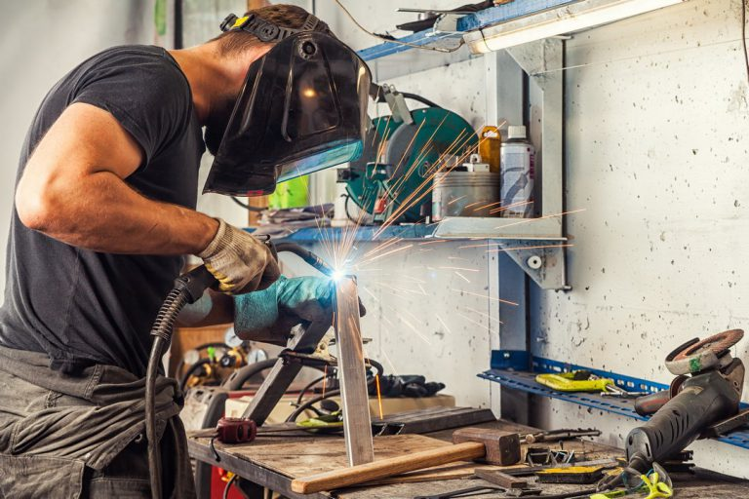
INTRODICTION
Weld quality is an essential aspect of metal construction, as it affects mechanical strength and production costs
What are the basic points to consider to ensure good welding quality?

Slide 4
Welding Quality Standards and Certifications:
ISO 3834: Quality management system for welding
AWS: Standard for Welded Steel Construction

Slide 5
Techniques to Ensure Welding Quality:
Settings Control
Material Quality
Training and Skills

Slide 6
Welding Parameters Influencing Quality:
Current intensity
Arc Speed
Electrode Choice

Slide 7
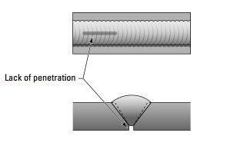
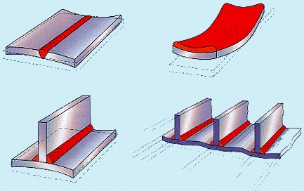
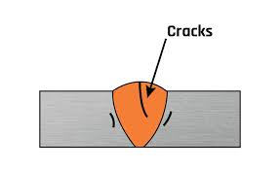
Common Faults During Welding:
Penetration
Deformations
Cracks

Slide 8
Welding quality control :
Quality control before welding:
Material confirmation:
To ensure that the chemical composition and mechanical properties meet design specifications
preparation:
To ensure that the preparation conforms to the design specifications and/or specified welding standard.

Slide 9
Checking the fit of the joints:
The distance between side walls, signal and support
complies with DMOS standards
Welding qualification:
Ensure the welder is qualified to perform the welding process.

Slide 10
Quality control during welding:
Make sure that the temperatures are within the limits specified in the DMOS.
Make sure the filler material meets DMOS specifications.
Other checks: cleaning between passes, weld bead appearance.
Make sure DMOS is tracked
Non-destructive testing as specified

Slide 11
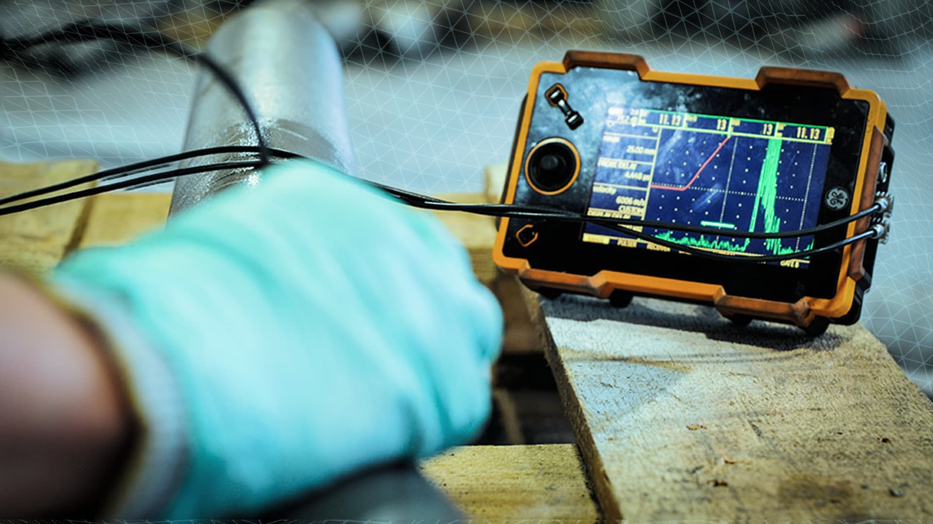
Quality control after welding:
The extent of quality control depends on the weld conformity standard and weld class.
Tests can be of the TD or TND type.

Slide 12
The different types of welding quality control:
When it comes to welding quality control, there are three types of control methods:
Non-Destructive Testing:
Non-destructive testing is a quality control method that does not damage the material
Different tests will be undertaken:
Check by visual inspection
Penetrant inspection
Leak test
Ultrasonic inspection
Thermography
Magnetoscopy
Chemical analysis
x-ray

Slide 13
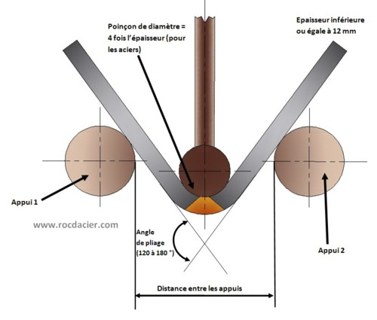
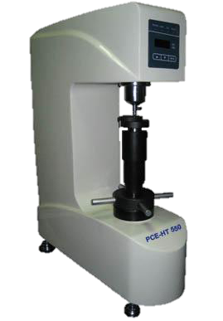
Destructive Testing:
Destructive testing is quality control methods that destroy the material being tested.
Different tests will be undertaken:
Macrography.
Hardness test.
Bending test.
Semi-destructive testing:
Semi-destructive testing will be used to test weld penetration or weld defects in the joint.
It can then be repaired after quality control testing.

Slide 14
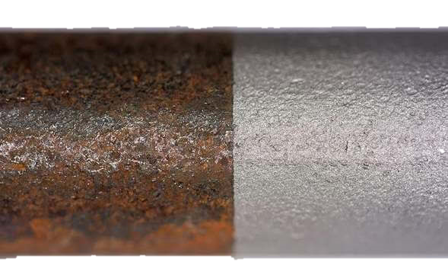
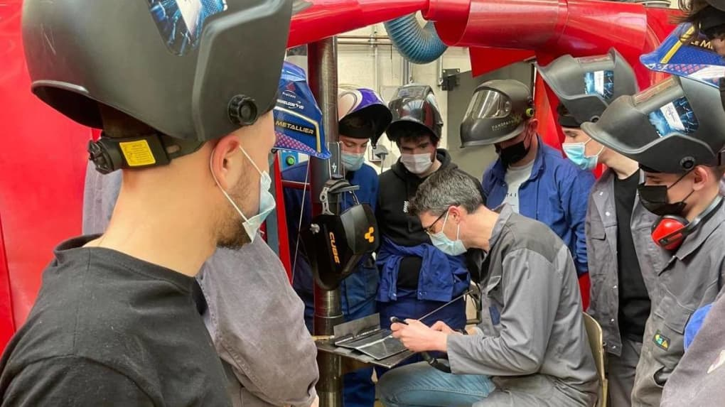
Best Practices to Improve Welding Quality :
Good Preparation:
Clean surfaces and remove contaminants to achieve good welding
training and skills :
Invest in training and skills development to improve welder performance.

Slide 15
Quality controls:
Conduct inspections and tests to ensure welds conform to required specifications.
Use of modern machines:
Welding equipment ensures high quality for welding operations.

Slide 16
Conclusion
In summary, to ensure high-level welding quality, it is necessary to follow best practices, meet specific standards, use proper techniques, and train and certify welders.

