Slide 1
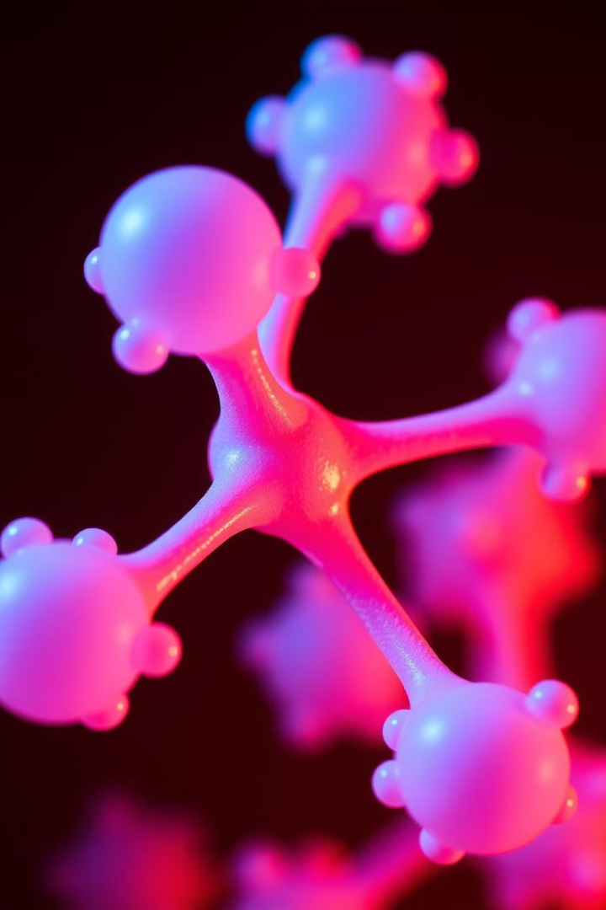
Introduction to Molecular Biology
Molecular biology is a captivating field that delves into the fundamental building blocks of life. It explores the complex molecular mechanisms underlying the functions and interactions of biological macromolecules, such as DNA, RNA, and proteins, which are essential for the survival and proper functioning of all living organisms. This discipline provides a deep understanding of the intricate processes that govern cellular activities, gene expression, and the inheritance of genetic information.
By Mouderas F.

Slide 2
Importance of Molecular Biology
1
Advancing Medical Research
2
Understanding Genetic Disorders
Molecular biology has revolutionized the field of medicine, enabling researchers to develop groundbreaking treatments, diagnose diseases at the genetic level, and personalize healthcare to individual patients.
By elucidating the molecular mechanisms underlying genetic disorders, researchers can develop targeted therapies and strategies for early intervention, improving the quality of life for individuals and their families.
3
Biotechnology and Genetic Engineering
Molecular biology is the foundation for advancements in biotechnology, allowing scientists to manipulate and engineer biological systems for various applications, such as the production of biofuels, development of genetically modified crops, and creation of novel therapeutic agents.

Slide 3
Definition of Molecular Biology
Understanding Biological Molecules
Investigating Cellular Processes
Integrating Multidisciplinary Approaches
This discipline examines the molecular mechanisms that govern cellular activities, such as gene expression, DNA replication, protein synthesis, and signal transduction pathways, which are essential for the maintenance and regulation of life.
Molecular biology is the study of the structure, function, and interactions of the fundamental biological macromolecules that make up living organisms, including DNA, RNA, and proteins.
Molecular biology integrates principles and techniques from various scientific fields, including chemistry, physics, genetics, and bioinformatics, to provide a comprehensive understanding of the molecular basis of biological phenomena.
By Mouderas F.

Slide 4
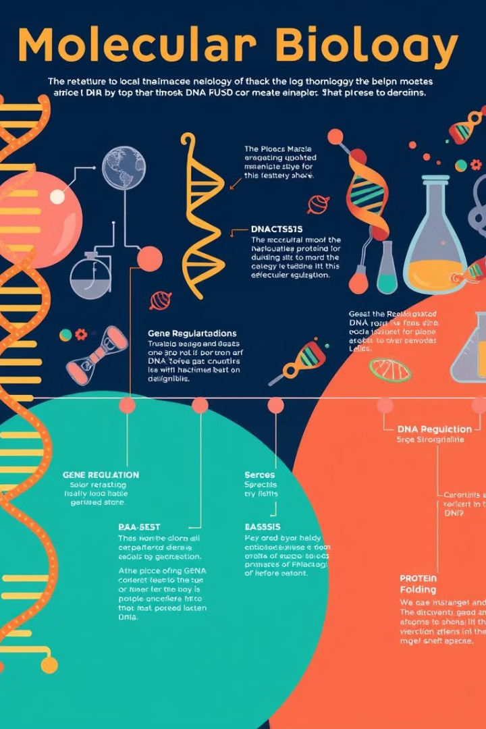
Key Discoveries in Molecular Biology
1
DNA Structure
The discovery of the double-helix structure of DNA by James Watson and Francis Crick in 1953 revolutionized our understanding of genetic information storage and inheritance.
2
Genetic Code
The elucidation of the genetic code, which describes how the sequence of DNA bases is translated into the sequence of amino acids in proteins, was a crucial milestone in molecular biology.
3
Gene Regulation
The identification of mechanisms that control gene expression, such as transcription factors and epigenetic modifications, has provided insights into how cells precisely regulate their genetic programs.

Slide 5
Applications of Molecular Biology
Diagnostics and Personalized Medicine
Biotechnology and Genetic Engineering
Molecular biology techniques, such as genetic testing and biomarker analysis, enable early disease detection, accurate diagnosis, and the development of personalized treatment strategies tailored to an individual's genetic profile.
The ability to manipulate and engineer biological systems at the molecular level has led to advancements in areas like biofuel production, genetically modified crops, and the development of novel therapeutic agents.
Forensic Science and DNA Profiling
Environmental Monitoring and Bioremediation
Molecular biology techniques, such as DNA fingerprinting, have revolutionized forensic science, allowing for the identification of individuals and the analysis of biological evidence in criminal investigations.
Molecular biology tools can be used to detect and monitor environmental pollutants, as well as develop microbial-based strategies for the bioremediation of contaminated sites.
By Mouderas F.

Slide 6
Groundbreaking Techniques in Molecular Biology
DNA Sequencing
Microscopy
Techniques like Sanger sequencing and next-generation sequencing have enabled the rapid and accurate determination of the nucleotide sequence of DNA, revolutionizing our understanding of genomes.
Advanced microscopy techniques, such as electron microscopy and super-resolution microscopy, have provided unprecedented insights into the structural and functional properties of biological macromolecules.
CRISPR-Cas9
PCR
The revolutionary CRISPR-Cas9 gene editing technology has transformed the field of molecular biology, allowing for precise and targeted modifications of genetic sequences.
Polymerase Chain Reaction (PCR) has become an indispensable tool in molecular biology, enabling the amplification of specific DNA sequences and facilitating a wide range of applications.

