Slide 1
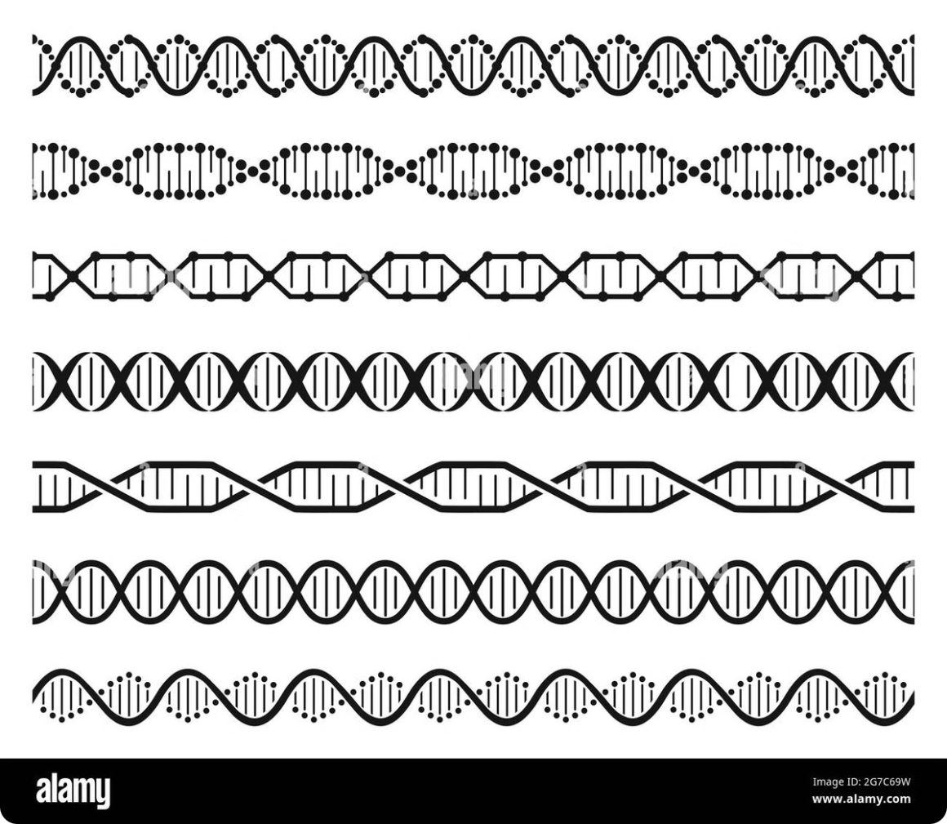
Genes and Genomes:
Genes and genomes form the foundation of life as we know it. These microscopic structures contain the instructions that shape every living organism on Earth. From the simplest bacteria to the most complex mammals, genes dictate the characteristics and functions of all life forms.
Mouderas F.

Slide 2
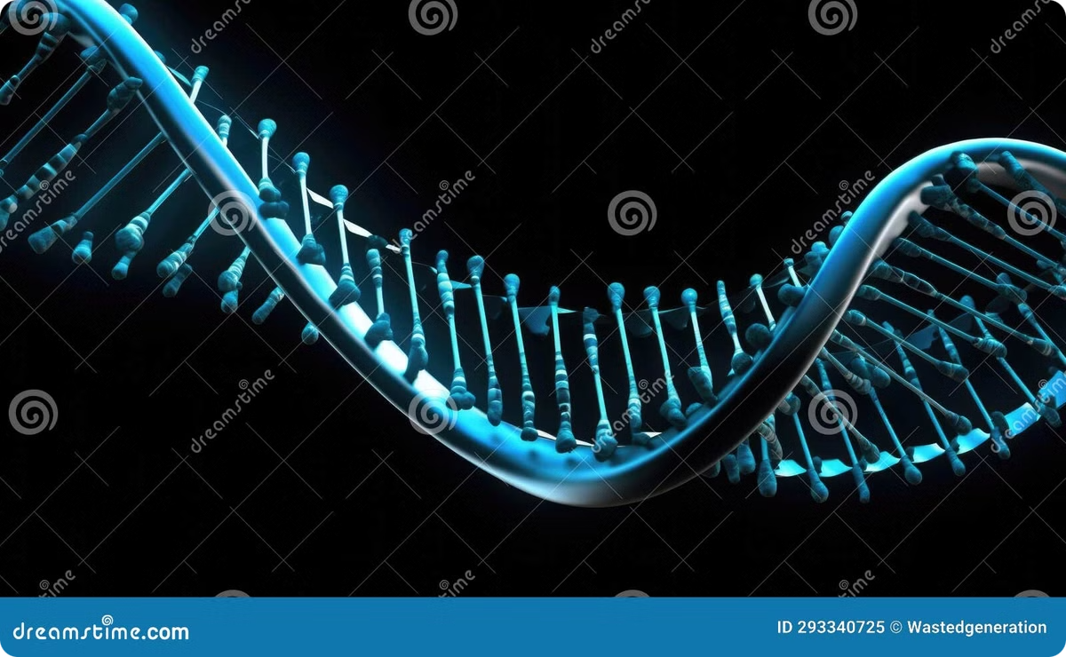
What are Genes?
Definition
Function
Genes are segments of DNA that contain instructions for building proteins, the workhorses of cells. They are the basic units of heredity, passed down from parents to offspring.
Genes control the development and functioning of all known living organisms. They determine traits such as eye color, height, and susceptibility to certain diseases.
Composition
Location
Genes are made up of nucleotides - adenine (A), thymine (T), guanine (G), and cytosine (C). The sequence of these nucleotides determines the genetic information.
In eukaryotes, genes are located on chromosomes within the cell nucleus. Prokaryotes have a single circular chromosome in their cytoplasm.

Slide 3
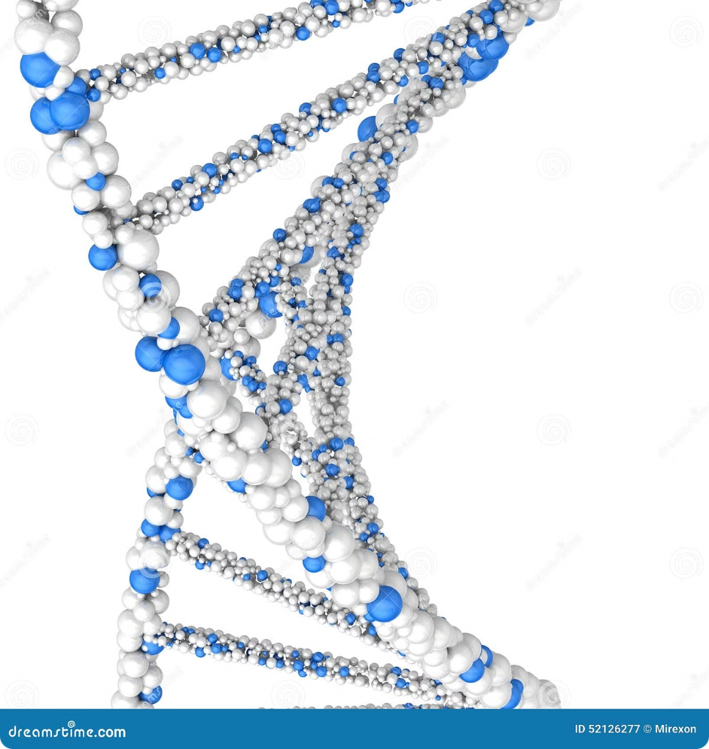
Structure of DNA
1
Discovery
In 1953, James Watson and Francis Crick unveiled the double helix structure of DNA, revolutionizing our understanding of genetics.
2
Double Helix
DNA consists of two strands coiled around each other, forming a spiral staircase-like structure. The sides are made of alternating sugar and phosphate molecules.
3
Base Pairs
The rungs of the ladder are formed by complementary base pairs: adenine (A) pairs with thymine (T), and guanine (G) pairs with cytosine (C).
4
Replication
The double helix structure allows for easy replication, as each strand can serve as a template for a new complementary strand.

Slide 4
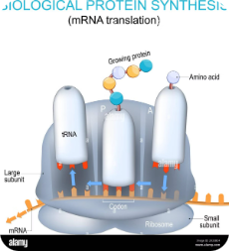
Genetic Code and Protein Synthesis
Transcription
Translation
Protein Formation
Regulation
The process begins with transcription, where the DNA sequence of a gene is copied into a complementary RNA molecule called messenger RNA (mRNA).
The mRNA then moves to the ribosomes, where it's translated into a sequence of amino acids. Each set of three nucleotides (codon) corresponds to a specific amino acid.
As the amino acids are linked together, they form a protein. The final protein's shape and function are determined by its unique sequence of amino acids.
Various regulatory mechanisms control when and how much of each protein is produced, allowing cells to respond to environmental changes and maintain homeostasis.

Slide 5
Mutation and Genetic Variation
Types of Mutations
Causes of Mutations
Genetic Variation
Mutations can occur in various forms, including point mutations (changes in single nucleotides), insertions, deletions, and chromosomal abnormalities. Some mutations are harmless, while others can lead to genetic disorders or contribute to evolution.
Mutations can be caused by environmental factors such as radiation, chemicals, or viruses. They can also occur spontaneously during DNA replication. The rate of mutation varies between species and even between different regions of the genome.
Mutations are a primary source of genetic variation, which is crucial for evolution and adaptation. Sexual reproduction also contributes to genetic diversity by combining parental genes in new ways, allowing populations to adapt to changing environments.

Slide 6
Genome Organization
1
Prokaryotic Genomes
2
Eukaryotic Genomes
Prokaryotes, such as bacteria, typically have a single circular chromosome containing their genetic material. Their genomes are compact, with little non-coding DNA and genes often organized into operons for efficient regulation.
Eukaryotes have more complex genome organization. Their DNA is packaged into multiple linear chromosomes within the nucleus. Eukaryotic genomes contain both coding and non-coding regions, including introns, regulatory sequences, and repetitive elements.
3
Chromatin Structure
4
Gene Density
In eukaryotes, DNA is wrapped around histone proteins to form nucleosomes, which are further compacted into chromatin. This structure allows for efficient storage of large amounts of genetic material and plays a role in gene regulation.
The proportion of coding DNA varies widely between species. For example, the human genome contains only about 1-2% protein-coding genes, with the rest consisting of non-coding regulatory sequences, introns, and repetitive elements.

Slide 7
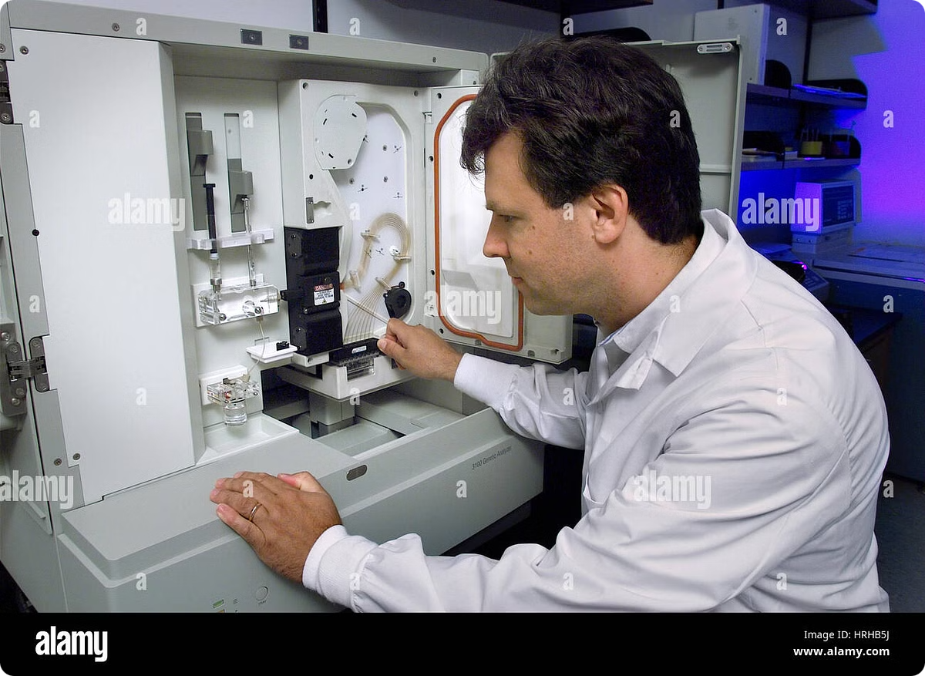
Sequencing the Human Genome
1
1990: Project Launch
The Human Genome Project begins as an international effort to sequence and map all human genes.
2
2001: Draft Sequence
The first draft of the human genome is published, covering about 90% of the genome.
3
2003: Project Completion
The Human Genome Project is declared complete, with 99% of the genome sequenced to 99.99% accuracy.
4
2022: T2T Consortium
The Telomere-to-Telomere (T2T) Consortium publishes the first truly complete sequence of a human genome, filling in the remaining gaps.

Slide 8
Genomics and Personalized Medicine
Genetic Testing
Pharmacogenomics
Advanced genetic tests can identify gene variants associated with disease risk, allowing for early intervention and prevention strategies.
Genetic information helps predict how individuals will respond to certain medications, enabling tailored drug selection and dosing.
Cancer Genomics
Prenatal Screening
Analyzing cancer genomes aids in developing targeted therapies and predicting treatment outcomes for individual patients.
Non-invasive prenatal testing uses fetal DNA in maternal blood to screen for genetic abnormalities early in pregnancy.

Slide 9
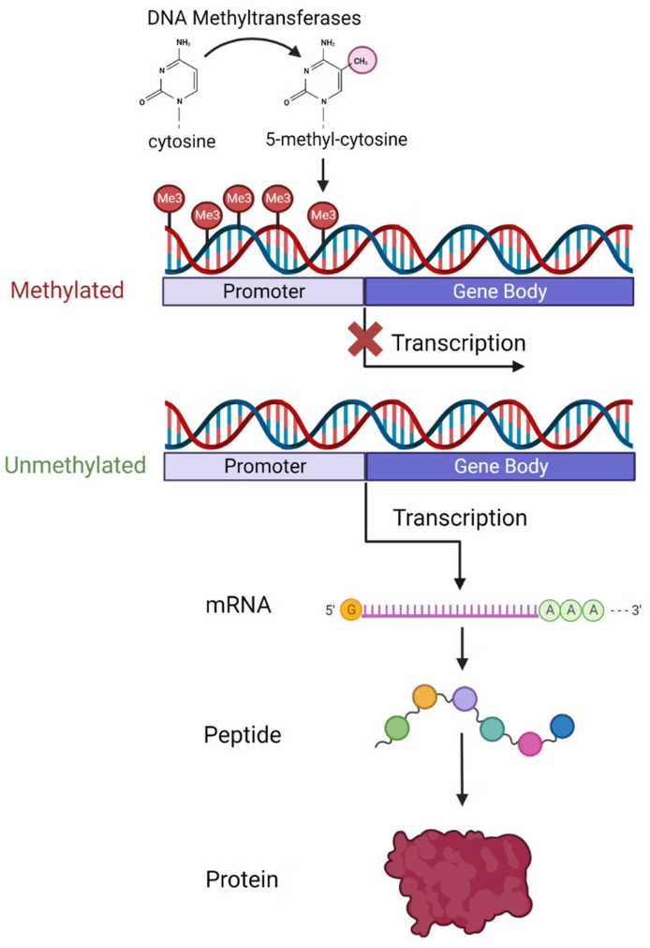
Epigenetics and Gene Regulation
Mechanism
Description
Effect on Gene Expression
DNA Methylation
Addition of methyl groups to DNA
Usually represses gene expression
Histone Modification
Chemical changes to histone proteins
Can activate or repress genes
Chromatin Remodeling
Changes in chromatin structure
Affects accessibility of genes
Non-coding RNAs
RNA molecules that don't code for proteins
Can regulate gene expression

Slide 10
Bioinformatics and Data Analysis
Protein Structure Prediction
Gene Expression Analysis
Comparative Genomics
Bioinformatics tools can predict the three-dimensional structure of proteins based on their amino acid sequence, aiding in drug design and understanding protein function.
Advanced algorithms analyze large-scale gene expression data, revealing patterns of gene activity across different tissues, conditions, or diseases.
Bioinformatics enables the comparison of genomes across species, providing insights into evolution, gene function, and the identification of conserved regulatory elements.

