Slide 1
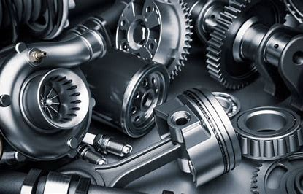
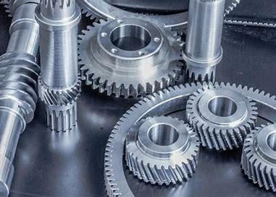
University of Tlemcen
Faculty of Technology
Department of Mechanical Engineering
L 2 GM
How to get products
Academic year 2023/2024

Slide 2
Minerals are generally extracted from mines.
Methods of obtaining products:
There are four basic methods for obtaining products:
By permanent forming, by pouring, by pressing, by removing the material.
By forming method: plastic, rolling, blacksmithing, concavity.
By casting method: molding
How to obtain products
By removing the material: turning, milling, punching, cavity.
By sintering method: from powders

Slide 3
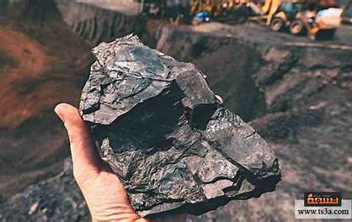
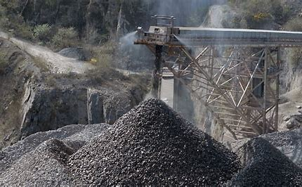
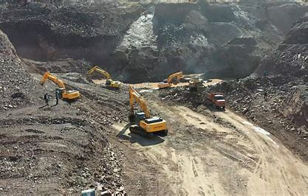

Slide 4
First by casting method:

Slide 5
moulding
Definition:
Molding is an industrial economic method in which complex mechanical parts are prepared by casting molten metal into a mold that contains a gap representing the effects of the piece to be casted, the forged metal takes the form of the mold cavity and after cooling we get the shape of the body to be made, the pieces obtained are called raw pieces.
Types of molding:
1/ Compression molding : In this case, the mold is metal and the molten metal is pressed into a gap bearing the shape of the piece to be obtained, as well as in stages:
1.Close the metal mold.
2. Inject molten metal into the mold.
3.Open the mold and remove the molded piece.
4.Repeat the process again to mold a new piece.

Slide 6
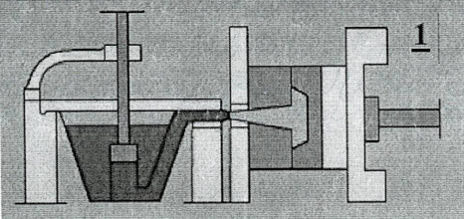
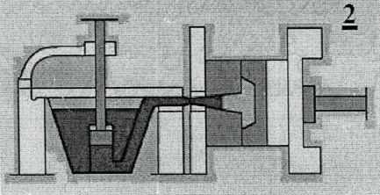
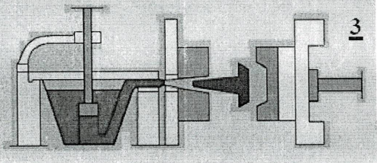
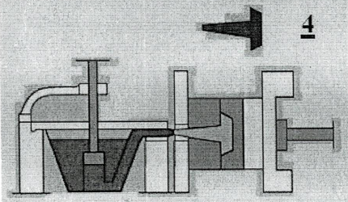
Compression molding process

Slide 7
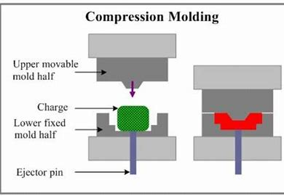
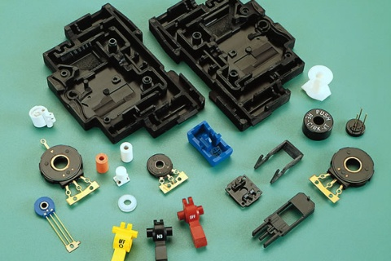
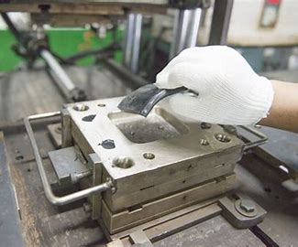
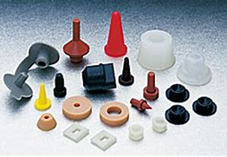

Slide 8
2/Cochlear molding : where the fuse is poured into a shell formed by two parts that are assembled and the process takes place through the stages as shown in the figures:
1.Preparation and assembly of the two shells.
2.Pour molten metal.
3.Dismantle the two shells and remove the piece obtained after cooling.
4.Remove the appendages.
3/Sand molding(non-permanent mold): In this method, sand is used as a basic material to which some materials are added that work to half its grains and we use a pattern of metal or wood that has the shape of the piece and the mold consists of two or more parts that work after pouring the molten metal and after cooling the sand mold breaks and we take out the molded piece.
Sand molding elements:
sand, clay, model and gear

Slide 9
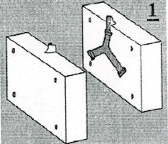
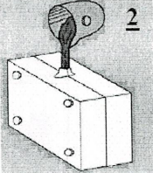
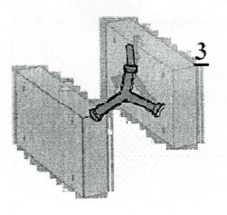
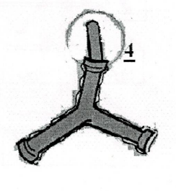
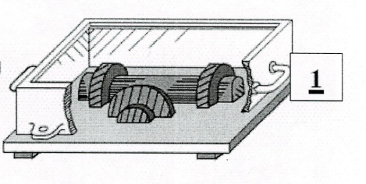
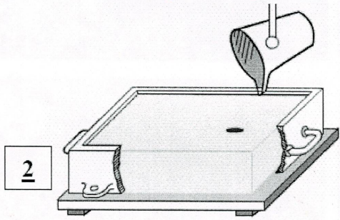
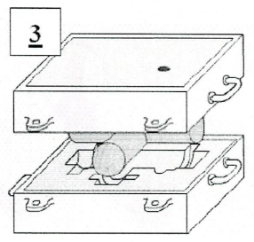
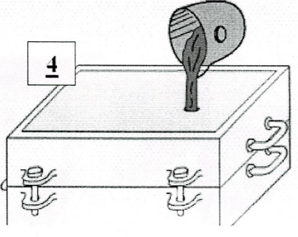
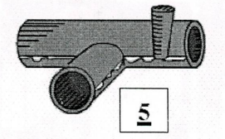
Cochlear molding
Sand molding

Slide 10
Secondly by the method of formation:

Slide 11
Rolling
Definition:
The pieces and rolled plates are obtained by introducing the metal several times between two or more rollers, according to the reduction ratio of the metal to be rolled, and the thickness of the rolled parts is controlled by changing the distance between the two rollings and from this process it is possible to obtain steel plates, railway rails. The rolling process is either cold or hot.
Forms obtained:
Sheets are either flat or rolled in the form of cylinders.
Long products in the form of columns with sections (square, rectangular, triangular, round) as well as in the form of (T, U, L).

Slide 12
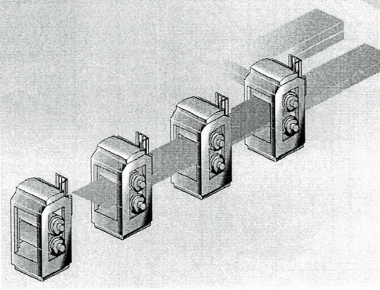
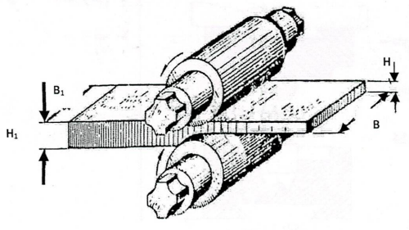
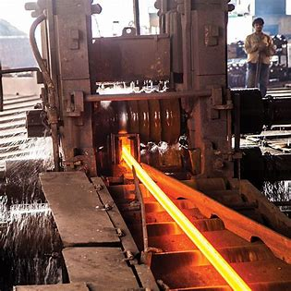
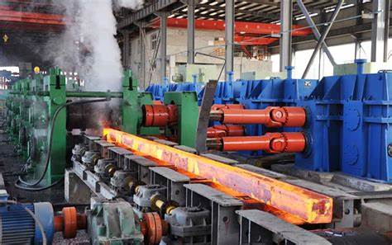
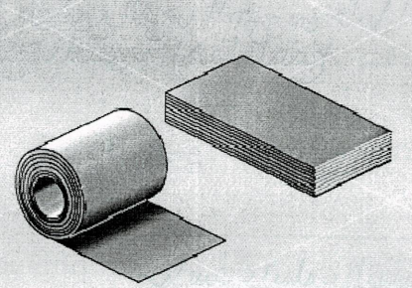
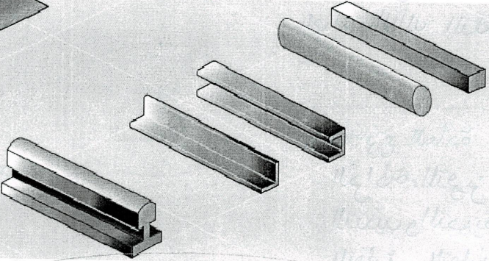
Rolling
Obtained shapes

Slide 13
Thank you for your attention

