Slide 1
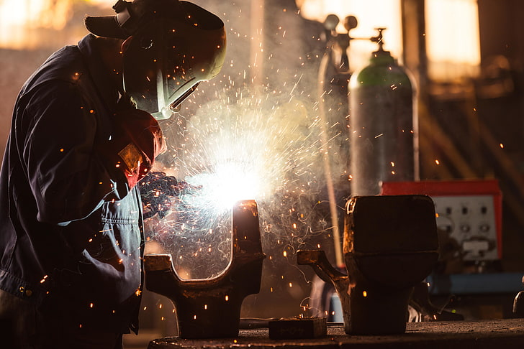
Introduction
Welcome to today's presentation on "Radiography in Welding." As we delve into the world of welding inspection, we'll shine a spotlight on the crucial role that radiography plays in ensuring the quality and integrity of welded structures.

Slide 2
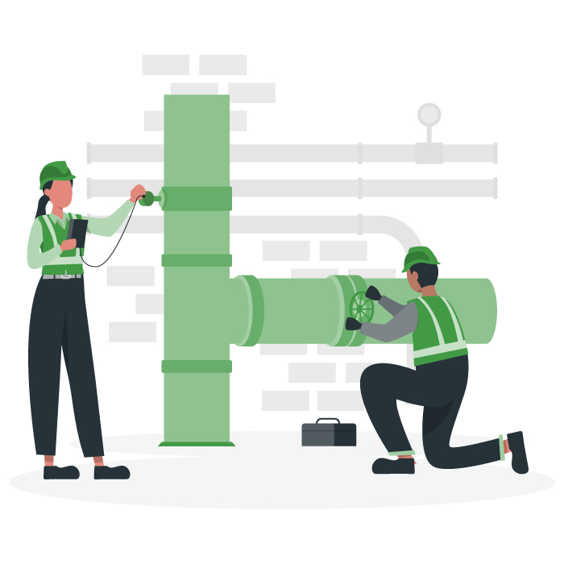
Non-destructive testing (NDT)
Non-destructive testing (NDT) refers to a set of inspection techniques used to assess the integrity, quality, and properties of materials and structures without causing damage or altering their physical properties.

Slide 3
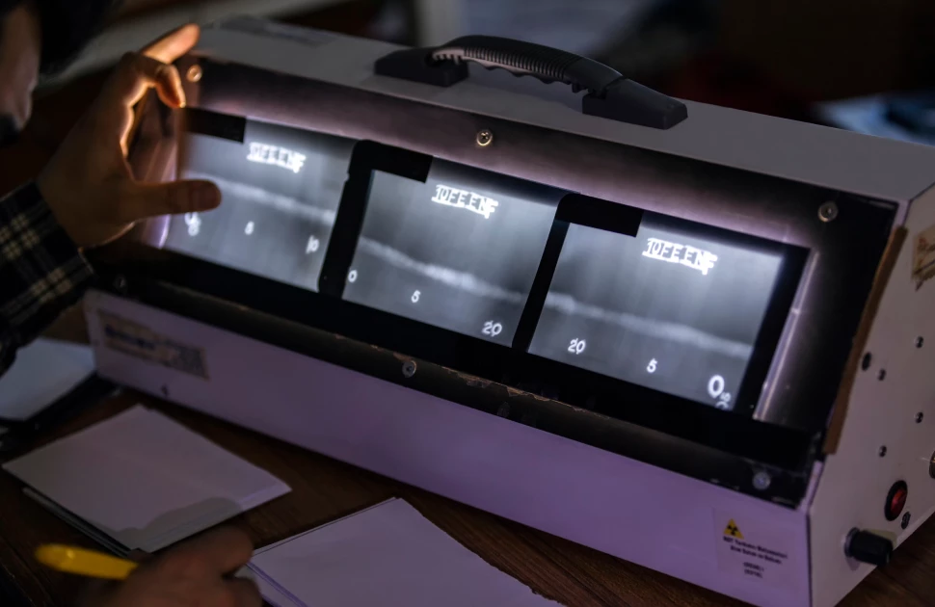
Basics of Radiography
Radiography is a technique that uses X-rays or gamma rays to produce images of the internal structures of objects.

Slide 4
How does it work
Step 1: A radioactive isotope produces gamma rays or X-rays.
Step 2: The radiation is sent through the weldment onto photographic film or digital detector.
Step 3: An image of the internal structure of the weldment is created on the film or digital detector.
Step 4:
-Film Radiography: remove the exposed film from the cassette and transfer it to the darkroom for development.
-Digital Radiography: capture the digital images in real-time during the exposure.
Step 5: Radiographic interpreters trained to read the films and identify weld discontinuities by the shape and variations of dark and light examine the test results.

Slide 5
Types of Radiographic Techniques
In welding, there are two main types of radiographic techniques used for non-destructive testing

Slide 6
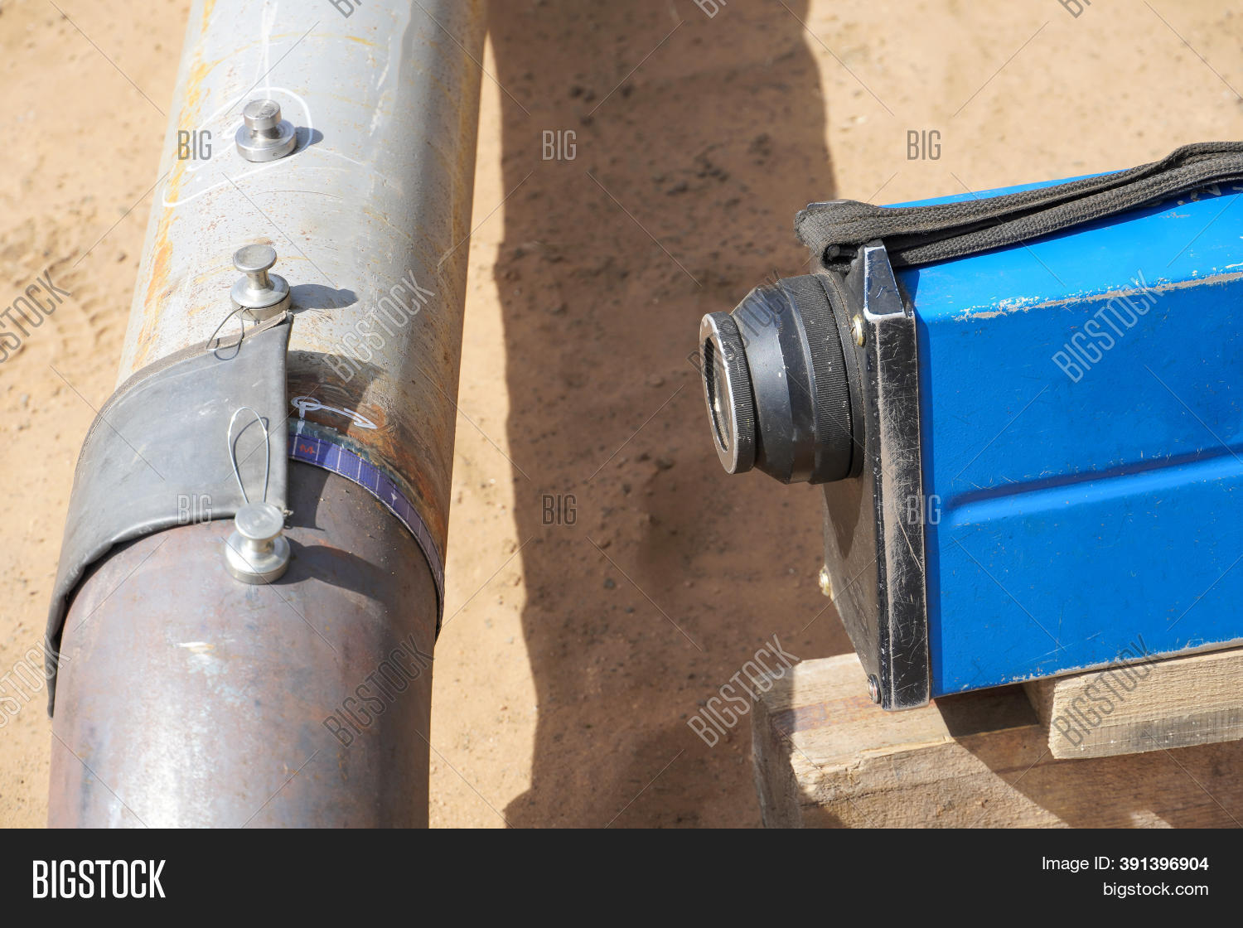
Film Radiography:
Involves the use of X-ray film as the imaging medium. X-rays pass through the object being inspected and expose the film.The film is then developed to produce a visible image.

Slide 7
Advantages:
Lower initial equipment cost compared to digital radiography.
Suitable for various material thicknesses.
Considerations:
Time-consuming process due to film development.
Storage of film records require physical space.

Slide 8
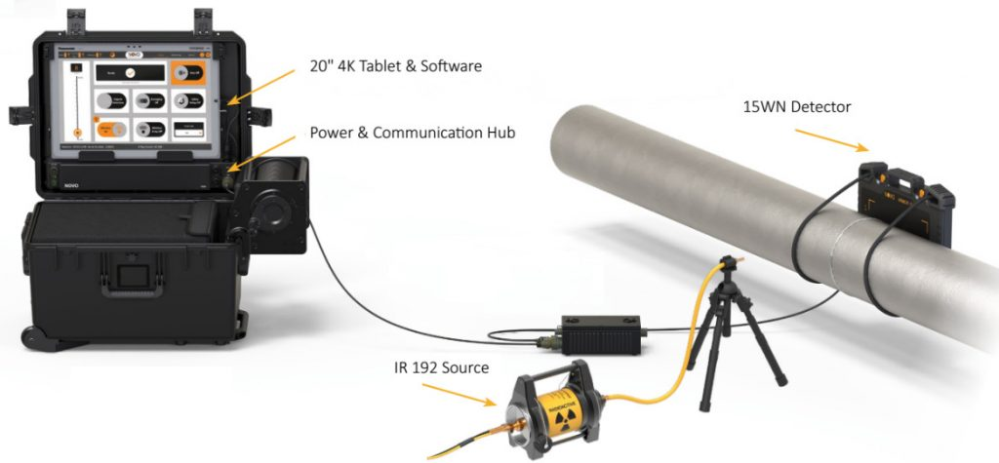
Digital Radiography:
Involves the use of digital detectors (such as flat-panel detectors) to capture X-ray images. The digital data is processed and can be viewed immediately.

Slide 9
Advantages:
Faster results and immediate image viewing.
Digital data can be easily stored, shared, and retrieved.
Considerations:
Higher initial equipment cost compared to film radiography.

Slide 10
Benefits of Radiography in Welding
Surface or volume detection in all materials.
it is excellent in detecting surface and subsurface flaws .
Possible conservation of radiograms for several decades.
It helps in inspecting the assembled components.
Cost-Effective Quality Control.
Non-Destructive Nature.
International Recognition.

Slide 11
Challenges and Considerations
Radiation Safety
Environmental Impact
The disposal of chemicals used in traditional film processing can have environmental implications.
Complexity and Skill Requirements
Achieving the desired resolution in radiographic images, especially for thin-walled or low-density materials, can be challenging.

Slide 12
Conclusion
In conclusion, radiography stands as a cornerstone in the realm of welding, providing a critical lens into the hidden aspects of welded joints. Its versatility makes it applicable across various welding techniques and industries, from manufacturing to critical sectors like aerospace and nuclear engineering.

