Slide 1
Reading a Research Literature; example of an Article
Dr ZEKRI
M2
Didactics

Slide 2
Do I have to read all the paper?
Yes
No
Yes, if I have basic ideas
No, if I’m looking for specific details
Keep scrolling…..

Slide 3
What to read
The title is often a bit of a give-away about where the text is going.
The abstract
The introduction
The conclusion
Skimming the headings to get you to the point; will also help you to know the concepts discussed, the chronology of theories, how concepts have been developed.

Slide 4
Read
For the point = direct
Not willy nilly
You need to find what the point the writer wants you to get

Slide 5
What should I read?
Your decision to read the full paper or skim it depends on;
What are you reading for?
The concept,
the context of research,
or to understand the topic (which you have no idea or very basic ideas about)
2. Are you trying to find in the paper the authors who have conducted similar research (related to your topic, concept, field)?
3. Are you trying to define concepts you’re working on?
4. Are you trying to find how the concepts have been searched on? (methods used, contexts? Type of sampling, type of methodology, interventions: type of tests)

Slide 6
Illustration 1
You decided to write a heading on ‘LMD’
Don’t read a long text about LMD system in Europe IF YOUR CONTEXT is not Europe:
LMD in Algeria ( what and how they define it, and how they employ it)
If you have further time… read about how it is employed in Europe.
If you compare between education in Europe and Algeria, read both texts fully.

Slide 7
Your reader cares about specificities, not generalities. (Each time I read your literature, I question, why did you talk about LMD? Ha it’s the educational system in Algeria that focuses on the teaching of English, and among its principles is developing language and communicative skills, with less regard to writing. I am doing research in writing… I should find critiques of the LMD that it focuses less on writing skills, which hinders/effect teachers’ professional development in teaching writing skills.

Slide 8
Read as a professional!
Read and Question
Write and question

Slide 9
LMD
LMD in Algeria
1. What is it? What are its principles, how does it function (credits)
2. How is it employed for teaching languages?
3. How is it employed for teaching English?
4. What does it focus on in teaching English in particular?
5. Communicative skills, rather writing skills?
6. What’s my focus?

Slide 10
Read, take notes, outline your text then write
Decolonising Methodologies Research and indigenous people; example 1
Researcher | Concept | Context | Theory | objective of analysis/ participants | Why women?
Linda Tuhiwai Smith | Indigenous practice methodologies | South and Central America | feminist research Decoloniality | women | To discuss issues focusing on problem-solving

Slide 11
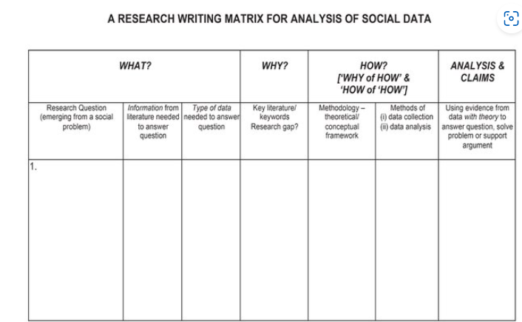
A Research Writing Matrix for discussing research rigour in the social sciences.

Slide 12
Read and summarise (example 2)
Summary of John Edwards’ Book: Language and identity 2009
How identity was regarded?
It is an emerging field of modernity and globalisation. Language and the social world are mutually shaping. The analysis of language use can be best captured in its cultural and social realms. In this sense, identity can be studied through a linguistic ethnography if it is replaced with the term ‘personal order’ (Edwards, 2009).
Personal order derives from a social order. A person is the site of meaning-making practices. Over time repetitions and practice individuals form their personal style. The accumulation of these practices become a guide to continuity in the present. The practices are described by Whetherell (2007) as psycho-discursive.
Psycho-discursive practices is the performance of all the self (subject), identity, the psychological, the emotional, the motives, the intentions, and the beliefs.
Meaning-making practices is about how people construct knowledge, and how they make sense of their experiences.

Slide 13
Reading time vs writing time
Read in mornings/nights but… take notes (later you forget what you read)
Keep references with your notes.
Write in a summarising style (with the reference)
Use apps that summarize papers (their aims, concepts, and findings)
But you still need to use ‘summarising skills’ an ‘paraphrasing skills’
Apps summarise content, your summary should be different as well in style and language, keeping the content as it represents the knowledge.

Slide 14
Questions

