Slide 1
Links and Resources
Dr Zekri Wafa

Slide 2
Doing Initial Research
Using different resources (print/online) to find relevant titles related to your area
Using key words that facilitate research on your topic
Finding relevant sources that create your understanding of your topic (articles, books)
Finding a good amount of information that aligns with your topic.
Ask your supervisor to send you references related to your topic (if they have any)
Locate other resources from the bibliographies of articles you found.
Find recent articles (2019, 2020)

Slide 3

GoogleScholar.com

Slide 4
How to find your references
Use proper keywords
Speaking in EFL
Enhancing speaking skills in EFL (there are more ESL than ESL) contexts
Enhancing speaking skills in second language classes
Enhancing speaking skills using project-based learning

Slide 5
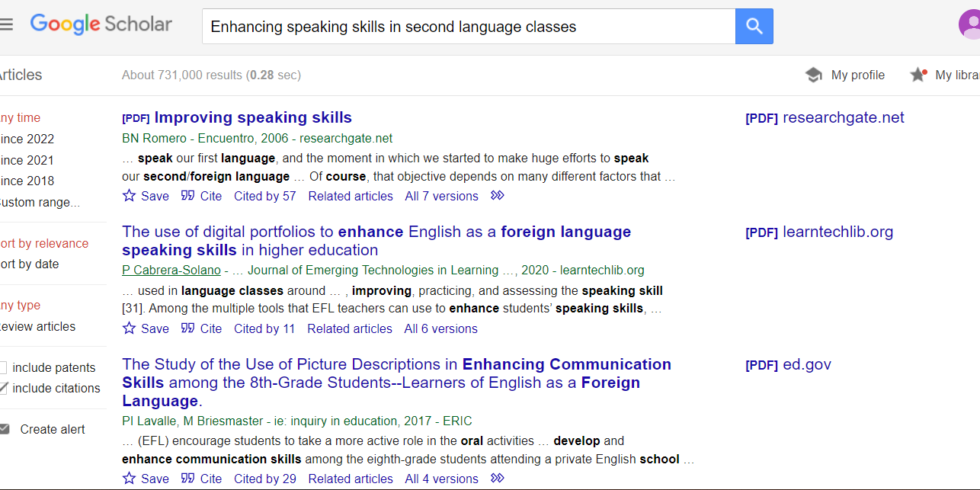
Enhancing speaking skills in second language classes

Slide 6
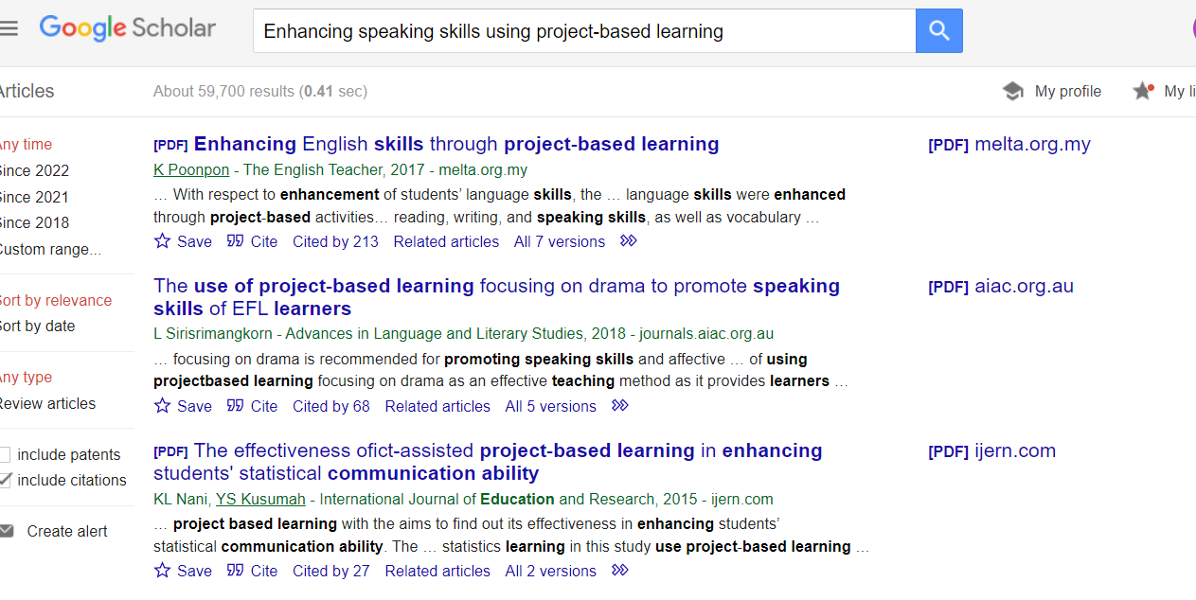
Enhancing speaking skills using project-based learning

Slide 7
SNDL?

Slide 8
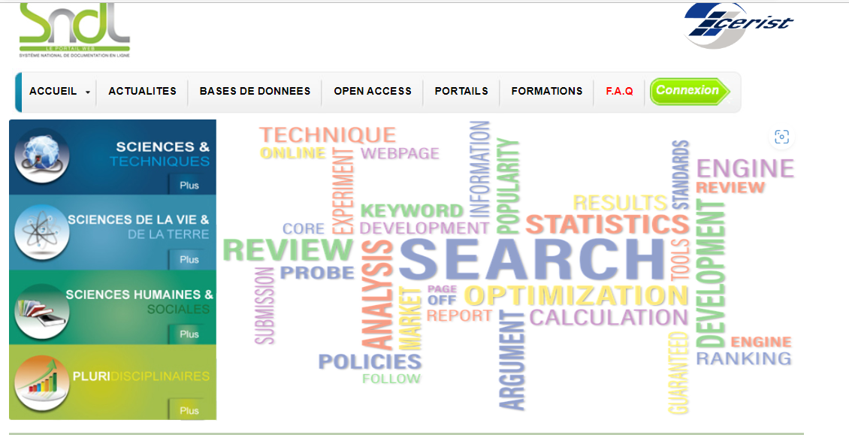
Access: contact

Slide 9
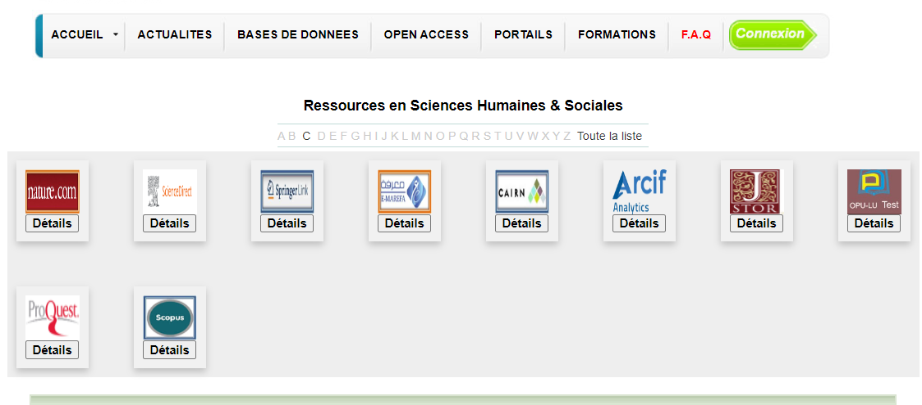
Databases= base de donnees

Slide 10
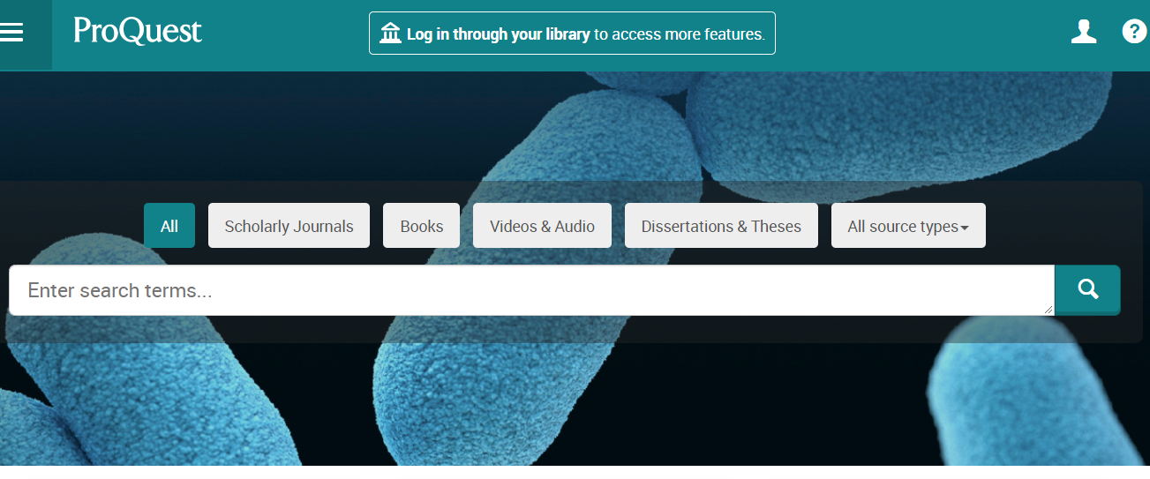
ProQuest for books reading

Slide 11
كيفية إستخدام موقع SNDL
https://www.youtube.com/watch?v=4HQC1y-YJr8
https://www.youtube.com/watch?v=EETSnijKii4

Slide 12
كيفية تحميل اطروحة من موقع SNDL
كيفية تحميل اطروحة من موقع SNDL – YouTube
تحميل أطروحات الماجستير والدكتوراه من SNDL || النظام الوطني للتوثيق على الخط || الفيديو الخامس - YouTube

Slide 13
guide d'utilisation de la base de données springer link via sndl
guide d'utilisation de la base de données springer link via sndl – YouTube

Slide 14
www.Elsevier.com
You can access it through SNDL

Slide 15
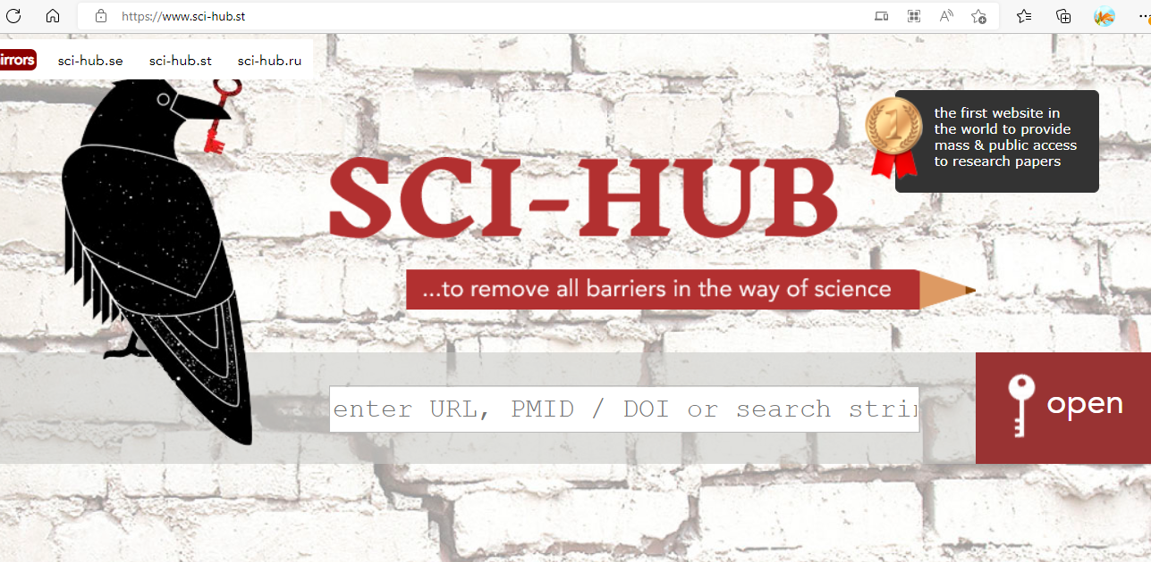
Sci-Hub: removing barriers in the way of science

Slide 16
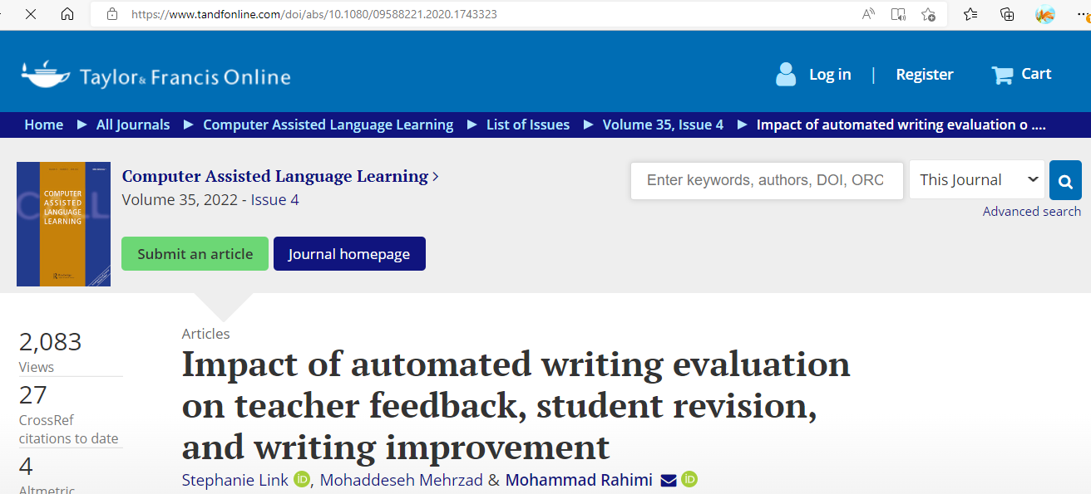
DOI

Slide 17
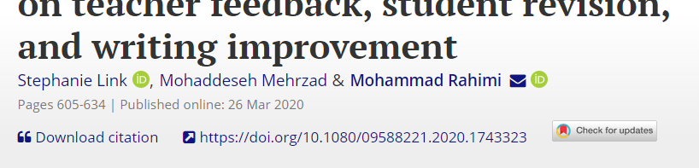
DOI

Slide 18
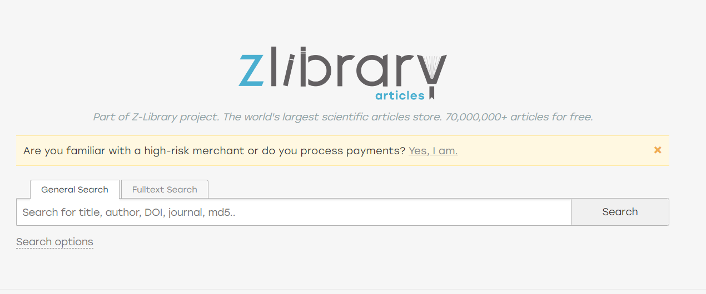
Electronic library. Download books free. Finding books (booksc.org)

Slide 19
Further information on the web
ONS.dz
National office of Statistics

Slide 20
Language Resources

Slide 21
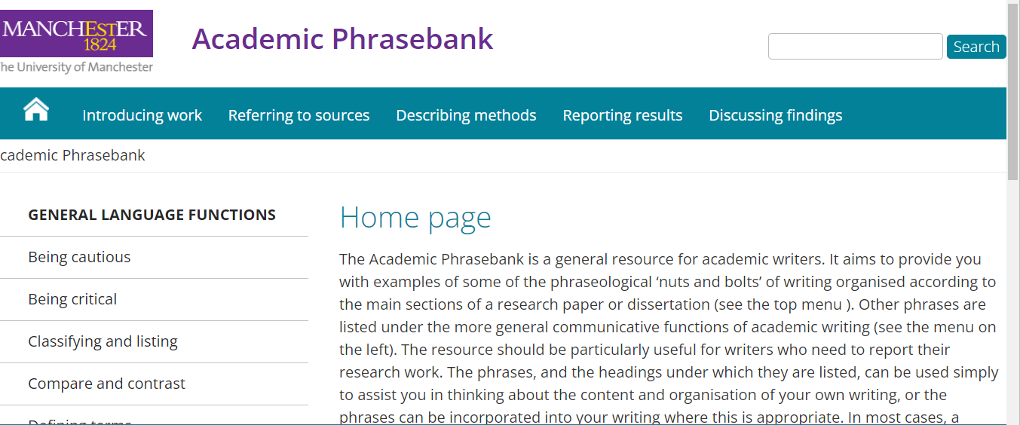
Manchester Phrasebank

