Slide 1
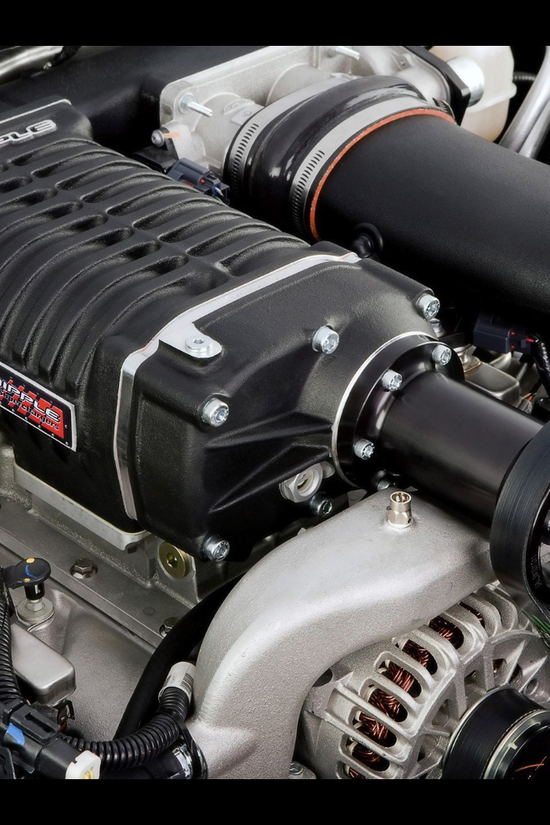
Supercharger
A supercharger is a device used in internal combustion engines to increase the amount of air and fuel mixture in the combustion chamber, resulting in increased engine power.
by Yacine Amara

Slide 2
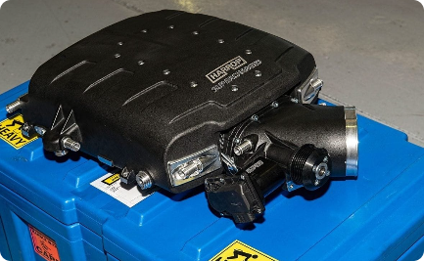
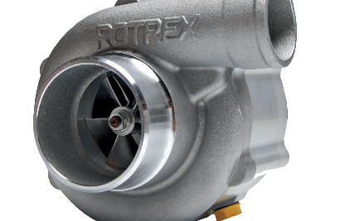
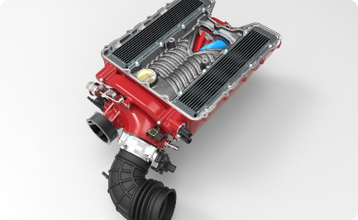
Types of Superchargers
Positive Displacement
Centrifugal
Twin Screw
This type of supercharger delivers a fixed amount of air per revolution, resulting in instant power delivery.
Centrifugal superchargers use a belt-driven impeller to compress the air, delivering power in a more linear and controlled manner.
Twin screw superchargers provide smooth and efficient airflow, ideal for high-performance applications.

Slide 3
How Does a Supercharger Work?
Compressor
A supercharger use a compressor to compress the incoming air, increasing its density before it enters the combustion chamber.
Belt or Gear Driven
The supercharger is driven by a belt or gears, drawing its power from the engine's crankshaft and forcing more air into the combustion chamber.
Increased Power
By compressing more air into the engine, a supercharger increases power output, resulting in improved acceleration and performance.

Slide 4
Benefits of Using a Supercharger
1
Increased Engine Power
A supercharger provides a significant boost in engine power, allowing for faster acceleration and increased performance.
2
Improved Torque
With the additional air and fuel mixture, a supercharger increases torque, resulting in more pulling power and better towing capacity.
3
Enhanced Engine Response
A supercharger provides instant power delivery, eliminating lag and providing a smooth and immediate response.

Slide 5
Drawbacks of Using a Supercharger
1
Increased Fuel Consumption
2
Higher Operating Temperatures
3
Added Engine Strain
The increased power and stress generated by a supercharger can put additional strain on engine components, potentially reducing longevity.
A supercharger requires more fuel to support the higher power output, resulting in reduced fuel efficiency.
The compressing action of a supercharger generates additional heat, requiring a robust cooling system to prevent overheating.

Slide 6
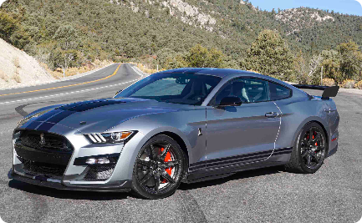
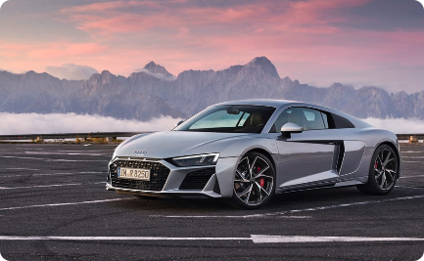
Examples of Vehicles with Superchargers
Ford Mustang Shelby GT500
Audi R8 V10
Mercedes-AMG GT
The Audi R8 V10 features a powerful V10 engine with a supercharger, blending exquisite design with exceptional performance.
The Mercedes-AMG GT combines stunning looks with a twin-turbocharged V8 engine, providing incredible speed and driving dynamics.
This iconic American muscle car boasts a supercharged V8 engine, delivering exhilarating performance and a distinctive engine roar.

Slide 7
Conclusion
Superchargers are a popular choice for enthusiasts seeking to maximize engine performance. While they offer increased power and responsiveness, it's important to consider the additional fuel consumption and impact on engine longevity.

