Slide 1
Chapter One: WHAT IS LITERATURE?
Dr,Amel RAHMOUNI
FAD 2023/2024

Slide 2
Literature
1, Latin “litera” acquaintance with letters
2, Creatively composed written works
3, Various forms: poetry, prose, drama,,,
4, Robert Frost: “ good literature should disturb the reader’s mind
5, Artistic value and exemplary style
6, Classified: language, origin, era, themes, genre, subject,,,

Slide 3
Who produces literature?
A man of letters
an artist who possesses a unique approach to writing and reading
poets, novelists, playwrights, and critics
is
Inclu-de

Slide 4
Functions of Literature
1, Entertainment
Pleasure and enjoyment
Homer: relaxation in a new fictional world
Mimetic and imitative: human emotions
Creative and illusory

Slide 5
2, Instruction
Language structure: Linguistic forms and styles

Slide 6
Instruction
Moral Values: fostering good manners and ethics

Slide 7
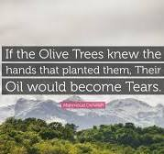
Instruction
Encapsulating the essence of a given society
Roman Jakobson (1978) argues that in the communication process, the addresser (the author) sends a message to the addressee (the reader) through a shared context (code)
Mahmoud Darwish

Slide 8
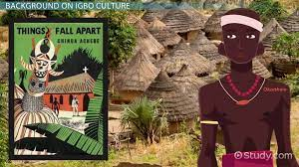
Things Fall Apart by Chinua Achebe
Example 02: The night was very quiet. It was always quiet except on moonlight nights. Darkness held a vague terror for these people, even the bravest among them. Children were warned not to whistle at night for fear of evil spirits. Dangerous animals became even more sinister and uncanny in the dark. A snake was never called by its name at night, because it would hear.

Slide 9
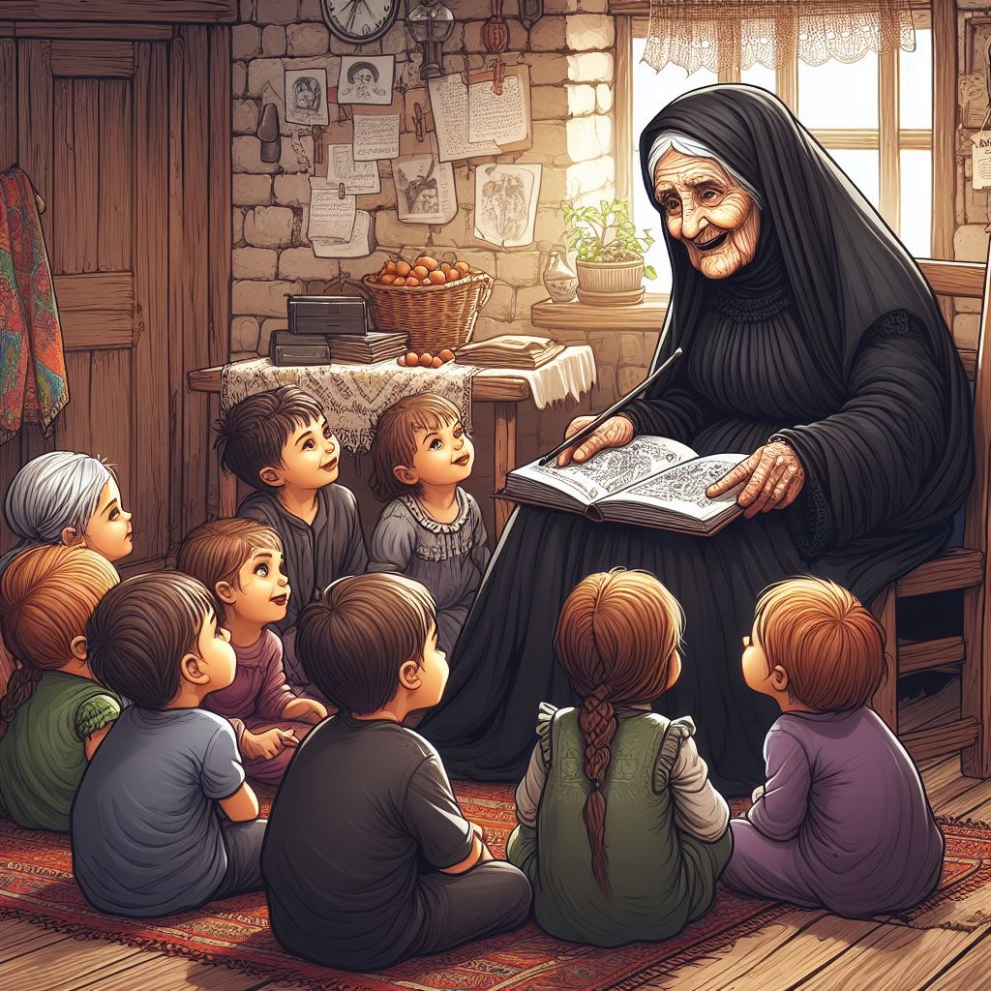
Forms of Literature
Oral Forms
Written Forms
Folktales, songs, chronicles in traditional communities,
Published by intellectuals for reading
intellectual and artistic endeavors

Slide 10
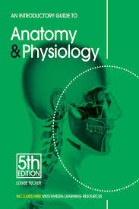
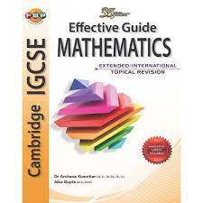
What is Not Literature
Purely Informative
Purely instructive
Only provide information: journals, newspapers, news, facts,,,,
Technical books, specialized disciplines, only instruction, no artistic qualities

