Slide 1
Professor. Zakia DJEBBARI
Introduction to Research Methodology
Research methodology is the systematic process of conducting research to explore, understand, and find solutions to complex problems. It involves defining research objectives, selecting appropriate methods, collecting and analyzing data, and drawing meaningful conclusions.
da

Slide 2
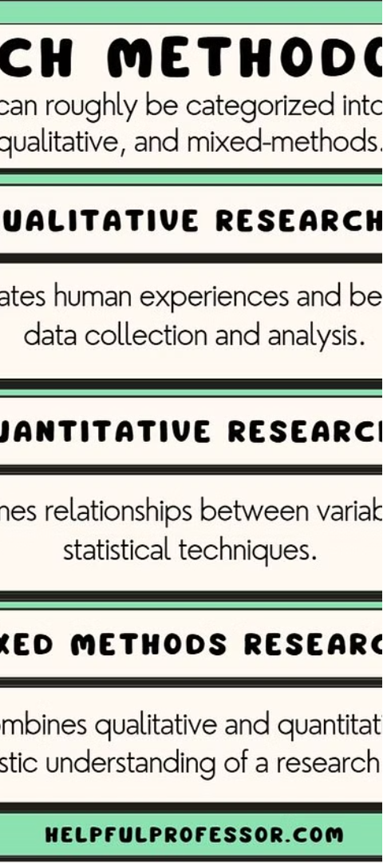
Defining Research
1
Systematic Investigation
2
Discovering New Insights
Research is a structured and methodical process of gathering information to expand knowledge and understanding.
Through research, we can uncover new concepts, theories, and solutions to address various challenges.
3
Evidence-Based Approach
Research relies on data and facts to draw conclusions, rather than relying on assumptions or personal biases.

Slide 3
Types of Research
Qualitative Research
Quantitative Research
Mixed Methods
Focuses on understanding human behavior, experiences, and opinions through methods like interviews, focus groups, and observations.
Emphasizes numerical data and statistical analysis to test hypotheses and identify patterns and trends.
Combines both qualitative and quantitative approaches to provide a more comprehensive understanding of a research problem.

Slide 4
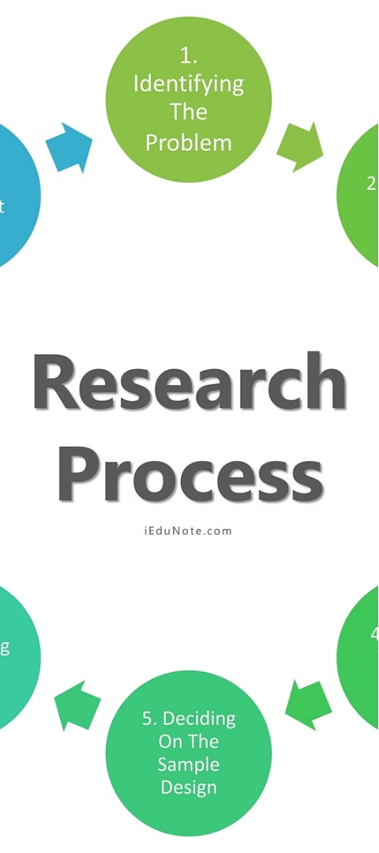
Research Process
1
Identify the Problem
Clearly define the research question or the issue that needs to be investigated.
2
Conduct a Literature Review
Explore existing knowledge and research on the topic to understand the current state of the field.
3
Design the Study
Determine the appropriate research methodology, data collection techniques, and analysis methods.

Slide 5
Research Design
Exploratory
Descriptive
Investigates a new or poorly understood phenomenon to identify potential ideas and insights.
Aims to describe the characteristics, behaviors, or attitudes of a specific population or phenomenon.
Explanatory
Evaluative
Examines the relationships between variables to understand the underlying causes and mechanisms.
Assesses the effectiveness, efficiency, or impact of a particular program, intervention, or policy.

Slide 6
Data Collection Methods
Surveys
Interviews
Observation
Document Analysis
Gather data through questionnaires, either online or in-person.
Conduct in-depth, one-on-one conversations to gather detailed information.
Systematically observe and record behaviors, interactions, or events in their natural setting.
Examine and interpret various forms of written, visual, or electronic records.

Slide 7
Data Analysis Techniques
Descriptive Analysis
Inferential Analysis
Content Analysis
Summarize and describe the characteristics of the data, such as measures of central tendency and dispersion.
Draw conclusions about the population based on sample data, using statistical techniques like regression or hypothesis testing.
Systematically identify and categorize patterns, themes, or meanings in qualitative data, such as interviews or documents.

Slide 8
Ethical Considerations in Research
1
Informed Consent
2
Confidentiality and Privacy
Ensure participants understand the purpose, risks, and benefits of the study and voluntarily agree to participate.
Protect the privacy of research participants and ensure the confidentiality of their personal information.
3
Minimize Harm
4
Integrity and Objectivity
Identify and mitigate potential risks to participants, both physical and psychological, and avoid causing any harm.
Maintain the highest standards of honesty, transparency, and objectivity in the research process and findings.

