Slide 1
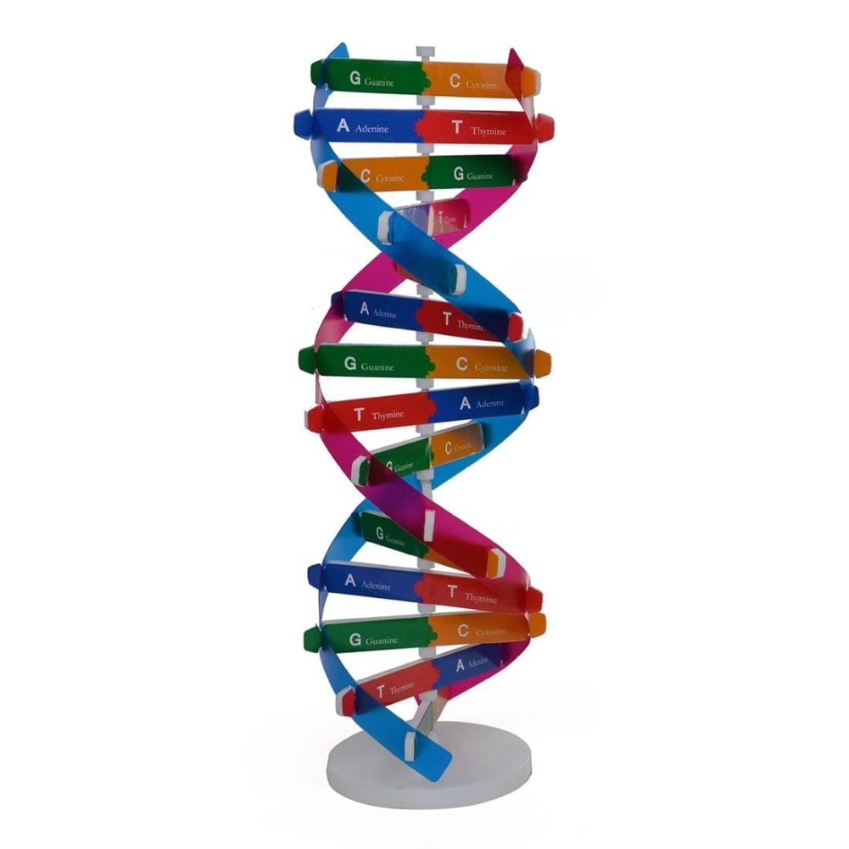
Nucleic Acids: The Building Blocks of Life
Nucleic acids are the fundamental biomolecules that store and transmit genetic information in living organisms. They play a crucial role in the complex processes that sustain life, from cellular function to heredity. This introduction will explore the structure and significance of the two main types of nucleic acids: DNA and RNA.
by Mouderas F.

Slide 2
The Essence of Nucleic Acids
1
What are Nucleic Acids?
2
Two Main Types
Nucleic acids are large, complex biomolecules composed of smaller units called nucleotides. They are responsible for storing, transmitting, and expressing genetic information within cells.
The two primary types of nucleic acids are DNA (deoxyribonucleic acid) and RNA (ribonucleic acid). DNA is the genetic material that stores hereditary information, while RNA plays a central role in protein synthesis.
3
Crucial Functions
Nucleic acids are essential for the growth, development, and reproduction of all living organisms. They allow cells to replicate, transcribe, and translate genetic information into the proteins that carry out life's processes.

Slide 3
The Structure of DNA
Nucleotides
Polynucleotide Chains
Genetic Coding
The basic building blocks of DNA are nucleotides, which consist of three components: a nitrogenous base, a sugar (deoxyribose), and a phosphate group. The sequence of these nucleotides encodes the genetic information.
DNA molecules are composed of two polynucleotide chains that wind around each other, forming the iconic double helix structure. These chains are held together by hydrogen bonds between the complementary base pairs.
The specific sequence of nucleotides in a DNA molecule serves as the genetic code, providing the instructions for the synthesis of proteins and the regulation of cellular activities.
by Mouderas F.
by Mouderas F.

Slide 4
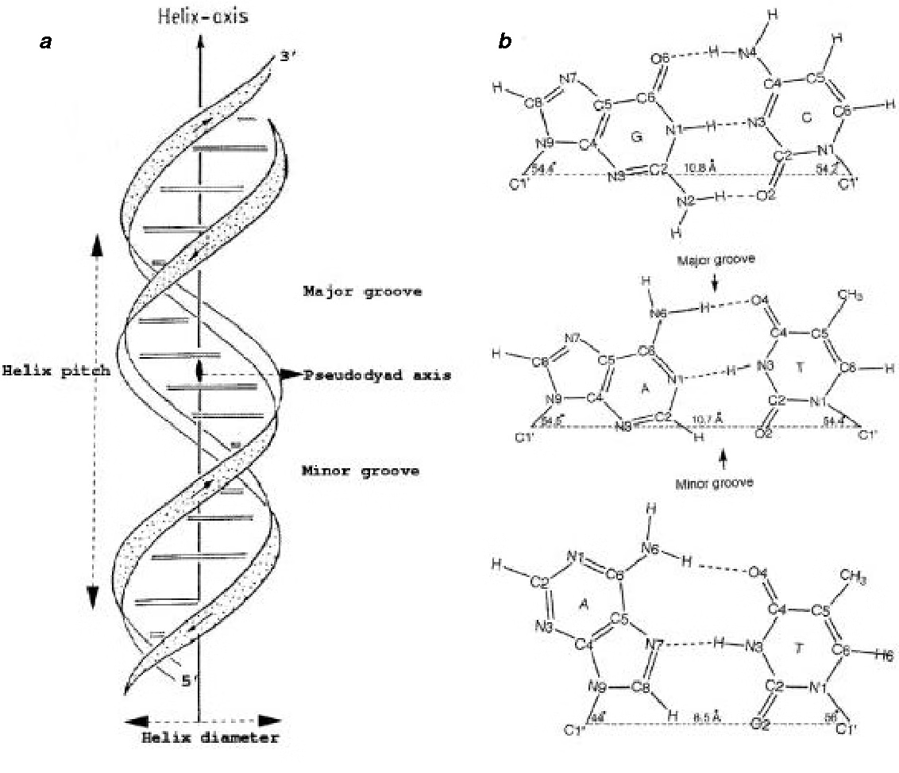
The Double Helix Structure
1
Discovery
The iconic double helix structure of DNA was first proposed by James Watson and Francis Crick in 1953, based on their groundbreaking work and the findings of other scientists.
2
Antiparallel Strands
The two DNA strands run in opposite directions, with the sugar-phosphate backbones on the outside and the nitrogenous bases on the inside, forming the characteristic double helix.
3
Base Pairing
The nitrogenous bases on the two strands are paired in a specific manner: adenine (A) pairs with thymine (T), and guanine (G) pairs with cytosine (C), stabilizing the double helix structure.

Slide 5
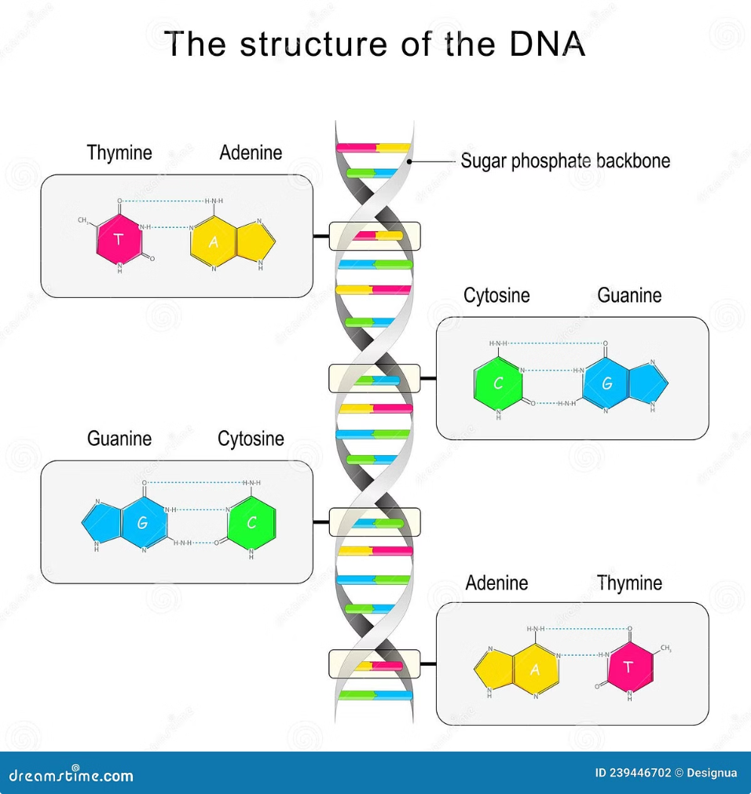
The Complementary Base Pairs
Adenine (A)
Thymine (T)
Adenine is one of the four nitrogenous bases found in DNA. It forms a complementary base pair with thymine (T) through two hydrogen bonds.
Thymine is the complementary base to adenine (A) in the DNA double helix. The two bases are held together by two hydrogen bonds.
Guanine (G)
Cytosine (C)
Guanine is another nitrogenous base in DNA. It forms a complementary base pair with cytosine (C) through three hydrogen bonds.
Cytosine is the complementary base to guanine (G) in the DNA double helix. The two bases are held together by three hydrogen bonds.

Slide 6
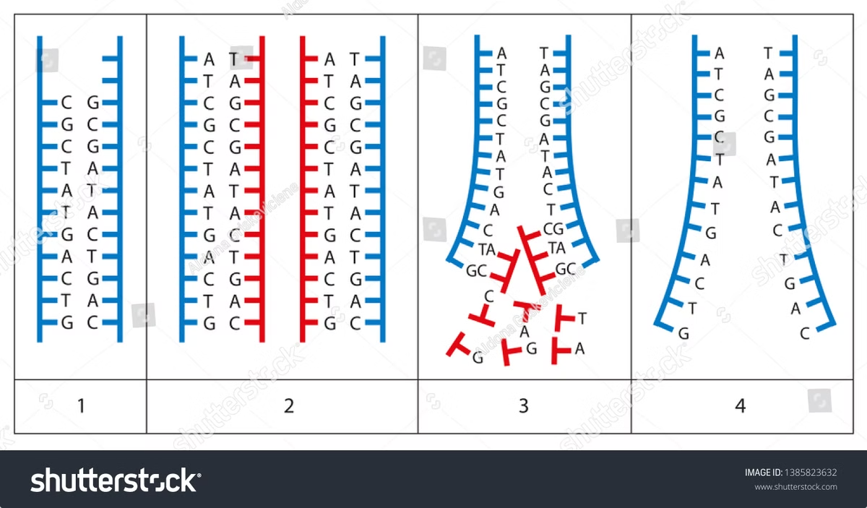
DNA Replication: The Copying of Genetic Information
1
Unwinding
During DNA replication, the double helix structure unwinds, allowing the two strands to separate and serve as templates for the synthesis of new, complementary strands.
2
Complementary Synthesis
Enzymes called DNA polymerases then read the template strands and assemble new polynucleotide chains, with each new strand complementary to the original template.
3
Semiconservative Replication
The resulting DNA molecules are "semiconservative," meaning that each new molecule contains one original strand and one newly synthesized strand, ensuring the accurate transmission of genetic information.

Slide 7
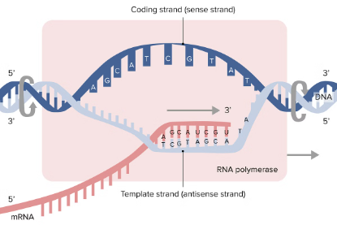
From DNA to RNA: The Process of Transcription
DNA Template
RNA Polymerase
Transcription
The genetic information stored in a specific DNA sequence serves as the template for the synthesis of a complementary RNA molecule.
The enzyme RNA polymerase reads the DNA template and assembles a single-stranded RNA molecule, known as a messenger RNA (mRNA), which carries the genetic instructions.
The process of transcription converts the genetic information from DNA into a portable, intermediate form (mRNA) that can be used for protein synthesis in the cell.

Slide 8
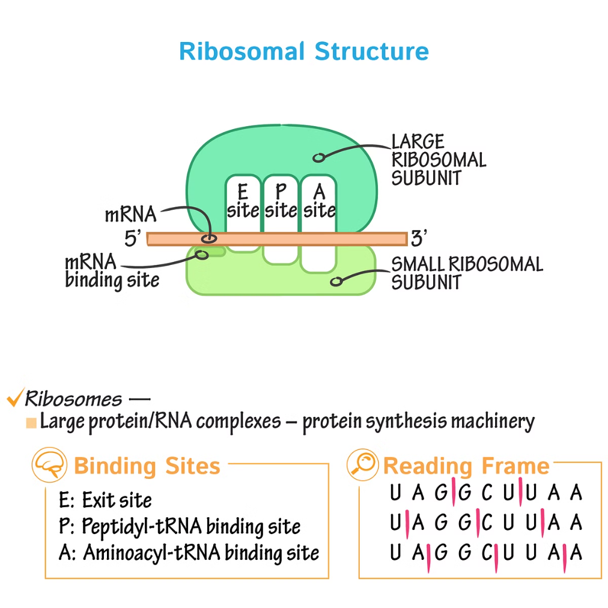
From RNA to Protein: The Process of Translation
Ribosome
Transfer RNA (tRNA)
Ribosomes are the cellular structures responsible for the synthesis of proteins, using the instructions provided by the mRNA molecule.
tRNA molecules carry specific amino acids to the ribosome, where they are assembled into a polypeptide chain according to the genetic code.
Peptide Bonds
Protein Folding
The amino acids brought by tRNA are linked together by peptide bonds, forming the final protein molecule that will carry out cellular functions.
The polypeptide chain then undergoes folding to assume its three-dimensional structure, which is crucial for the protein's function.

Slide 9
Genetic Information and Heredity
Genetic Information
Inheritance
Genetic Diversity
The unique sequence of nucleotides in a DNA molecule encodes the genetic information that determines an organism's physical characteristics and biological functions.
During cell division and reproduction, DNA is replicated and passed on to daughter cells and offspring, ensuring the continuity of genetic information and the transmission of hereditary traits.
Variations in the DNA sequence, such as mutations, contribute to the genetic diversity within a population, allowing organisms to adapt to changing environmental conditions.
by Mouderas F.

Slide 10
The Importance of DNA in Biological Processes
1
Cell Function
2
Heredity and Evolution
DNA provides the genetic instructions for the synthesis of proteins, which are essential for the growth, development, and proper functioning of all living cells.
The accurate transmission of genetic information from one generation to the next is crucial for the inheritance of traits and the evolution of species over time.
3
Biotechnology and Medicine
The study and manipulation of DNA have led to advancements in fields such as genetic engineering, forensics, personalized medicine, and the development of diagnostic tools and therapies.

