Slide 1
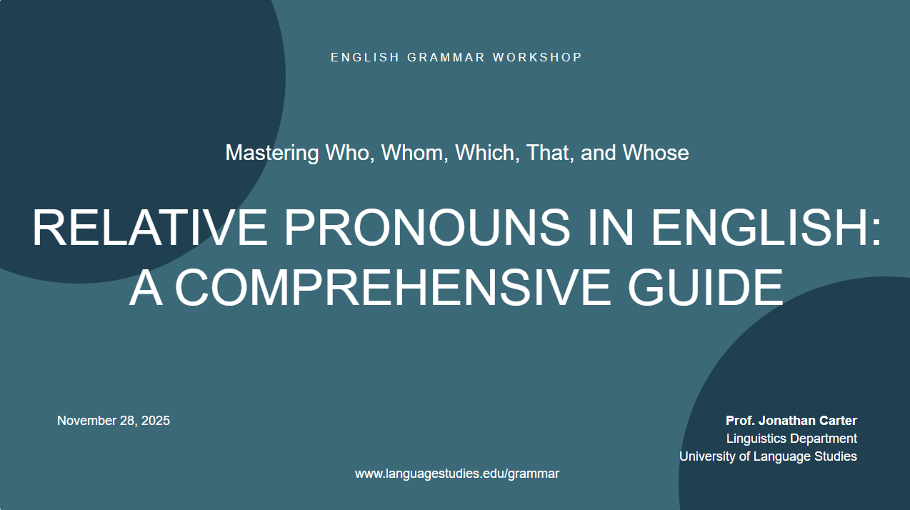
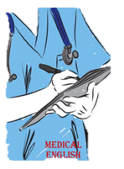

K.BENMAAMAR
Faculty of Medicine

Slide 2
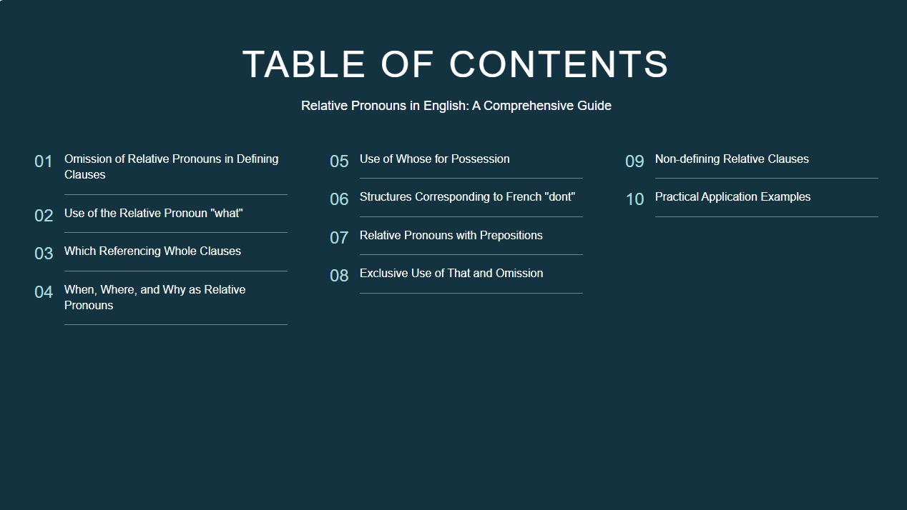
K.BENMAAMAR
Faculty of Medicine

Slide 3
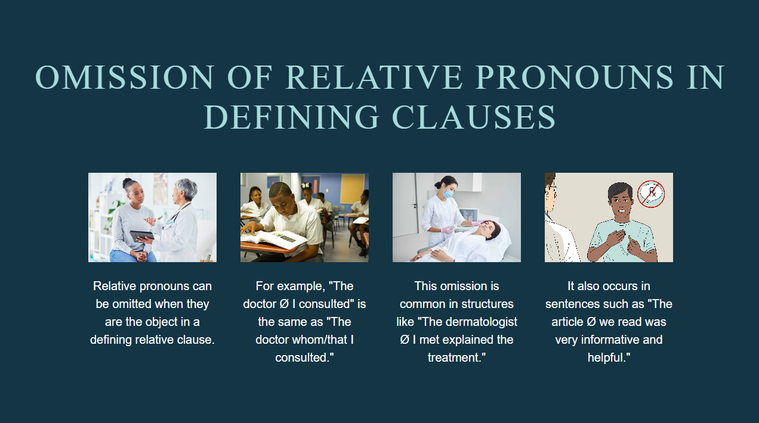
K.BENMAAMAR
Faculty of Medicine

Slide 4
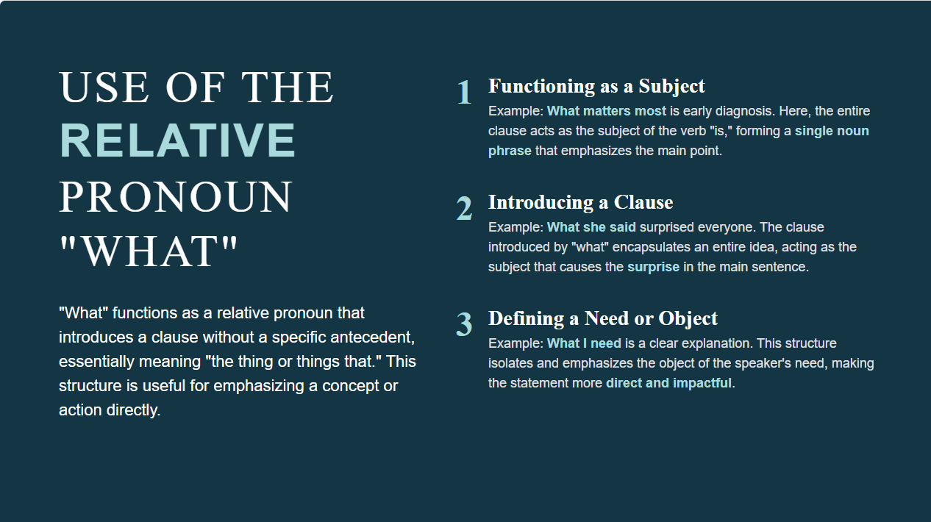
K.BENMAAMAR
Faculty of Medicine

Slide 5
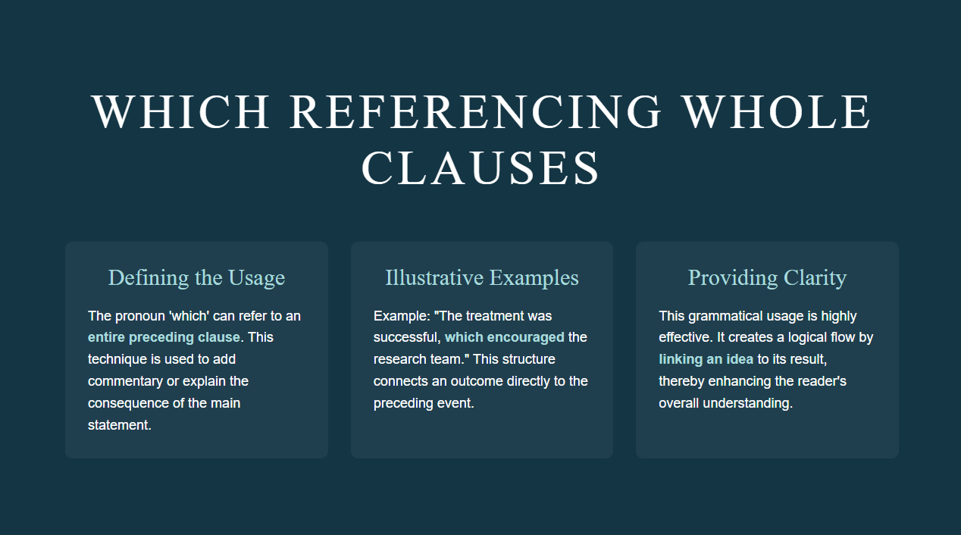
K.BENMAAMAR
Faculty of Medicine

Slide 6
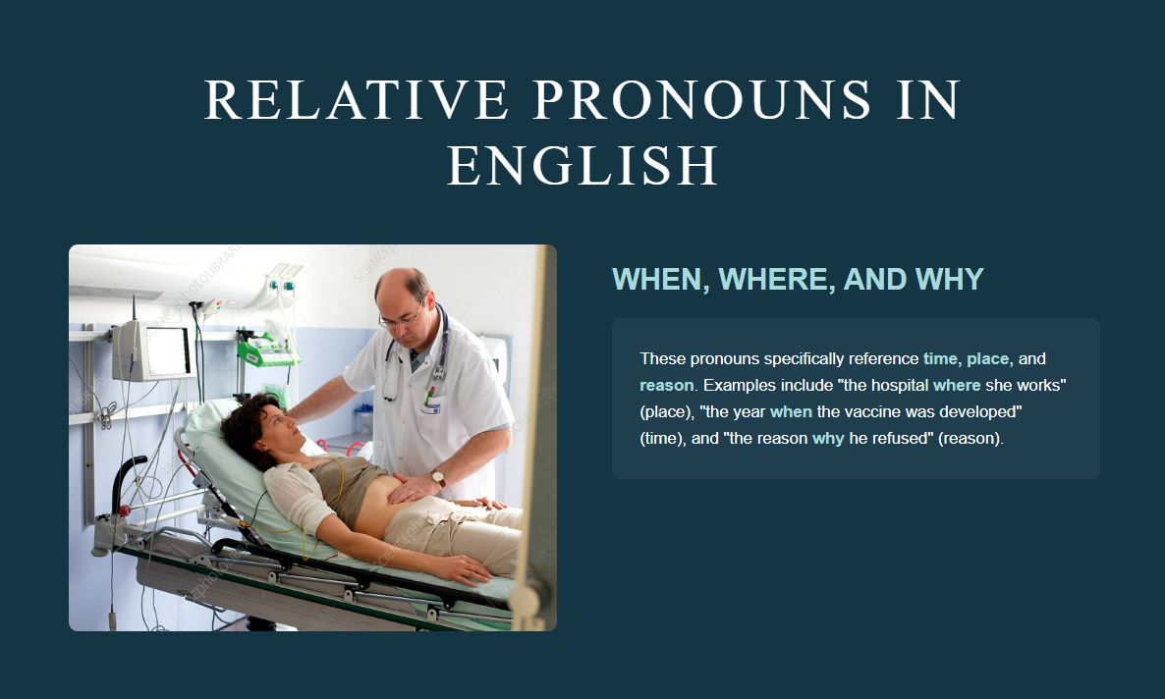
K.BENMAAMAR
Faculty of Medicine

Slide 7
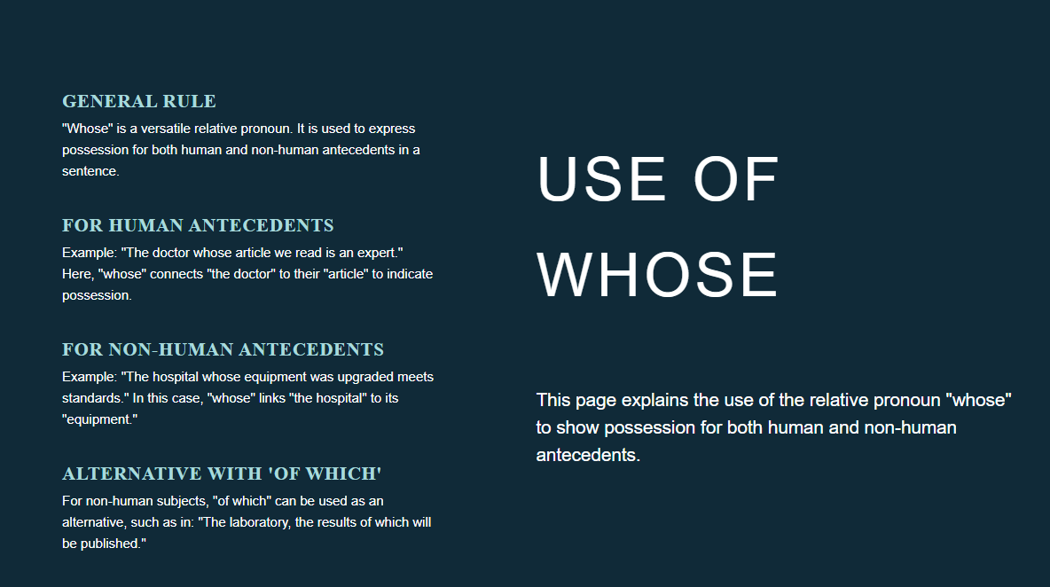
K.BENMAAMAR
Faculty of Medicine

Slide 8
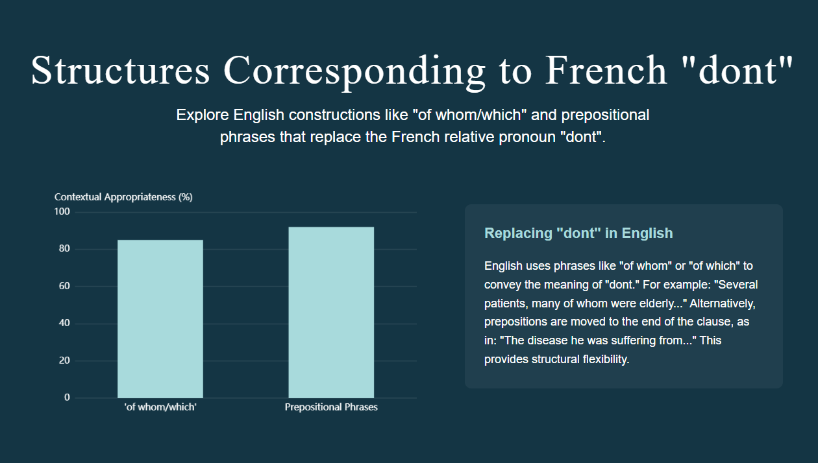
K.BENMAAMAR
Faculty of Medicine

Slide 9
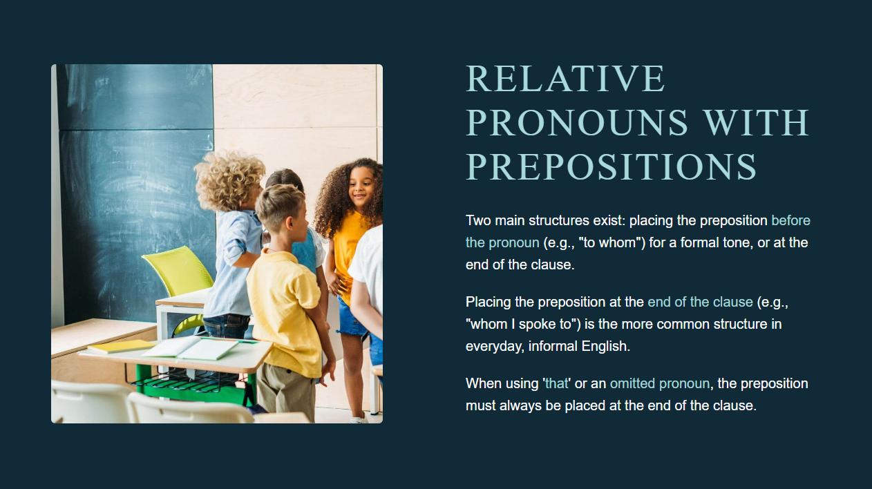
K.BENMAAMAR
Faculty of Medicine

Slide 10
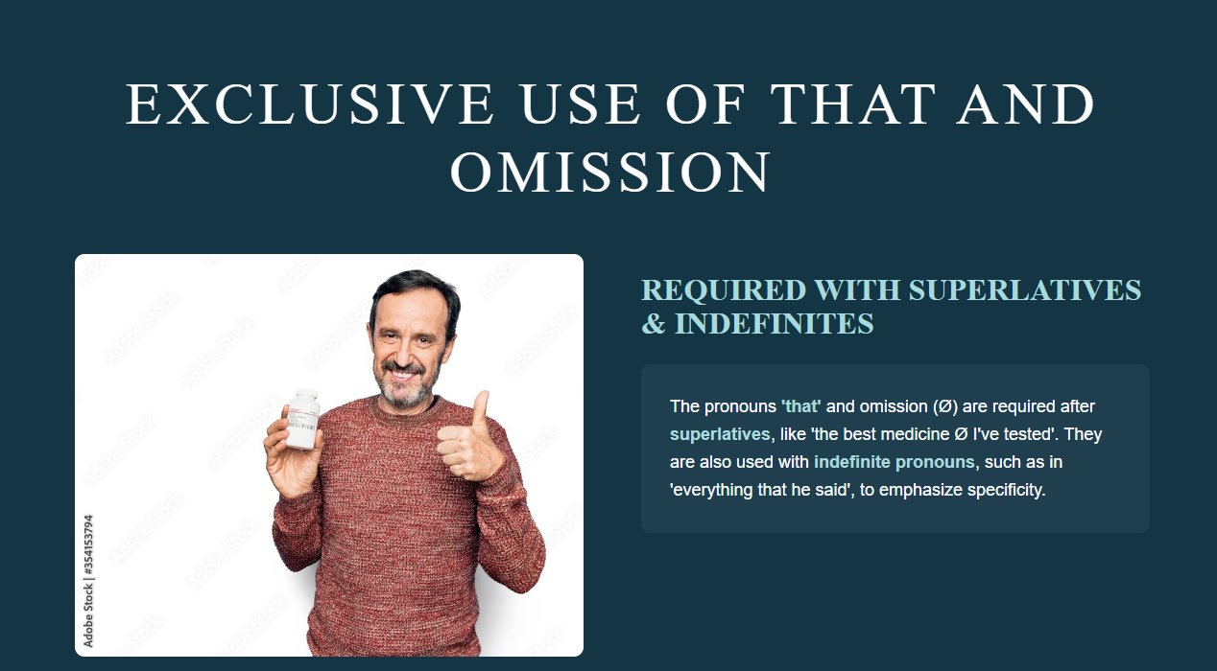
K.BENMAAMAR
Faculty of Medicine

Slide 11
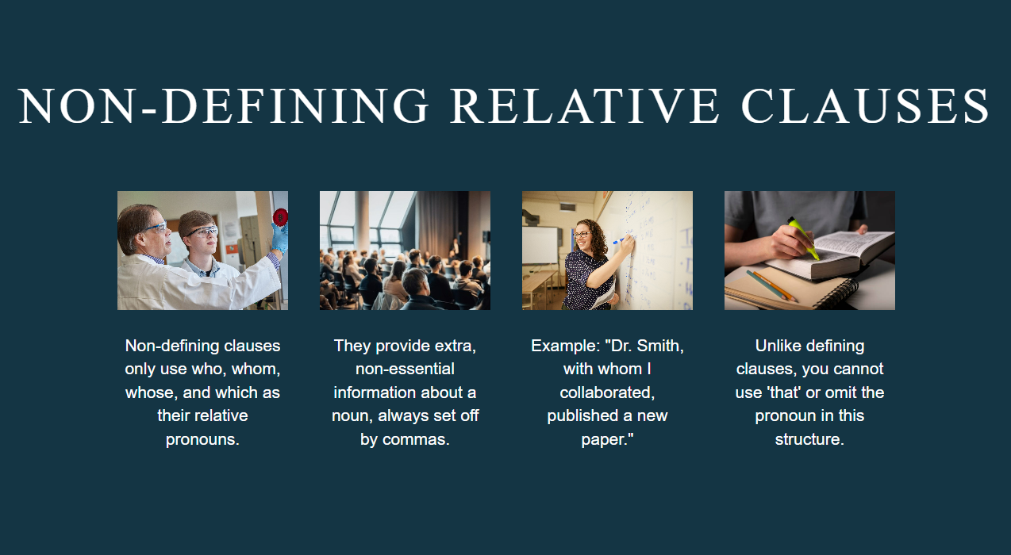
K.BENMAAMAR
Faculty of Medicine

Slide 12
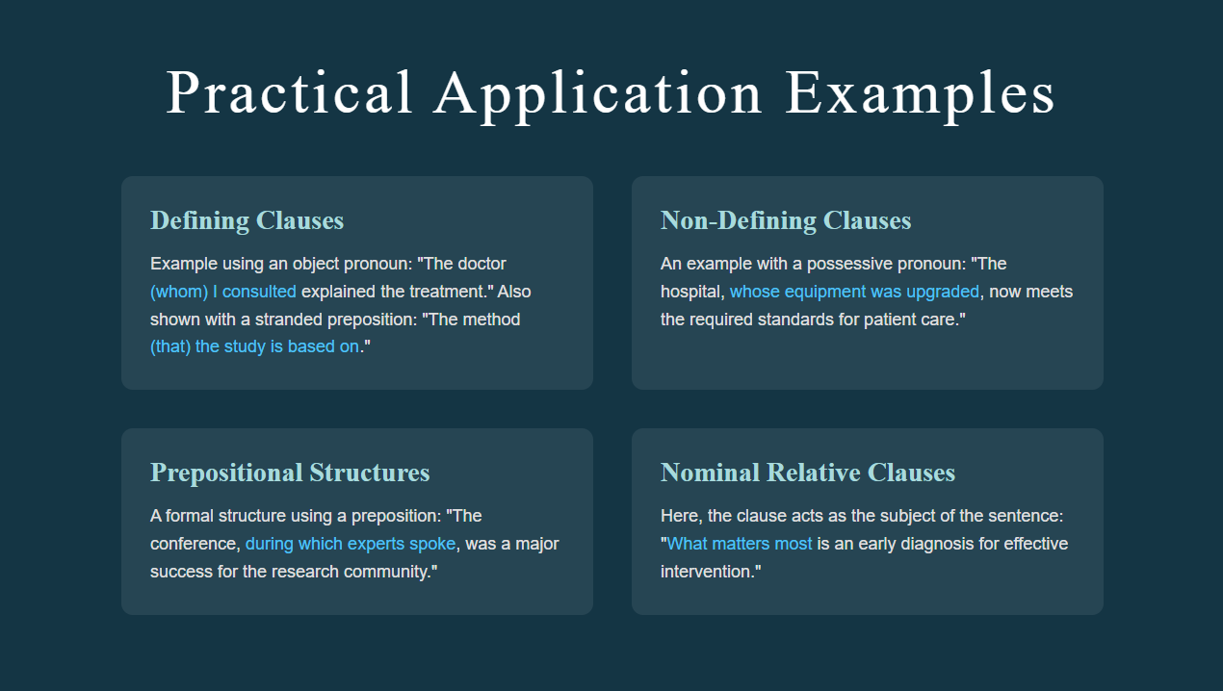
K.BENMAAMAR
Faculty of Medicine

