Slide 1

Gastro-Intestinal System: Essential History Taking
A comprehensive guide for medical students and junior clinicians on eliciting crucial information regarding gastrointestinal complaints.
K,BENMAAMAR

Slide 2
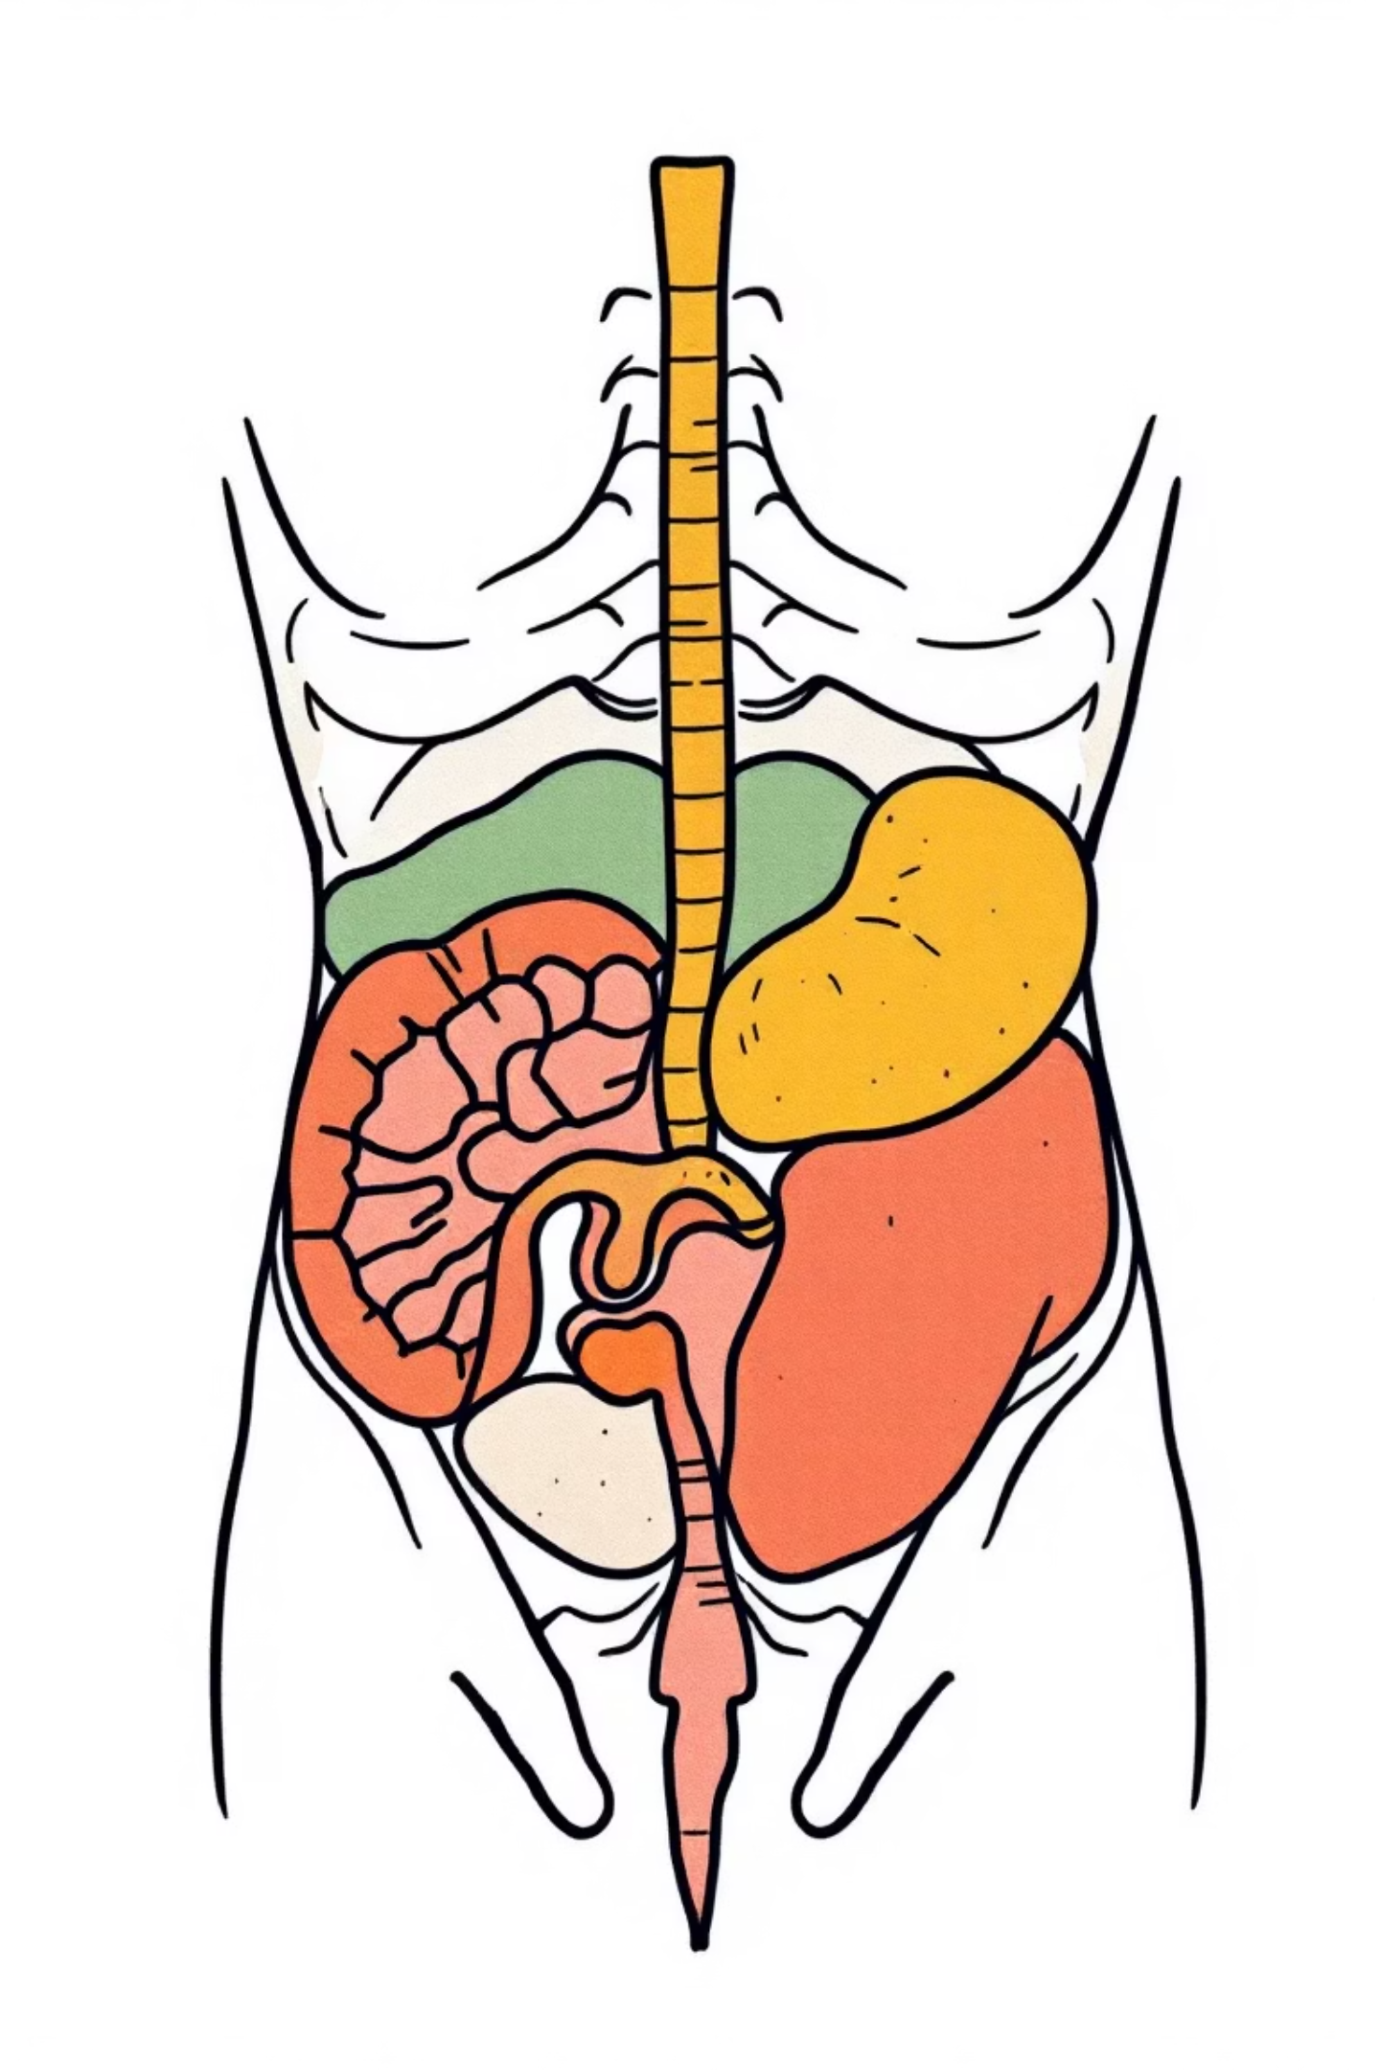
Unpacking Abdominal Pain: The Patient's Story
Understanding the nuances of abdominal pain is paramount. Each detail can offer a clue to the underlying diagnosis.
1
Site & Radiation
Where is the pain located? Is it central or generalised? Does it move to other areas like the back, groin, or back passage?
2
Associated Factors
Does the pain coincide with nausea, vomiting, sweating, feeling faint, fever, or shortness of breath?
3
Relieving Factors
What makes the pain better? Consider rest, specific body positions (sitting, bending forward, lying still), defecation, or medication.
4
Aggravating Factors
What brings the pain on? Is it related to defecation, stress, eating, movement, changing position, or breathing?
K,BENMAAMAR

Slide 3


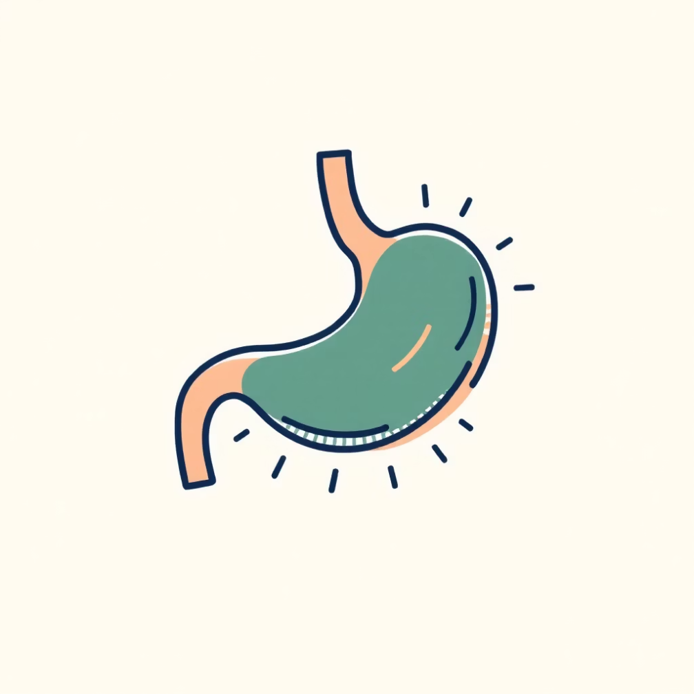
Patient's Perspective & General Well-being
Exploring the patient's own theories and general health markers can provide valuable context.
Patient's Opinion on Cause
"Crise de Foie" / Upset Stomach
What do you think is causing the pain? An ulcer, gallstones, appendicitis, or something else?
Do you have an upset stomach? (A common expression for digestive upset or even a form of migraine).
Beyond the pain itself, assessing a patient's diet, appetite, and weight offers critical insights into their gastrointestinal health.
K,BENMAAMAR

Slide 4

Diet, Appetite, and Weight Changes
A thorough dietary history and understanding of appetite and weight fluctuations are key diagnostic tools.
01
02
Dietary Habits
Appetite Fluctuations
What do you usually eat? Meat, fish, dairy, vegetables, cereals, sweets, or everything? Are your teeth in good condition? Do you wear dentures? Can you chew your food properly?
Do you have a good appetite? Has it increased or decreased? Is a decreased appetite due to lack of desire or pain when eating?
03
Weight Stability
How much do you weigh? Is your weight stable? Have you gained or lost weight? Was weight loss intentional (dieting) or unintentional?
K,BENMAAMAR

Slide 5

Meal-Related Discomfort
Understanding how a patient feels during and after eating can pinpoint specific digestive issues.
Early Satiation
Postprandial Fullness
Post-Meal Discomfort
Can you finish a normal meal?
Do you feel full after eating only a small amount?
Do you feel uncomfortable after eating?
K,BENMAAMAR

Slide 6

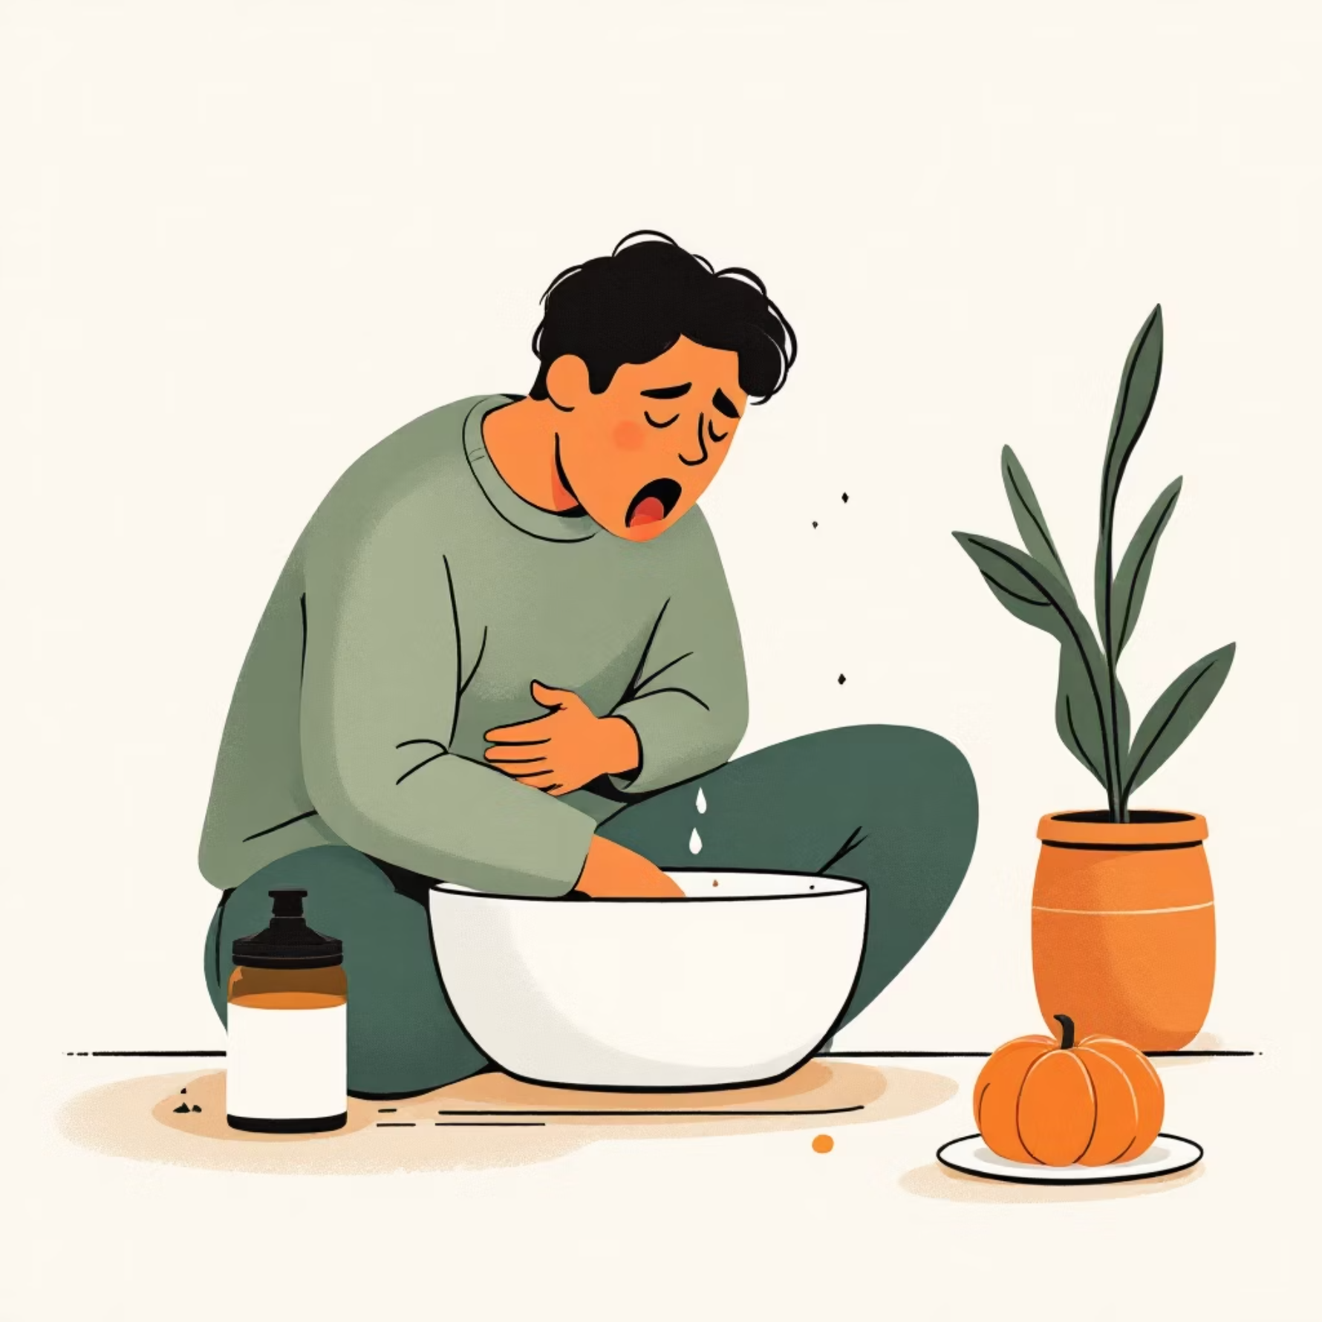
Nausea, Vomiting, and Haematemesis
Detailed questioning about nausea and vomiting, especially the presence of blood, is crucial for diagnosis.
Nausea & Vomiting
Do you have nausea? Do you feel sick? Do you retch?
Do you vomit only after eating?
What is the nature of the vomit (food, bile, clear fluid)?
Do you vomit large quantities?
Is vomiting preceded by nausea, pain, headache, or dizziness?
K,BENMAAMAR
Haematemesis (Blood in Vomit)
Have you ever noticed blood in your vomit? Did the blood appear at the start, or only after several vomiting episodes?

Slide 7
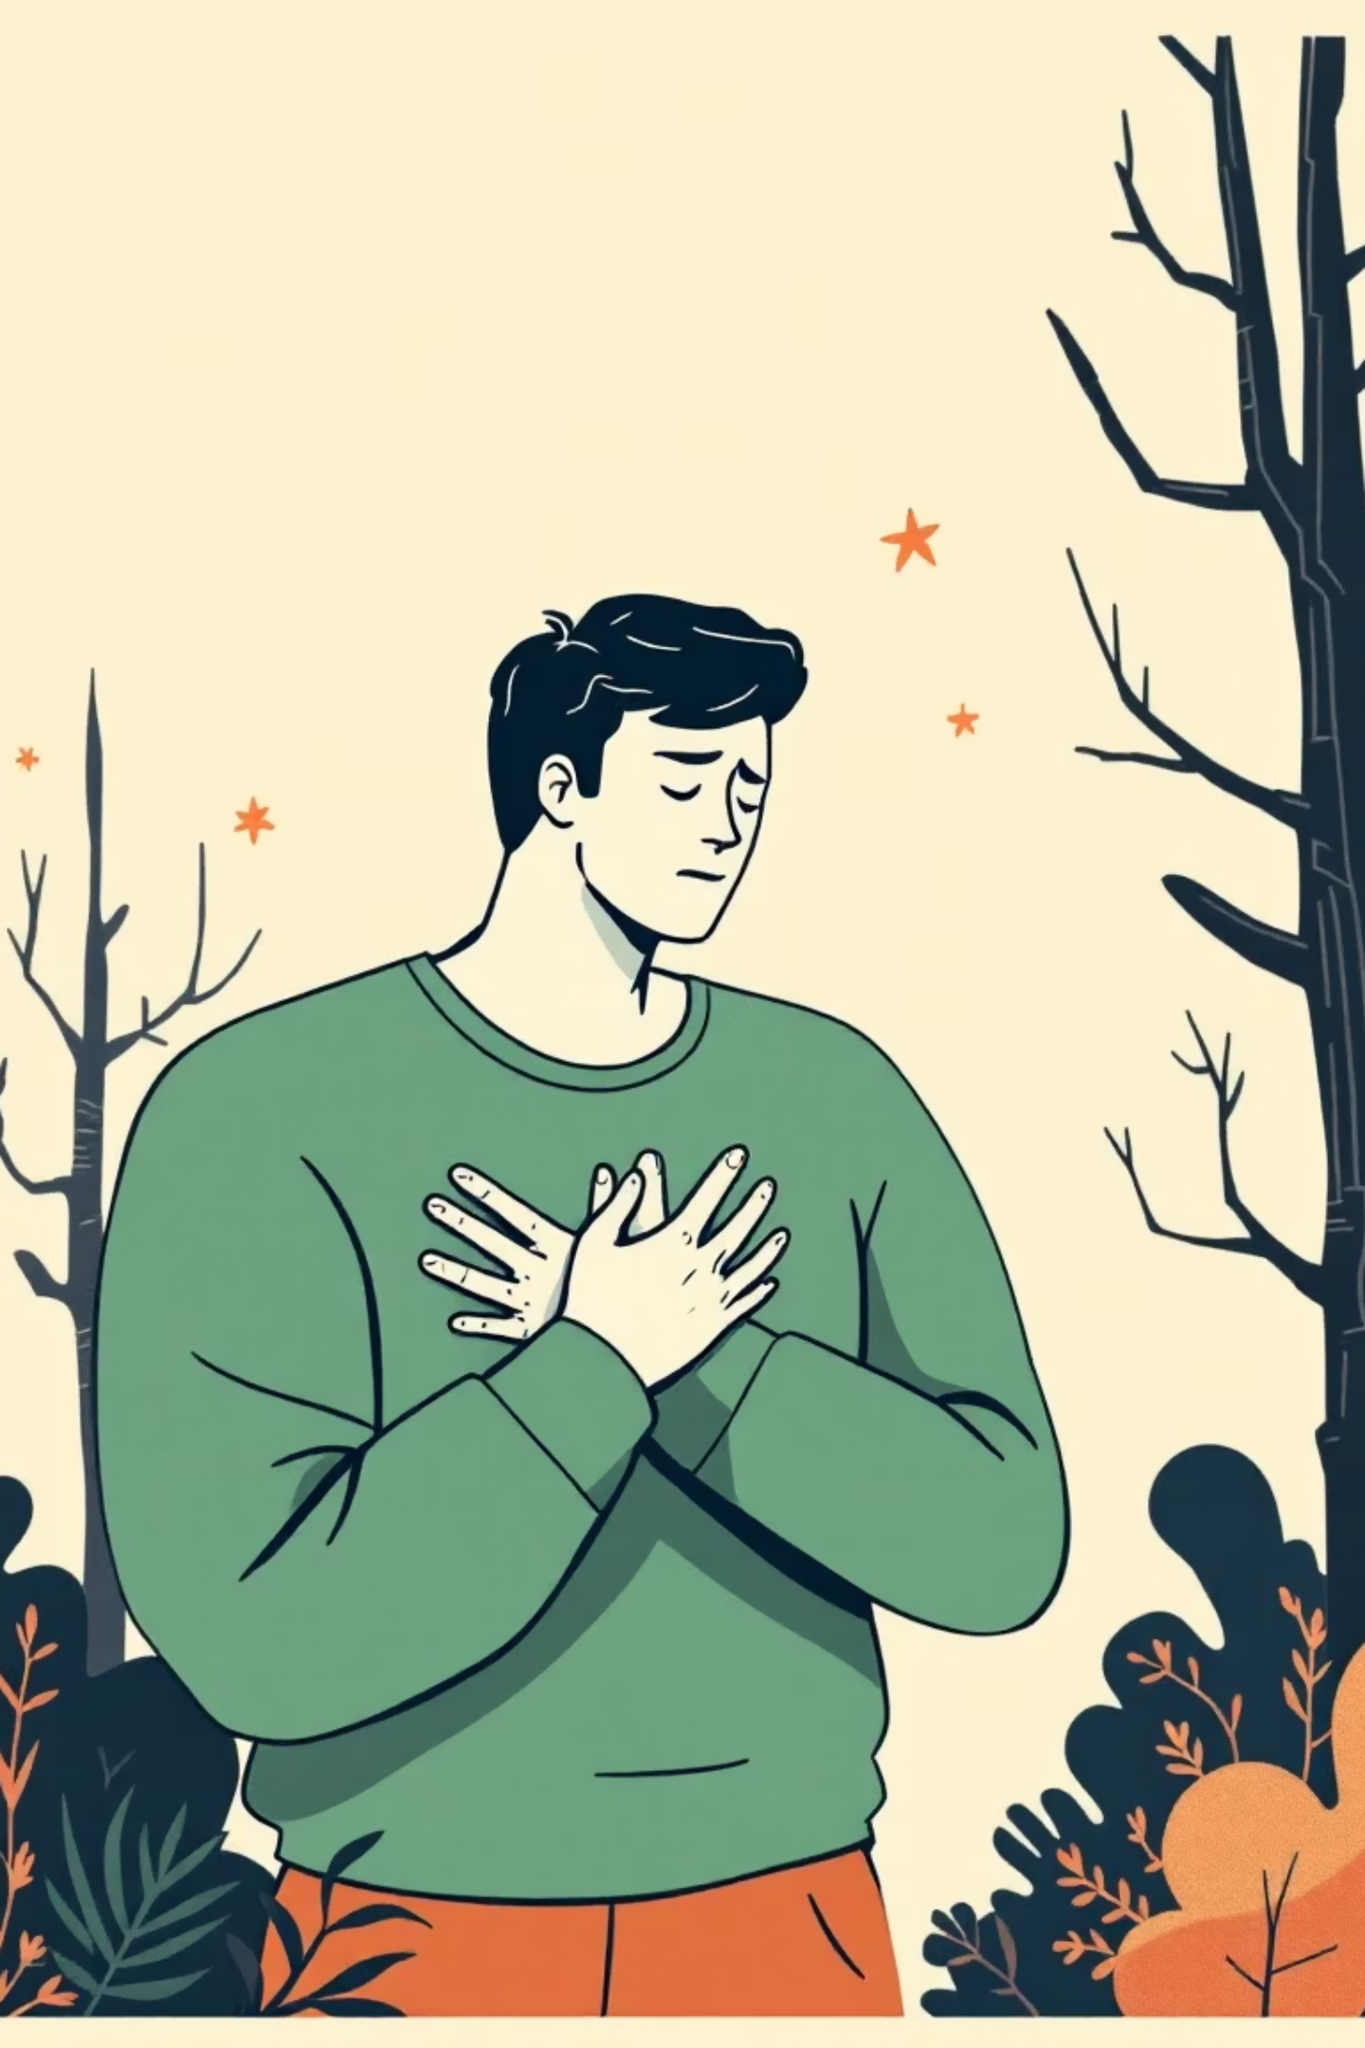
Gastro-Oesophageal Reflux Disease (GERD)
Investigating symptoms related to GERD requires specific questions about reflux pain and associated manifestations.
Reflux Symptoms
Additional Symptoms & Triggers
Do you get acid regurgitation (sour or bitter taste)? Do you belch frequently? Do you have heartburn (burning pain behind the chest)? Does the pain radiate to your arms or jaw?
Chronic cough, shortness of breath, bad breath (halitosis), frequent hiccups. Triggers include lying down, bending forward, pregnancy. Worse with fatty foods, chocolate, hot drinks, coffee, alcohol, spicy foods.
Relief Strategies
What have you tried to relieve symptoms? Antacids, proton pump inhibitors (PPIs), raising the head of the bed, losing weight.
K,BENMAAMAR

Slide 8


Swallowing Difficulties (Dysphagia)
Difficulty or pain during swallowing can indicate significant issues in the oesophagus or pharynx.
Do you have difficulty swallowing? Difficulty initiating swallowing?
Is it with solids or liquids, or both?
At what level does the food stick?
Is swallowing painful?
Does fluid regurgitate into your nose?
Do you choke when swallowing?
K,BENMAAMAR
Dysphagia can range from mild discomfort to a severe impediment to nutrition and hydration. Always inquire about the onset and progression.

Slide 9
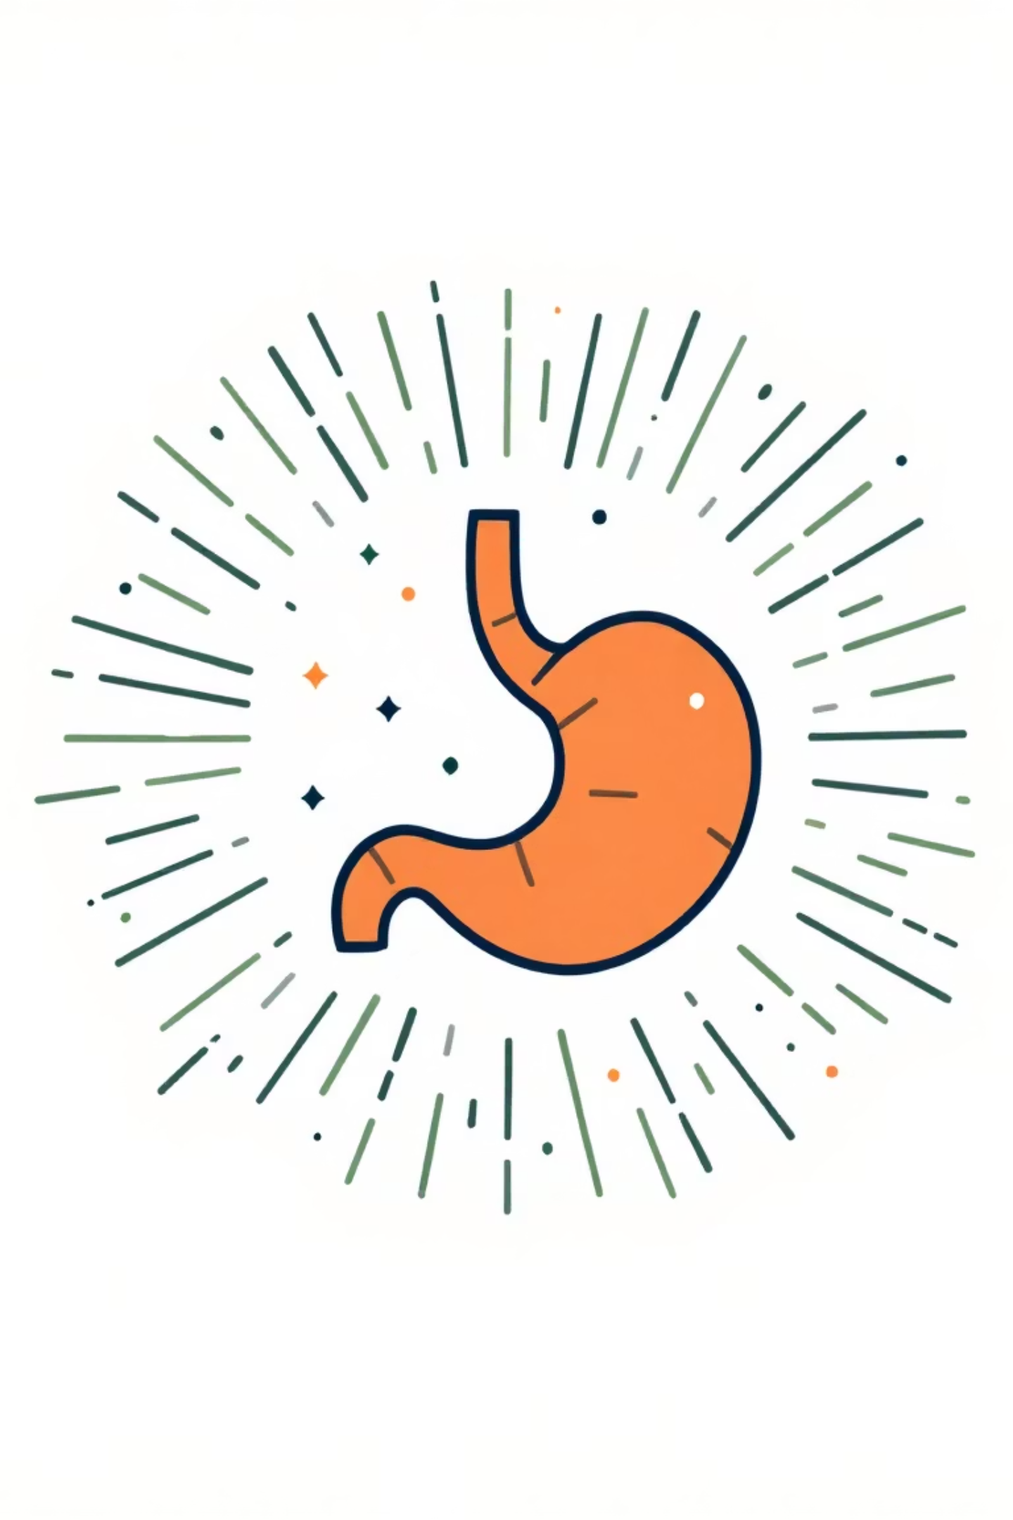

Bowel Habits: Diarrhoea
A detailed inquiry into diarrhoeal symptoms is vital for identifying gastrointestinal pathology.
Diarrhoea Characteristics
Are you passing stools more often? How many times a day?
Have you noticed a change in consistency?
Appearance: pale, brown, black/tarry. Odour: offensive.
Consistency: hard, soft, watery, frothy. Quantity: bulky, moderate.
Have you noticed blood, mucus, or pus?
Documenting colour, consistency, and presence of blood or mucus is crucial for differential diagnosis, from infections to inflammatory bowel disease.
K,BENMAAMAR

Slide 10
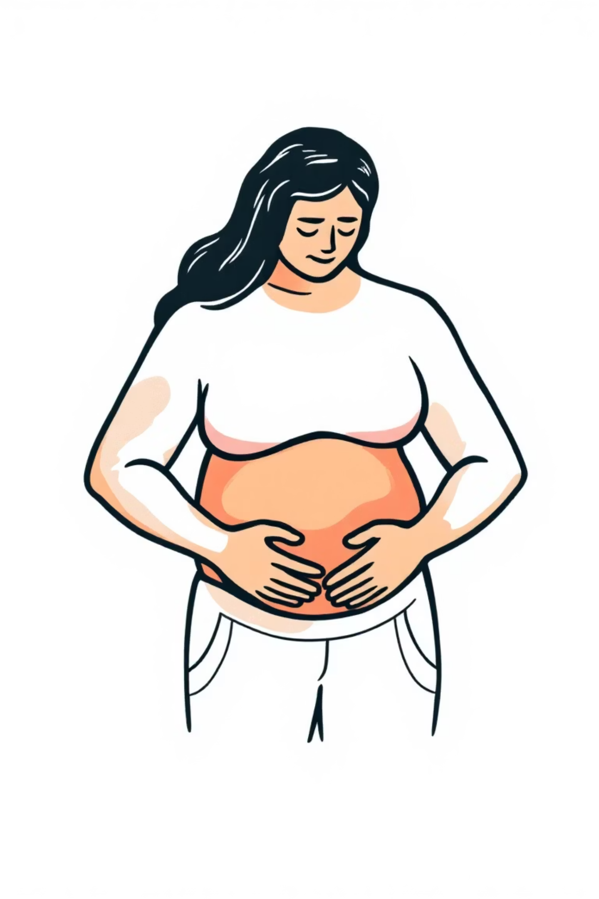
Bowel Habits: Constipation & Abdominal Distension
Addressing constipation and abdominal distension completes the comprehensive gastrointestinal history.
Constipation
Do you have difficulty emptying your bowels? Have you recently changed your diet? Started new medications, and if so, which ones? Are you passing wind?
Abdominal Distension
Do you experience abdominal bloating or distension? What type of food causes difficulty? How long have you had this problem? Is it getting worse?
These questions help to differentiate functional issues from more serious conditions requiring further investigation.
K,BENMAAMAR

